Slide 1

2018
3-Month
Transition Analysis
RESULTS PRESENTATION &
INVESTOR DISCUSSION PACK

Slide 2

CONTENTS
2020 FULL YEAR RESULTS
CEO and CFO Results Presentations
CEO Presentation
2
2
CFO Presentation
12
Group & Divisional Financial Performance
Group including impact of Large / Notable items
Australia Retail & Commercial
Institutional
27
27
38
42
New Zealand Division
47
Treasury
50
62
73
90
101
109
Customer Support (COVID-19)
Risk Management
Housing Portfolio
Corporate Overview and Environment, Social & Governance (ESG)
Carbon Policy
All figures within this investor discussion pack are presented on Cash Profit (Continuing operations) basis in Australian Dollars unless otherwise noted. In arriving at Cash Profit, Statutory Profit
has been adjusted to exclude non-core items, further information is set out on pages 76-79 of the 2020 Full Year Consolidated Financial Report.
1

Slide 3
2020
FULL YEAR RESULTS
SHAYNE ELLIOTT
CHIEF EXECUTIVE OFFICER

Slide 4

OUR PURPOSE
Guiding the way we support customers
Guiding the way we engage with our people
Guiding the way we work with stakeholders
3

Slide 5
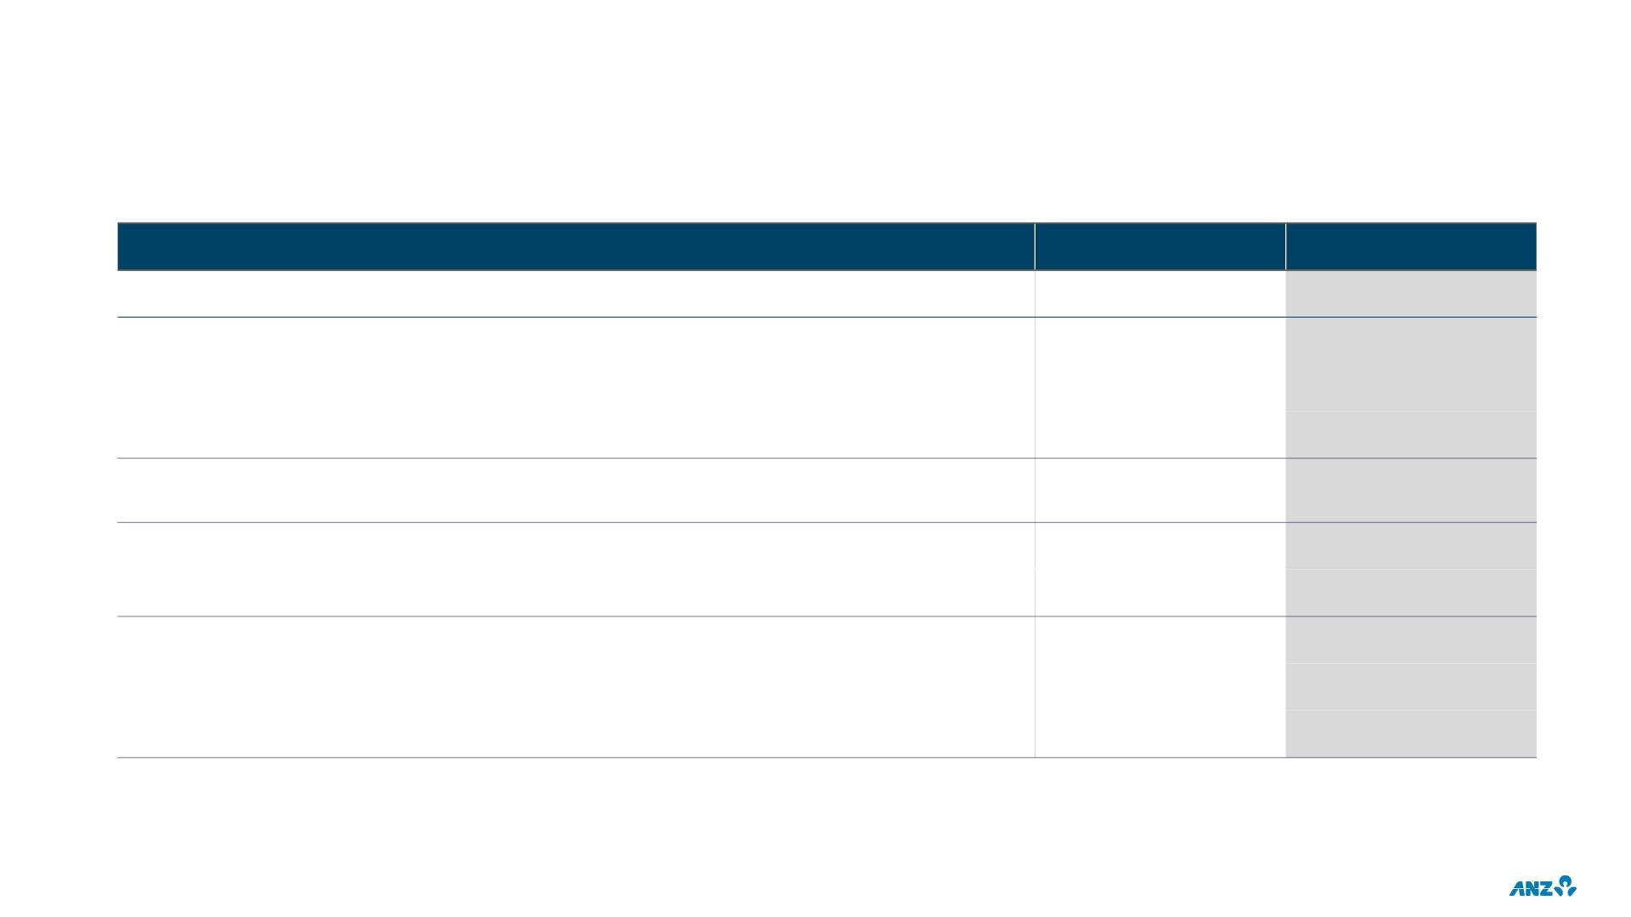
FINANCIAL SNAPSHOT
FY20
3,577
3,758
6.2
FY20 v FY19
-40%
Statutory Profit ($m)
Cash Profit (Continuing operations)¹ ($m)
Return on Equity (%)
-42%
-471bps
-42%
Earnings Per Share (cents)
132.7
Cash Profit (Continuing operations) ex. large / notable items ($m)
5,297
-21%
-100
Dividend Per Share (cents)
Franking
60
100%
11.3
CET1 Ratio (APRA Level 2) (%)
Net Tangible Assets Per Share ($)
Provision coverage ratio² (%)
-2bps
+2%
20.04
1.39
+45bps
1. Includes the impact of Large / Notable items, excludes discontinued operations
2. Collectively assessed provisions as a % of credit risk weighted assets
4

Slide 6
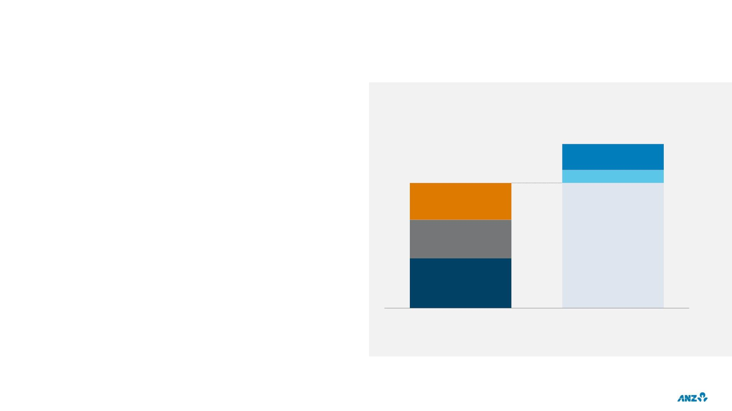
WELL PREPARED FOR THE ENVIRONMENT
CET1 AND ADDITIONAL BUFFERS
58bps ($2.5b) increase in capital (CET1) in 2H20
174bps CET1 capital generated from PBP in FY20⁴
$1.6b increase in CP balance in FY20
$106b surplus stable funding⁵
$64b
Capacity to generate future
profit ~$10b PBP illustrative
based on FY20⁷
$49b
CP Balance $5b
Mgmt
Buffer
$15b3
CCB
$15b
2
CET1
CET1
min.
$19b
$60b surplus liquid assets⁶
CET1 ¹
(Sep-20)
CET1 & Additional buffers
(Sep-20)
1. Sep-20 capital ratios include RWA increase as a result of APRA modelling and policy related capital changes; 2. Capital Conservation Buffer; 3. CET1 Buffer above 8% CET1; 4. FY20 Profit before
Provisions (PBP) on a post tax basis for Cash Continuing Operations excluding Large / Notable items; 5. Stable funding in excess of NSFR regulatory minimums, as at 30 September 2020; 6. Liquid assets in
excess of LCR regulatory minimums, FY20 average; 7. FY20 Profit before Provisions (PBP) and tax for Cash Continuing Operations excluding Large / Notable items
5

Slide 7
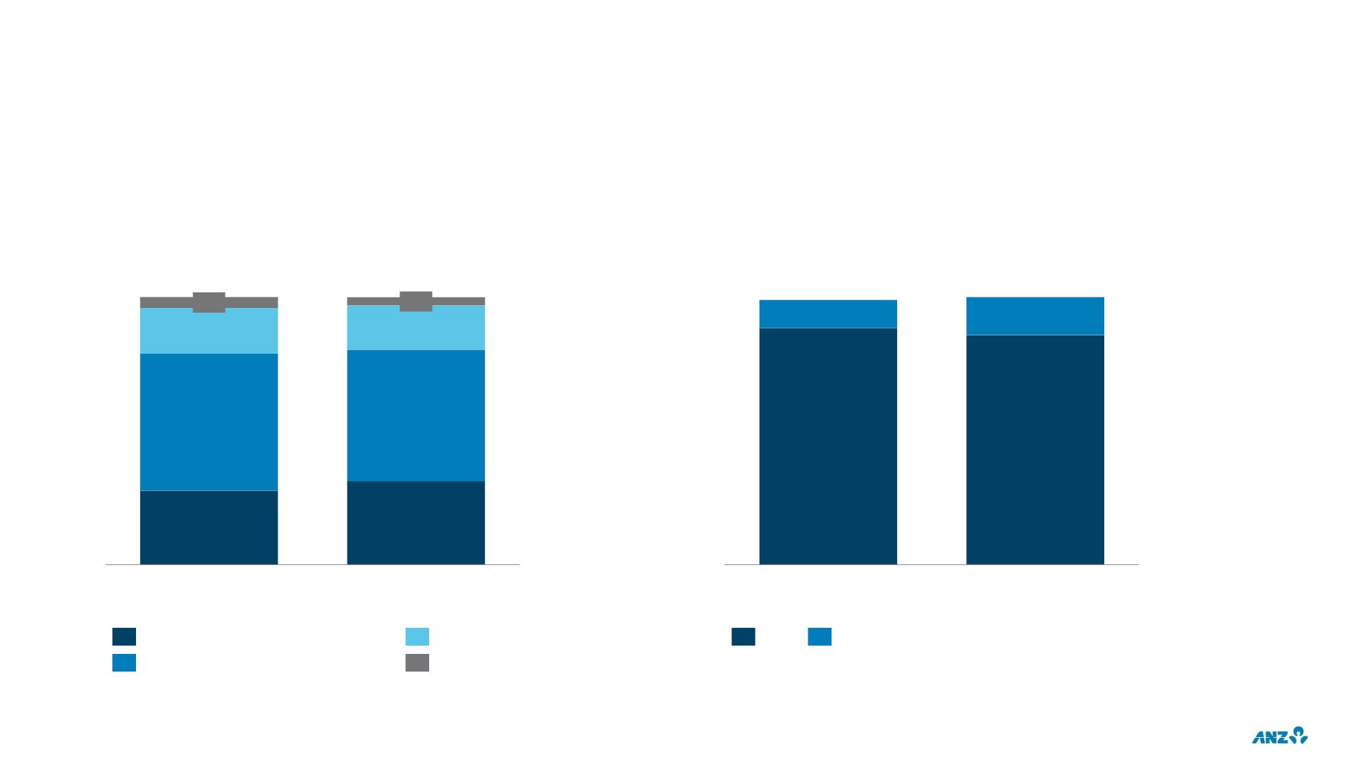
BUSINESS PERFORMANCE
INCOME CONTRIBUTION¹
EXPENSES¹
$b
$b
18.7
0.8
18.7
0.6
8.5
8.6
1.2
3.1
0.9
3.2
9.6
9.2
7.6
7.4
5.2
5.9
FY19
FY20
FY19
FY20
Institutional
NZ
BAU
Investment
Australia Retail & Commercial
Other
1. Cash continuing excluding Large / Notable items
6

Slide 8
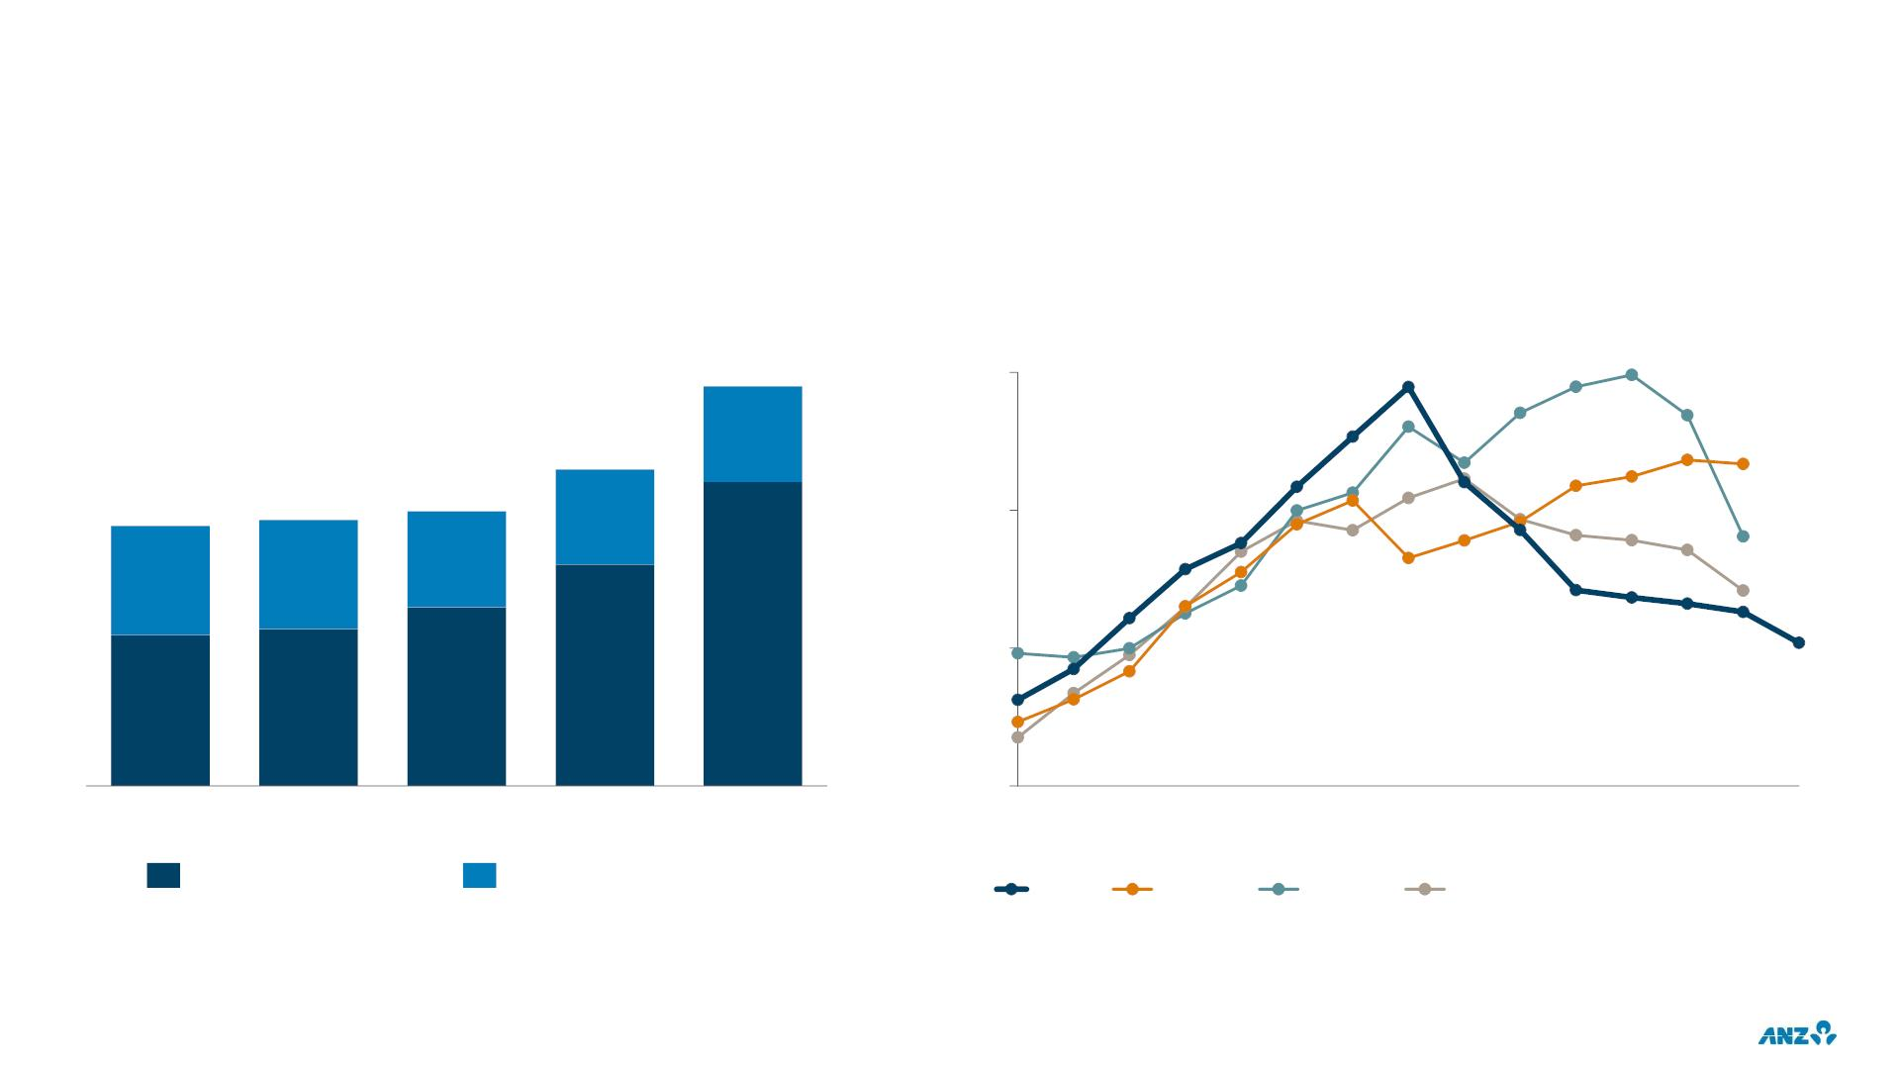
RECORD LEVEL OF INVESTMENT
TOTAL INVESTMENT SPEND¹
CAPITALISED SOFTWARE BALANCE²
$b
$b
1.77
3
2
1
0
1.40
30%
24%
1.15
42%
1.18
41%
1.22
35%
76%
FY20
70%
FY19
58%
FY16
59%
FY17
65%
FY18
Sep-
08
Sep-
10
Sep-
12
Sep-
14
Sep-
16
Sep-
18
Sep-
19
Sep-
20
Investment Expensed
Investment Capitalised
ANZ
Peer 3
Peer 2
Peer 1
1. Cash continuing
2. Source: Capitalised software balances sourced from publicly available company financials; 2020 numbers are based on the most recent half year financial disclosures
7

Slide 9
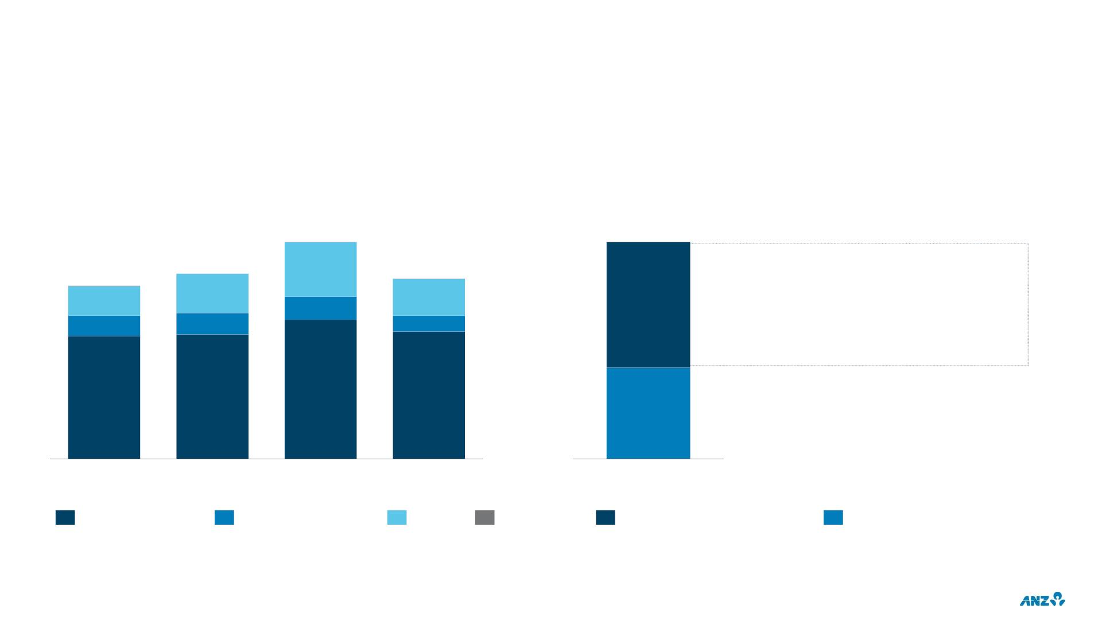
SUPPORTING CUSTOMERS
INSTITUTIONAL LENDING¹
AUSTRALIA HOME LOAN REPAYMENT DEFERRALS
$b
Accounts (000s)
190
95
162
• 79% returning to full payments
152
26
48
20
158
34
19
32
14
55
40
• 20% have requested a further deferral
18
• 1% restructured or transferred to hardship
107
109
122
111
Mar-19
Sep-19
Mar-20
Sep-20
Markets
Mar-20 to 15 Oct-20
Total deferrals
Corporate Finance
Transaction Banking
Others
Expired or advised intention
Still on initial deferral
1. Net Loans and Advances, prior periods are FX adjusted, Other <$0.5b
8

Slide 10
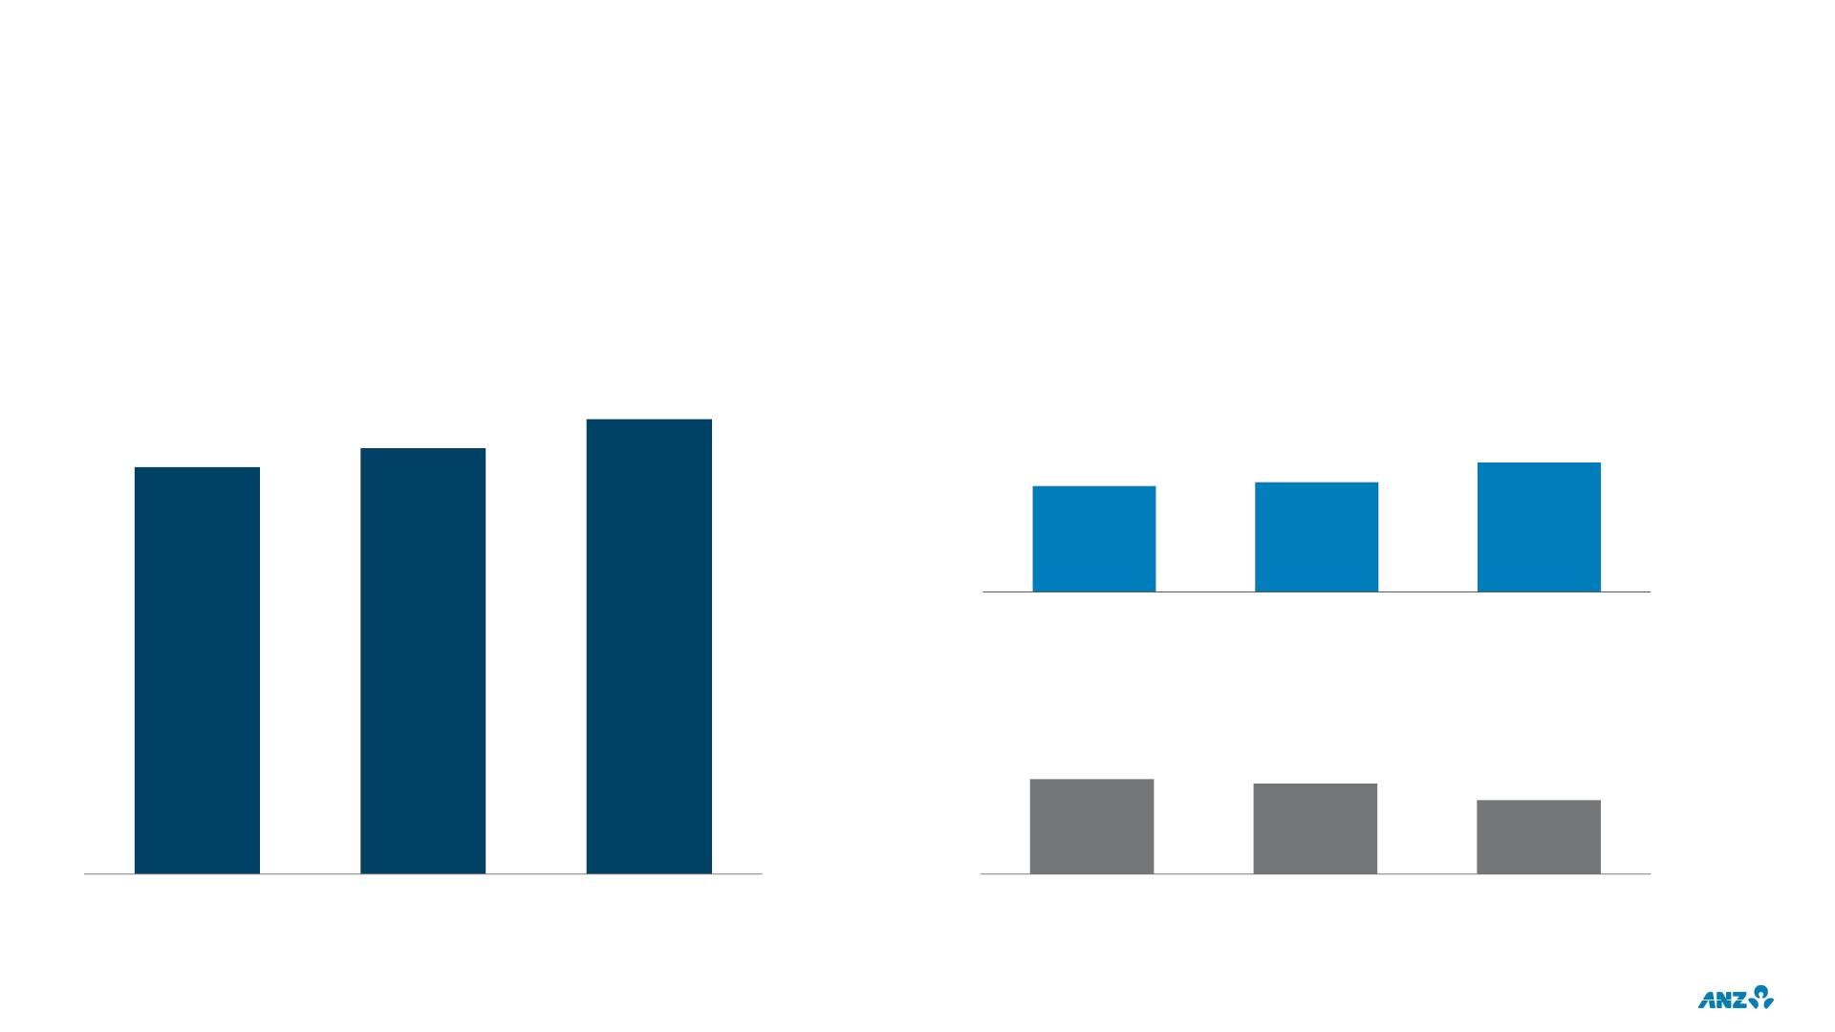
CUSTOMER BEHAVIOUR
CUSTOMER DEPOSITS
OFFSET ACCOUNTS - AUSTRALIA
Retail & Commercial
$b
$b
329
295
308
33
27
28
Sep-19
Mar-20
Sep-20
CREDIT CARDS – AUSTRALIA & NEW ZEALAND
$b
8
8
6
Sep-19
Mar-20
Sep-20
Sep-19
Mar-20
Sep-20
9

Slide 11
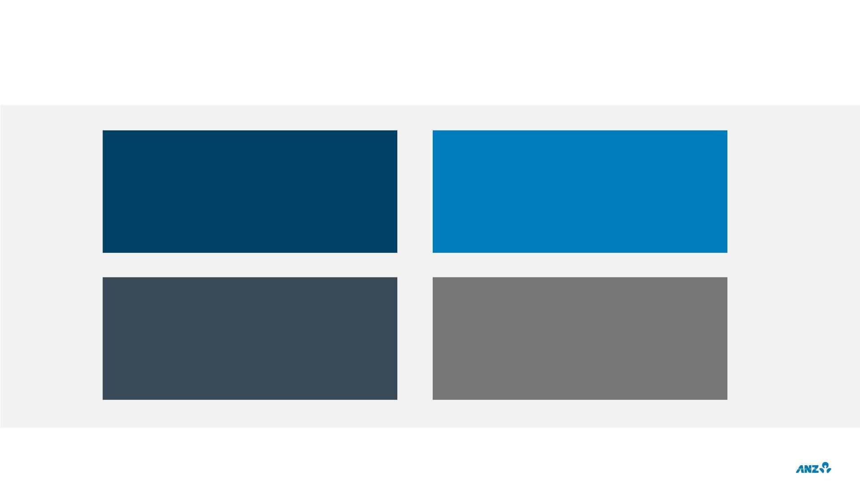
FOUR PRIORITIES ESTABLISHED IN 2016
1. Creating a simpler,
better balanced bank
2. Focusing on areas
where we can win
3. Building a superior
everyday experience to
compete in the digital age
4. Driving a purpose and
values led transformation
10

Slide 12

KEY MESSAGES
• Emerge with stronger relationships
• Continue to reshape the portfolio
• Continue to make the bank simpler
• Deliver new capabilities
• Ready to take advantage of opportunities
11

Slide 13
2020
FULL YEAR RESULTS
MICHELLE JABLKO
CHIEF FINANCIAL OFFICER

Slide 14
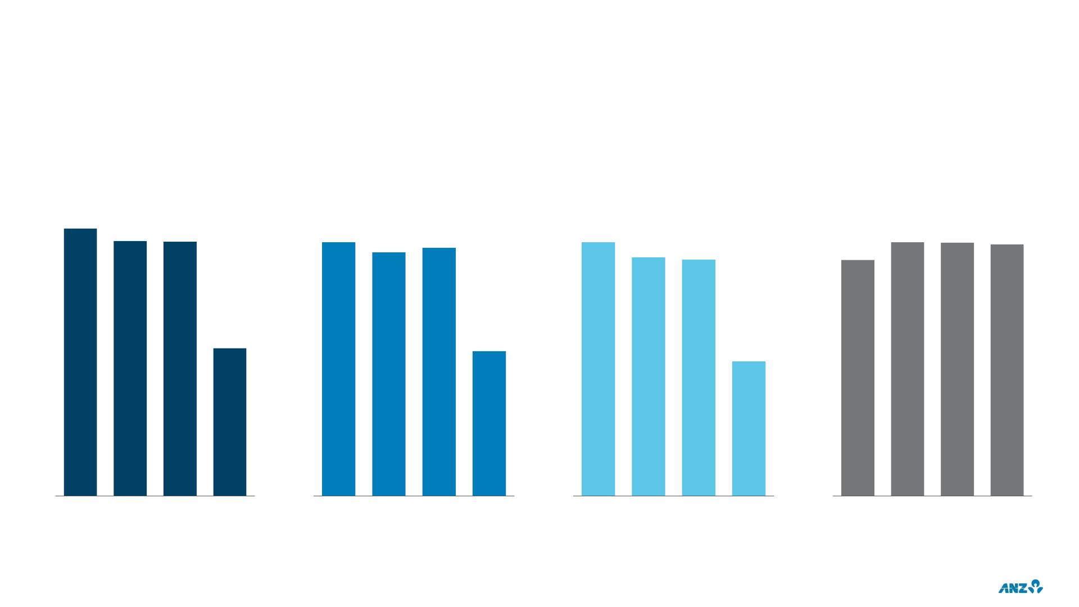
OVERVIEW
CASH PROFIT CONTINUING OPERATIONS
CASH PROFIT¹
CASH EPS¹
ROE¹
CET1 RATIO (LEVEL 2)
$m
cents
%
%
6,809
6,487 6,470
233
223
228
11.7
11.4
11.4
11.3
11.0
10.9
10.6
3,758
133
6.2
FY17
FY18
FY19
FY20
FY17
FY18
FY19
FY20
FY17
FY18
FY19
FY20
Sep-17 Sep-18 Sep-19 Sep-20
1. FY17 has not been restated for AASB15 impacts
13

Slide 15

AGENDA
1.
2.
3.
Key pillars in protecting our balance sheet
Major components within capital including earnings and credit quality
Capital & dividends
14

Slide 16
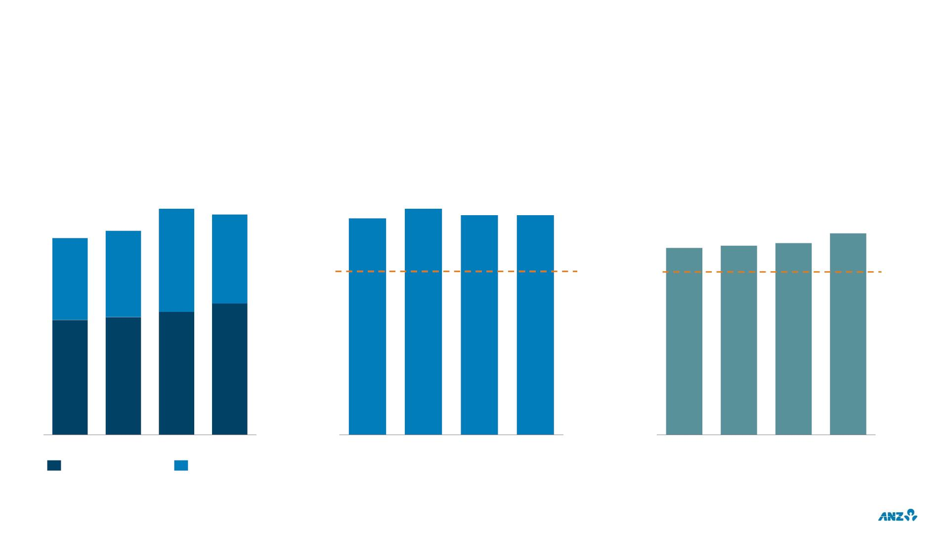
LIQUIDITY & FUNDING
CUSTOMER DEPOSITS
LIQUIDITY COVERAGE RATIO
NET STABLE FUNDING RATIO
End of period $b
Average
End of period
567
552
223
137%
143%
139%
139%
493
205
512
217
124%
115%
116%
118%
259
100%
Regulatory
Minimum
100%
Regulatory
Minimum
288
295
308
329
Mar-19
Sep-19
Mar-20
Sep-20
1H19
2H19
1H20
2H20
Mar-19
Sep-19
Mar-20
Sep-20
Retail & Commercial
Institutional
15

Slide 17
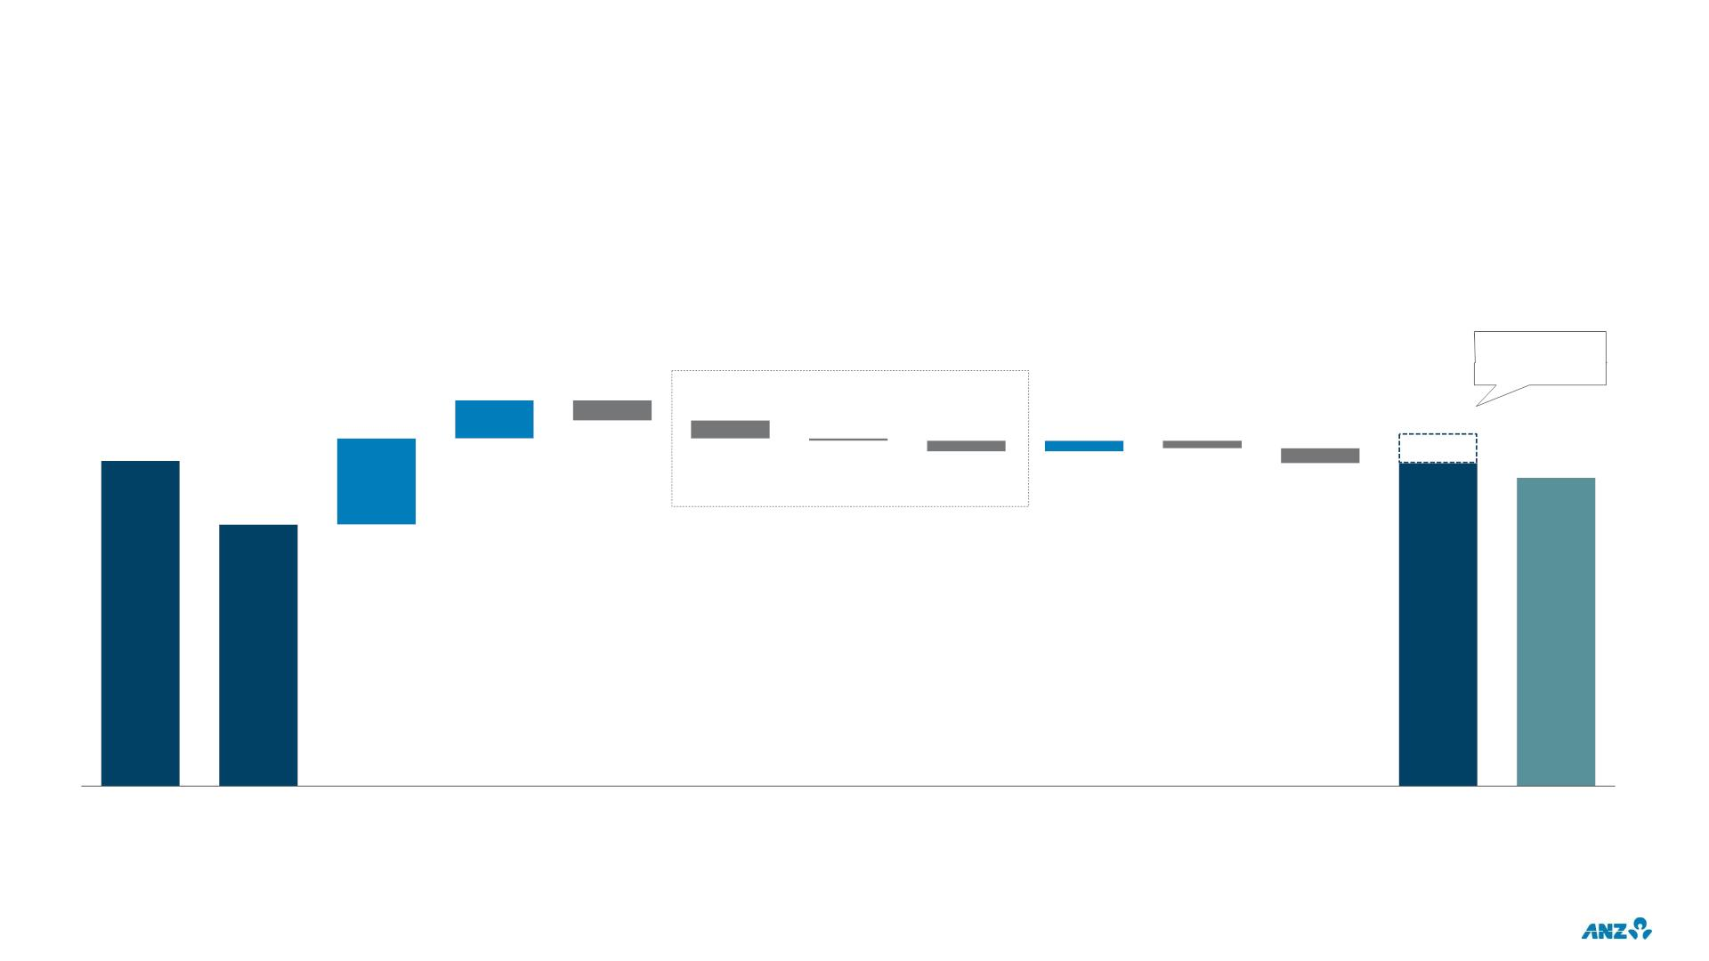
CAPITAL
CET1 RATIO (APRA LEVEL 2)
%
Pro-Forma
CET1 ratio³
0.4
Credit impacts 29bps
0.8
0.1
~11.4
11.3
11.4
-0.2
-0.2
0.0
-0.1
-0.1
11.2
-0.1
10.8
Sep-19
Mar-20
Profit before Underlying Market Risk
Credit
Net DTA
on CIC
Risk
Asset
Other²
Interim
dividend
(net of DRP)
Sep-20
Sep-20
(Level 1)
provisions
(net of tax)¹
business
CRWA
& IRRBB
RWA
impairment
charge (CIC)
(net of tax)
Migration Divestments
movement
1. Excludes Large / Notable items which are included in ‘Other’
2. Other impacts include capital deductions (which mainly comprises the movement in retained earnings in deconsolidated entities and capitalised software), net imposts, movements in non-cash
earnings, net foreign currency translation and impacts from large/notable adjustments (not capital deduction related)
3. With conversion of NZD500m Capital Note
16

Slide 18
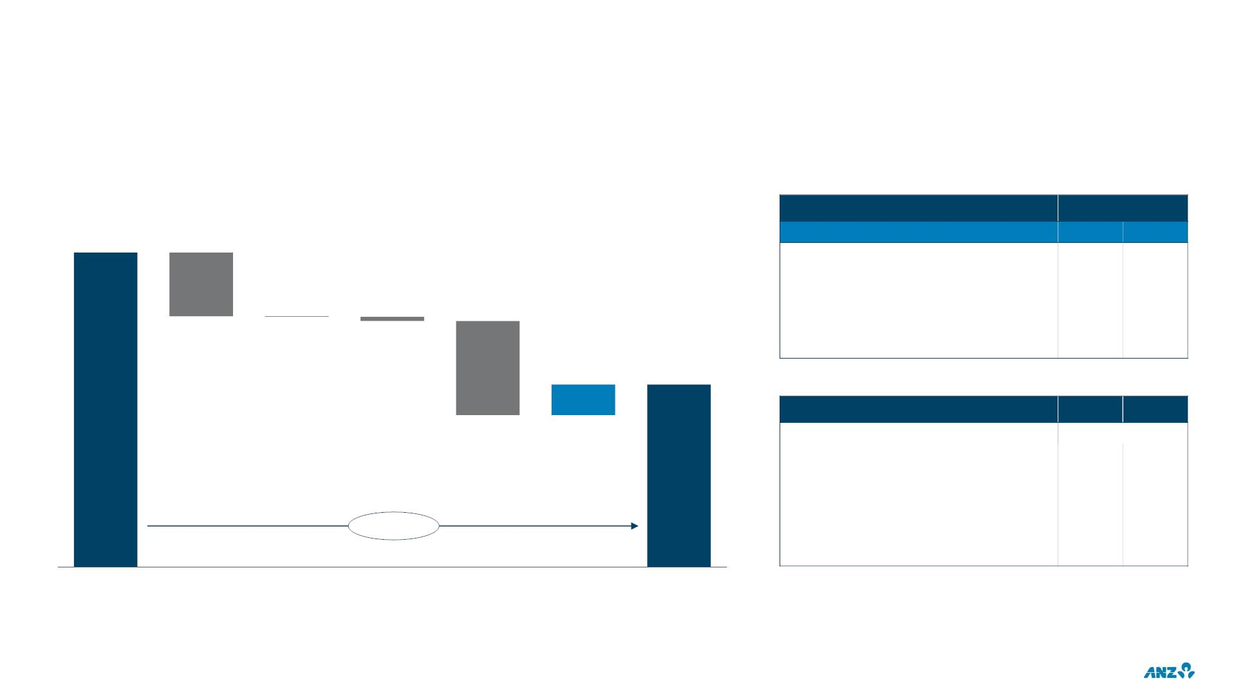
FINANCIAL PERFORMANCE
CASH PROFIT CONTINUING OPERATIONS
GROUP PROFIT DRIVERS
$m
CONTINUING OPERATIONS EX L/N
FY20 v FY19
6,470
PBP
NPAT
Total Group ex Large / Notable
Divisional performance
Australia Retail & Commercial
Institutional
-1%
-21%
-7%
+29%
-8%
-26%
+4%
-22%
-1,308
-14
-87
New Zealand Division (NZD)
631
3,758
LARGE / NOTABLE ITEMS ($m)¹
FY19
FY20
-1,934
TOTAL ($m after tax)
Divestments
-231
308
-475
-54
-
-1,539
23
Customer remediation
Restructuring
-279
-115
-138
-815
-215
-42%
Accelerated software amortisation
Asian associates impairment
Other
-
-10
FY19
Large /
Notable items
after tax
Income
Expenses
Provisions
Tax & NCI
FY20
1. Further detail on Large / Notable items is included within the Overview and Additional Financials section of the Investor Discussion pack
17

Slide 19
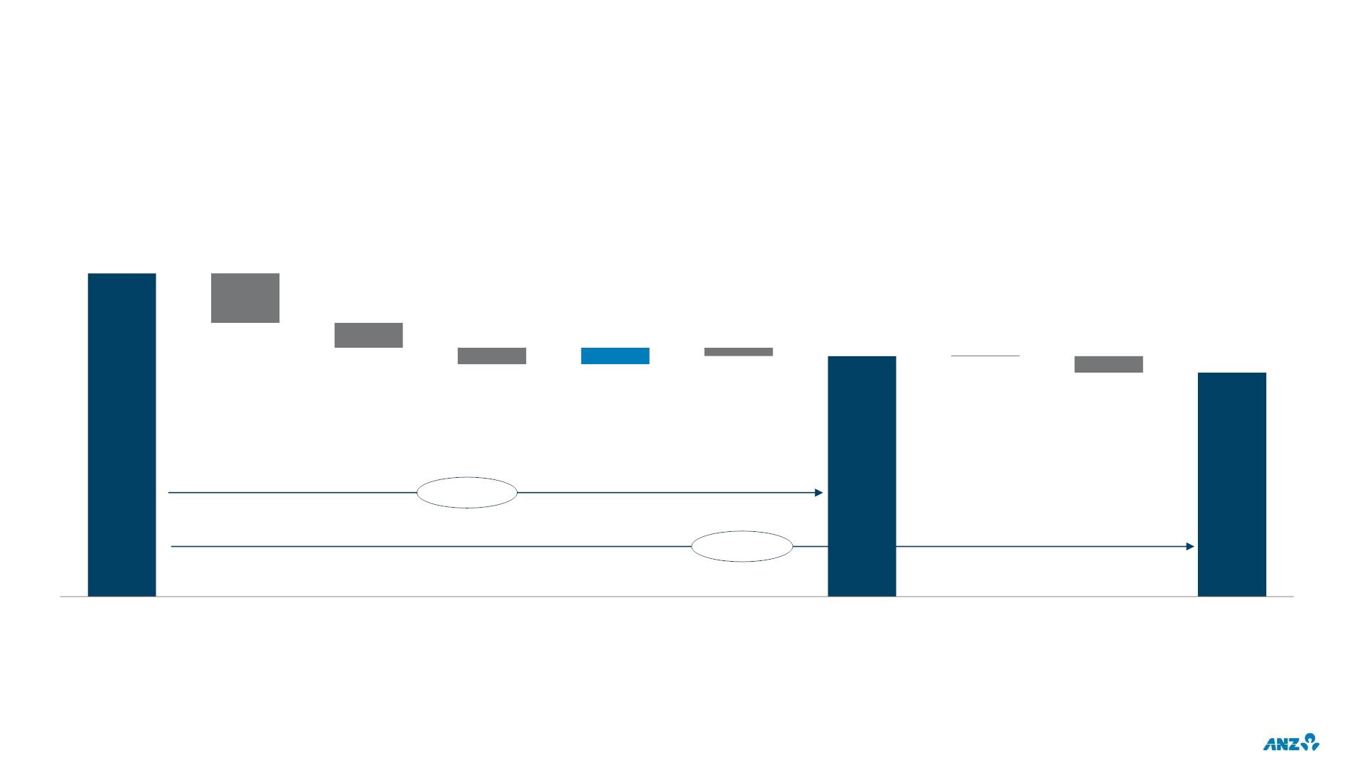
NET INTEREST MARGIN
CONTINUING OPERATIONS
GROUP NET INTEREST MARGIN (NIM)
bps
169
-6
2
159
0
-3
-1
157
-2
-2
-10bps
-12bps
1H20
Impact of rates
net of repricing
Asset &
deposit mix
Liquidity
Wholesale
funding &
deposit pricing
Asset pricing
2H20
underlying¹
Markets
Balance Sheet
activities²
Large /
Notable items
2H20
1. Excluding Large / Notable items and Markets Balance Sheet Activities
2. Includes the impact of growth in discretionary liquid assets and other Balance Sheet Activities
18

Slide 20
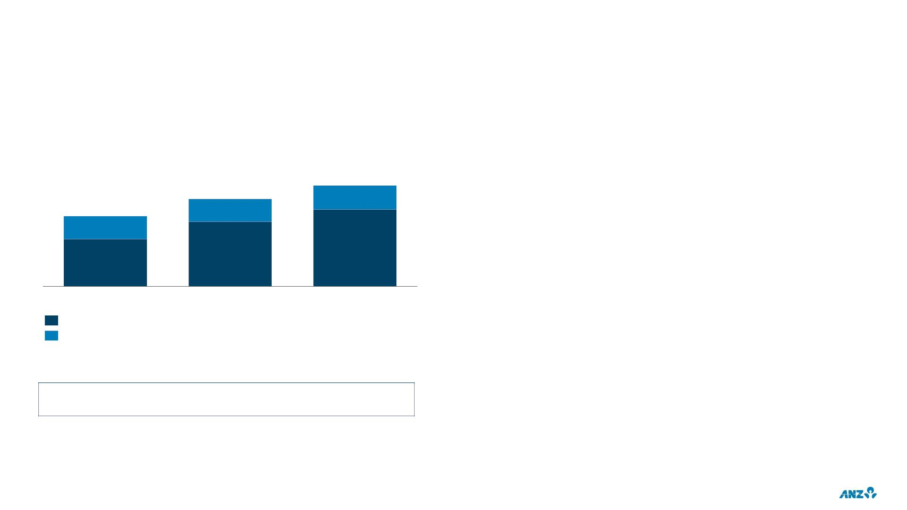
MARGIN CONSIDERATIONS
LOW RATE ENVIRONMENT
CONSIDERATIONS
$b
~234
~55
• Continued impact of low rates on replicating
~203
portfolio
~163
~53
~53
~179
• Central bank actions
~110
~150
• Changes in business and deposit mix
Sep-19
Mar-20
Sep-20
Low rate deposits <25bps
• System liquidity, wholesale funding maturities
Capital (excluding intangibles) and other non-interest bearing liabilities
and asset demand
REPLICATING PORTFOLIO
1H21 replicating portfolio impact (v 2H20)
~-3bps
• Competition
19

Slide 21
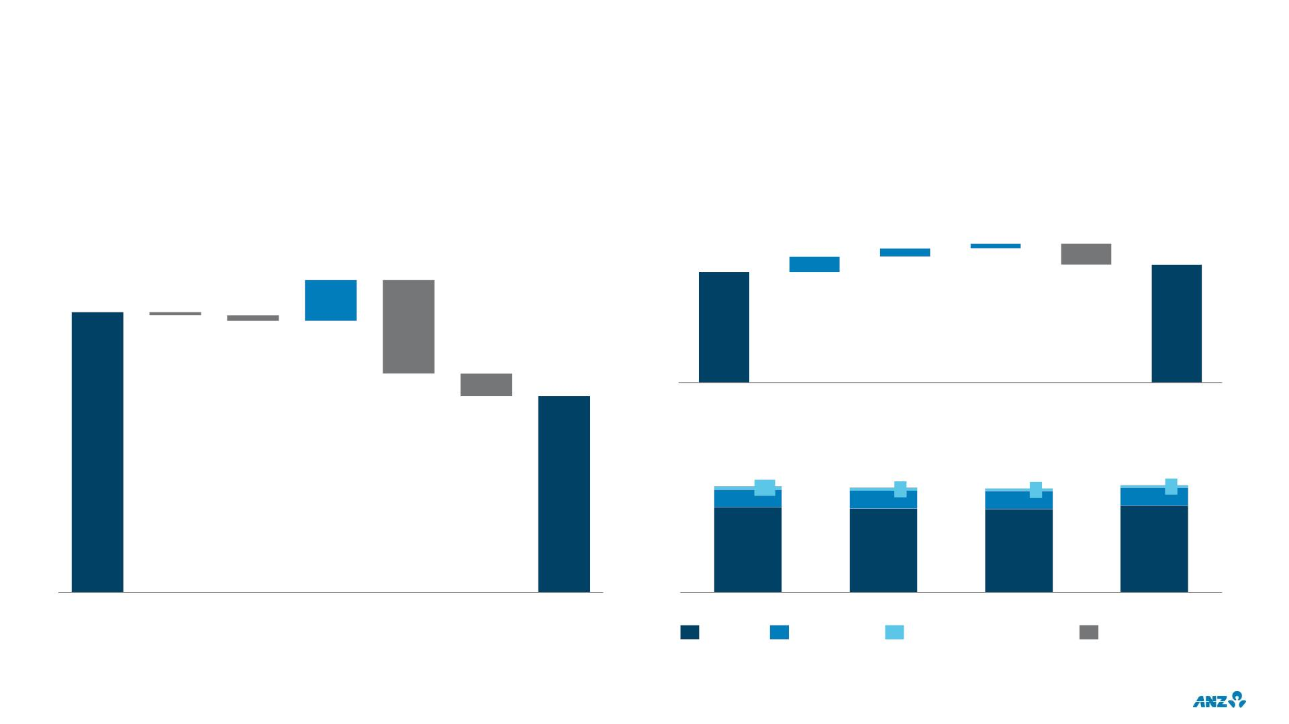
AUSTRALIA RETAIL & COMMERCIAL
CONTINUING OPERATIONS EXCLUDING LARGE / NOTABLE ITEMS
INCOME CONTRIBUTION
HOME LOAN BALANCE & LENDING FLOWS¹
$m
$b
12
7
23
275
78
264
-31
4,683
-6
-11
-178
4,523
Mar-20
New sales Net OFI Refi.
Redraw
& Int.
Repay/
Other
Sep-20
-43
NET LOANS & ADVANCES
$b
337
10
332
330
339
57
57
9
57
8
57
7
269
265
264
275
1H20
Retail
volume
Retail
margin
Comm.
volume
Comm.
margin
Other
Operating
Income
2H20
Mar-19
Sep-19
Commercial
Mar-20
Cards & Personal Loans
Sep-20
Other²
Housing
1. Gross Loans & Advances basis, includes Non-Performing Loans. New sales excludes refinances into ANZ, captured within the Net Other Financial Institutional Refinance category (Net OFI Refi)
2. Other includes ‘Advice’ (<$1b in each period)
20

Slide 22
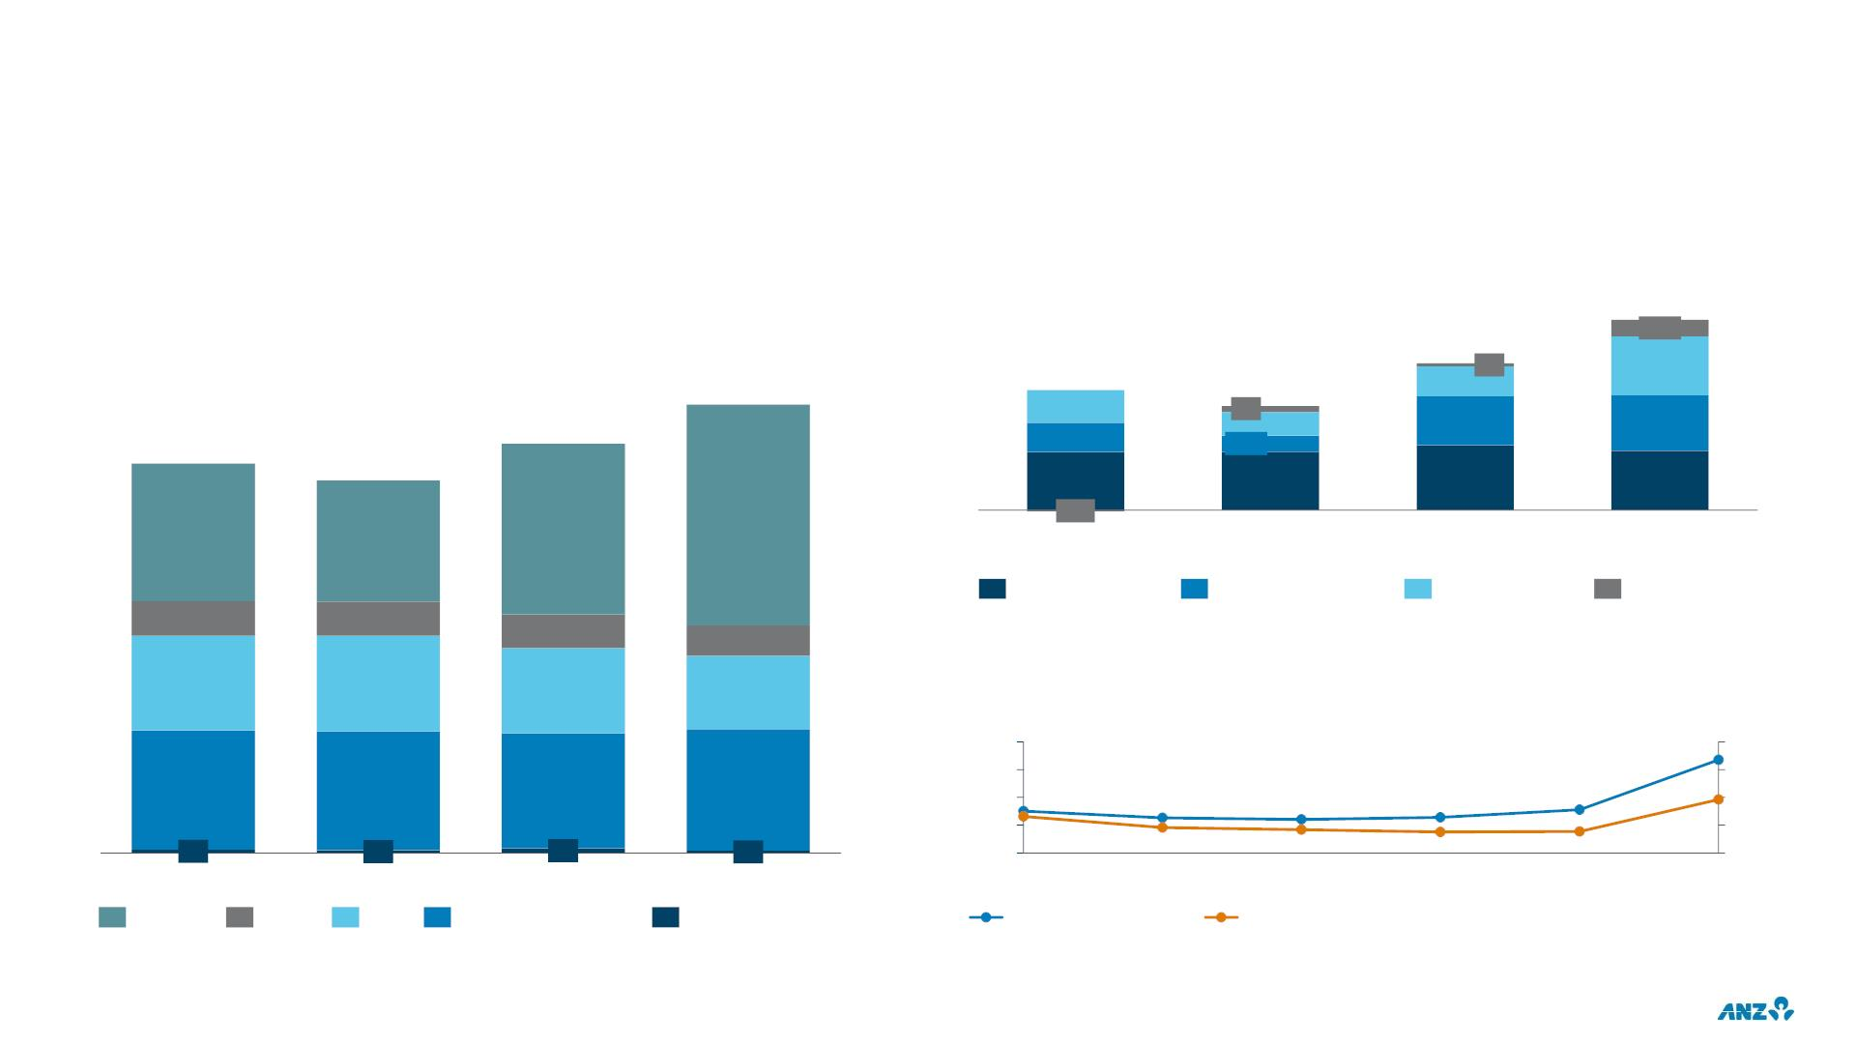
INSTITUTIONAL
CONTINUING OPERATIONS EXCLUDING LARGE / NOTABLE ITEMS
INSTITUTIONAL INCOME COMPOSITION¹
MARKETS INCOME COMPOSITION
$m
$m
1,508
131
1,164
24
940
826
48
238
468
438
471
3,060
256
235
2,791
190
388
513
2,657
126
463
2,541
826
459
-10
940
1,164
1,508
1H19
2H19
1H20
2H20
Franchise Sales
Franchise Trading
Balance Sheet
Derivative val/n adj.
236
644
234
652
231
580
209
498
MARKETS AVG VALUE AT RISK (99% VAR)
$m
80
60
40
20
67
40
30
20
815
810
786
829
30
13
25
24
26
31
19 10
23
19
31
16
9
8
8
8
1H19
2H19
1H20
2H20
1H18
2H18
1H19
2H19
1H20
2H20
Markets
Trade
PCM
Corporate Finance
Other
Non-traded (LHS)
Traded (RHS)
1. Trade: Trade & Supply Chain; PCM: Payments & Cash Management
21

Slide 23
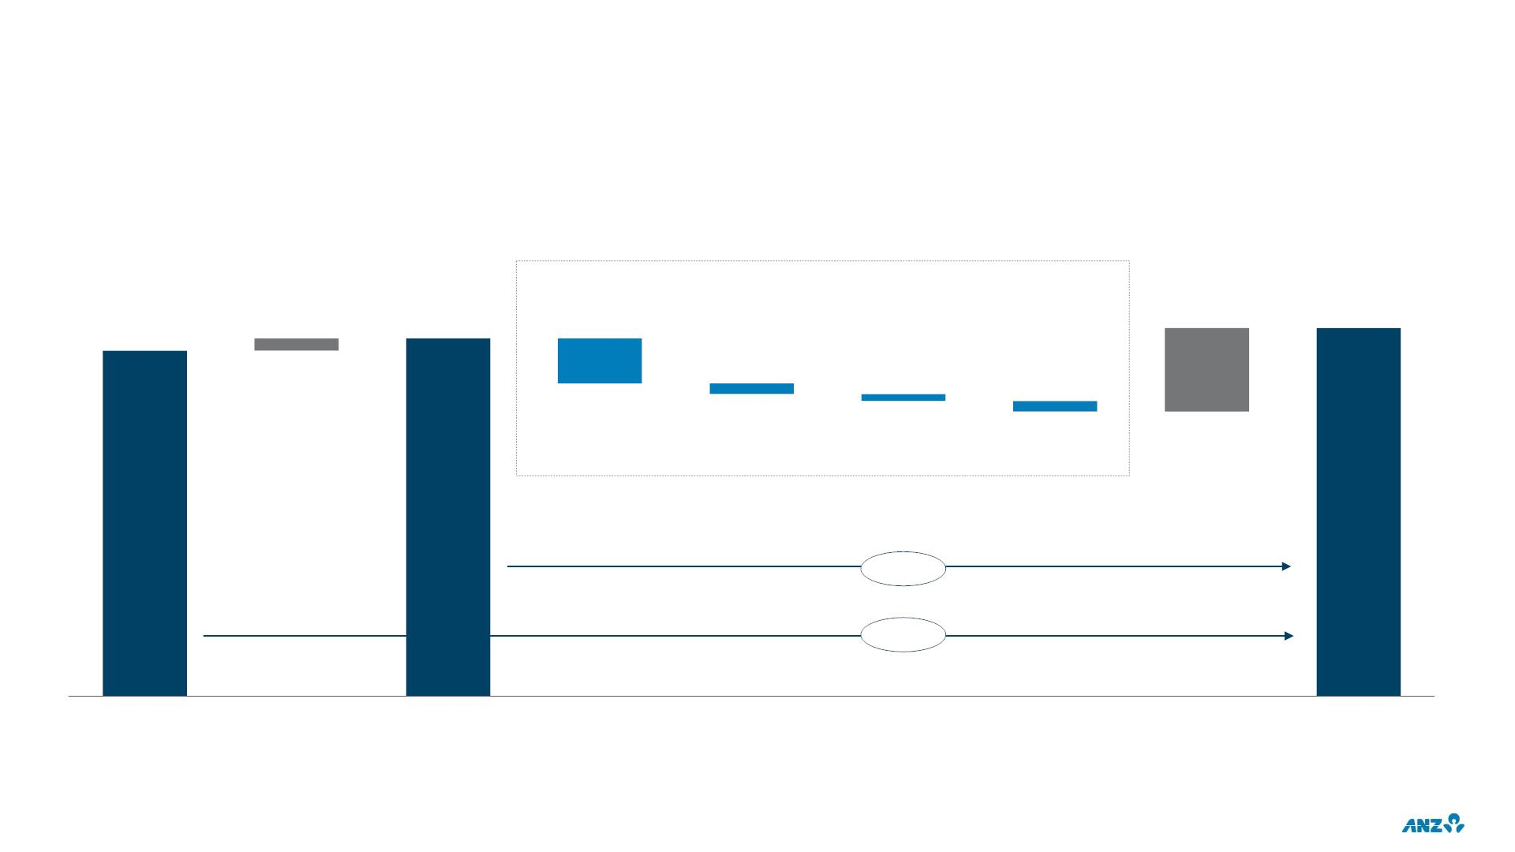
EXPENSES
CONTINUING OPERATIONS EXCLUDING LARGE / NOTABLE ITEMS
EXPENSE DRIVERS
$m
BAU costs down $281m
(absorbing inflation of $128m)
47
8,574
321
8,614
8,527
-172
-42
-26
-41
flat
+1%
FY19
FX
FY19
FX adjusted
Personnel
Premises
Technology
Other
Investment
FY20
22

Slide 24
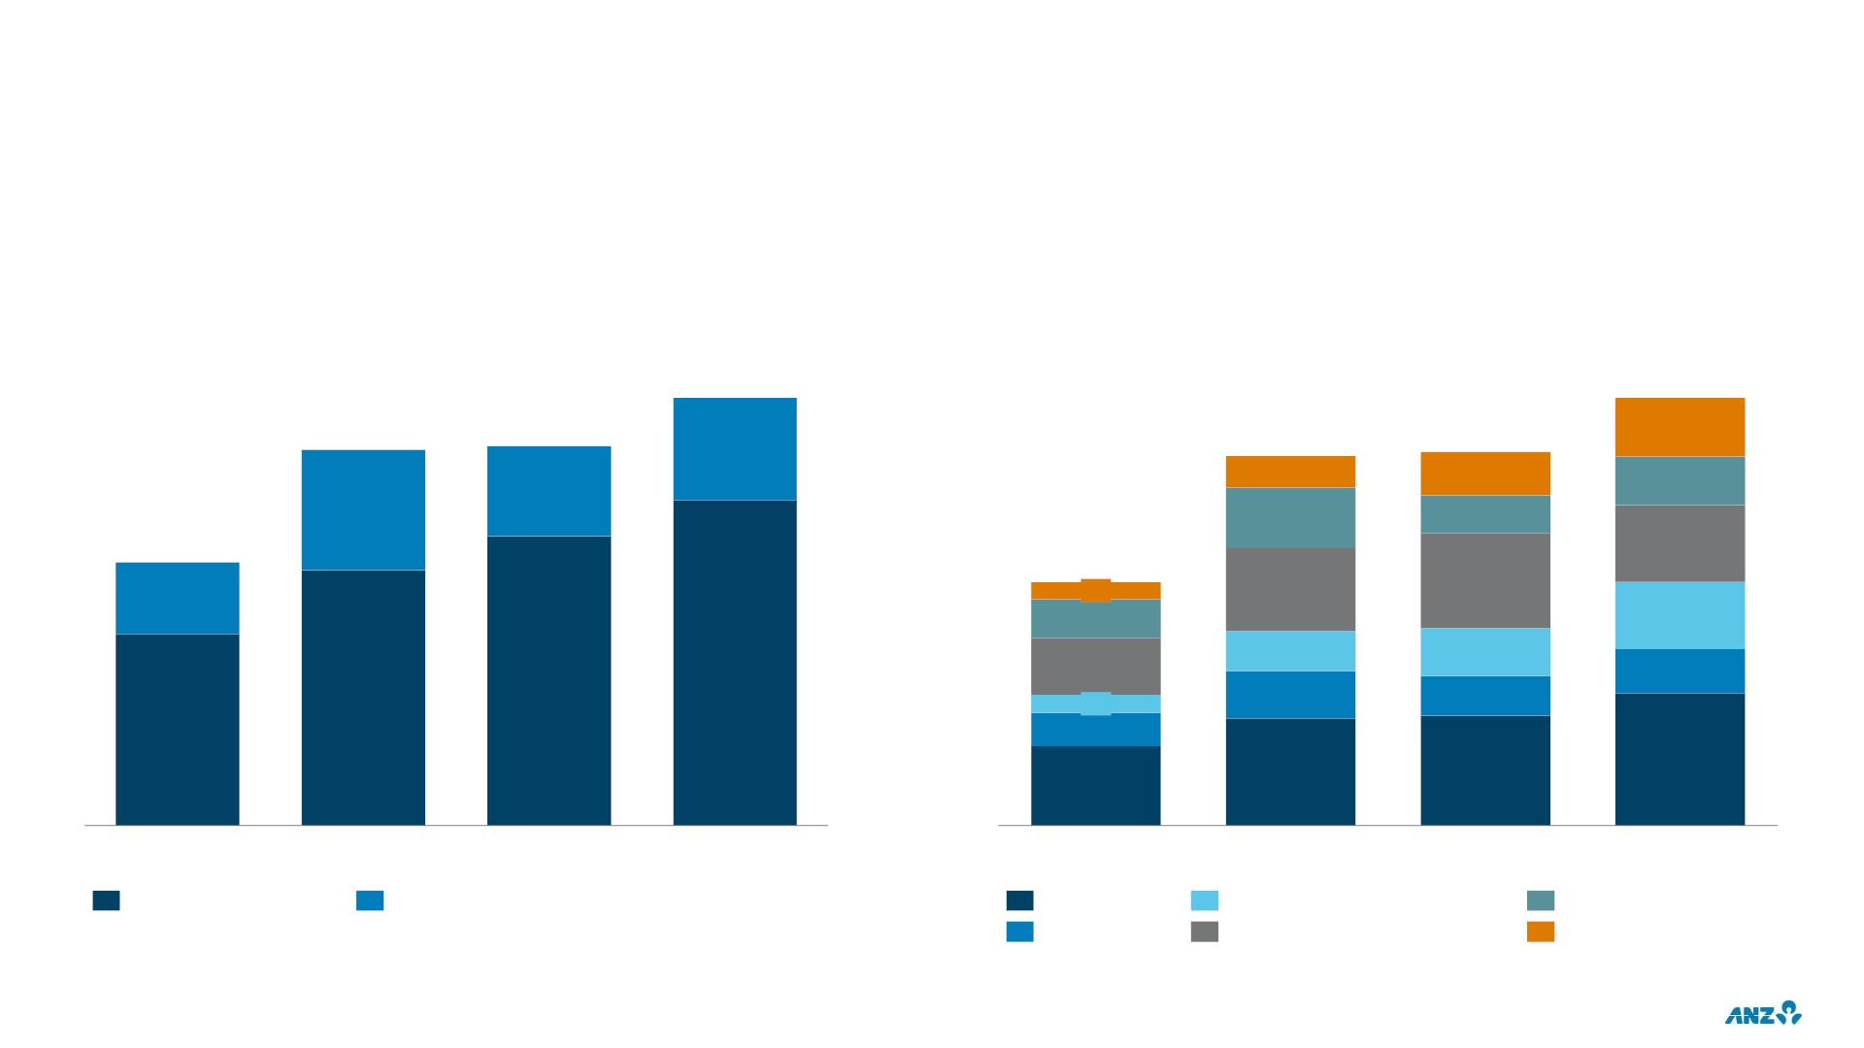
INVESTMENT SPEND
CONTINUING OPERATIONS
EXPENSED & CAPITALISED
BY CATEGORY
$m
$m
939
939
115
825
833
24%
825
62
833
85
24%
95
32%
119
75
578
151
578
33
77
186
27%
163
132
86
76%
111
78
93
94
78
68%
76%
35
66
73%
310
315
360
255
1H19
2H19
1H20
2H20
1H19
2H19
1H20
2H20
Investment Expensed
Investment Capitalised
Australia R&C
Institutional
New Zealand
Technology Infrastructure
Digital & Data
Enablement, Property & Ops.
23

Slide 25
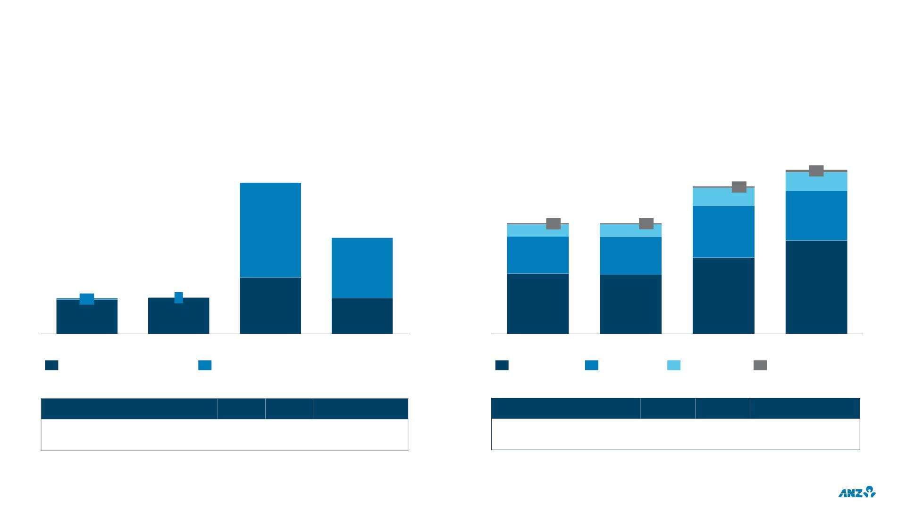
PROVISION CHARGE & BALANCE
CONTINUING OPERATIONS
TOTAL PROVISION CHARGE
COLLECTIVE PROVISION BALANCE
$m
$m
5,008
80
570
1,674
4,501
50
541
3,378
43
3,376
38
1,513
1,048
626
1,064
669
369
374
1,590
1,132
1,169
393
13
402
4
2,320
2,845
1,834
1,795
380
398
395
1H19
2H19
1H20
2H20
Mar-19
Sep-19
Mar-20
Sep-20
Individual Provision charge
Collective Provision charge
Australia R&C
Institutional
New Zealand
Pacific / Other
LOSS RATES (%)
1H19
2H19
1H20
2H20
COVERAGE RATIOS (%)
Mar-19
Sep-19
Mar-20
Sep-20
IP / Avg. GLA¹
0.12
0.13
0.13
0.13
0.20
0.53
0.12
0.33
CP balance / CRWA²
CP balance / EAD³
0.98
0.35
0.94
0.35
1.17
0.42
1.39
0.50
Total provision charge / Avg. GLA¹
1. GLA: Gross Loans & Advances
2. Credit Risk Weighted Assets
3. Exposure at Default
24

Slide 26
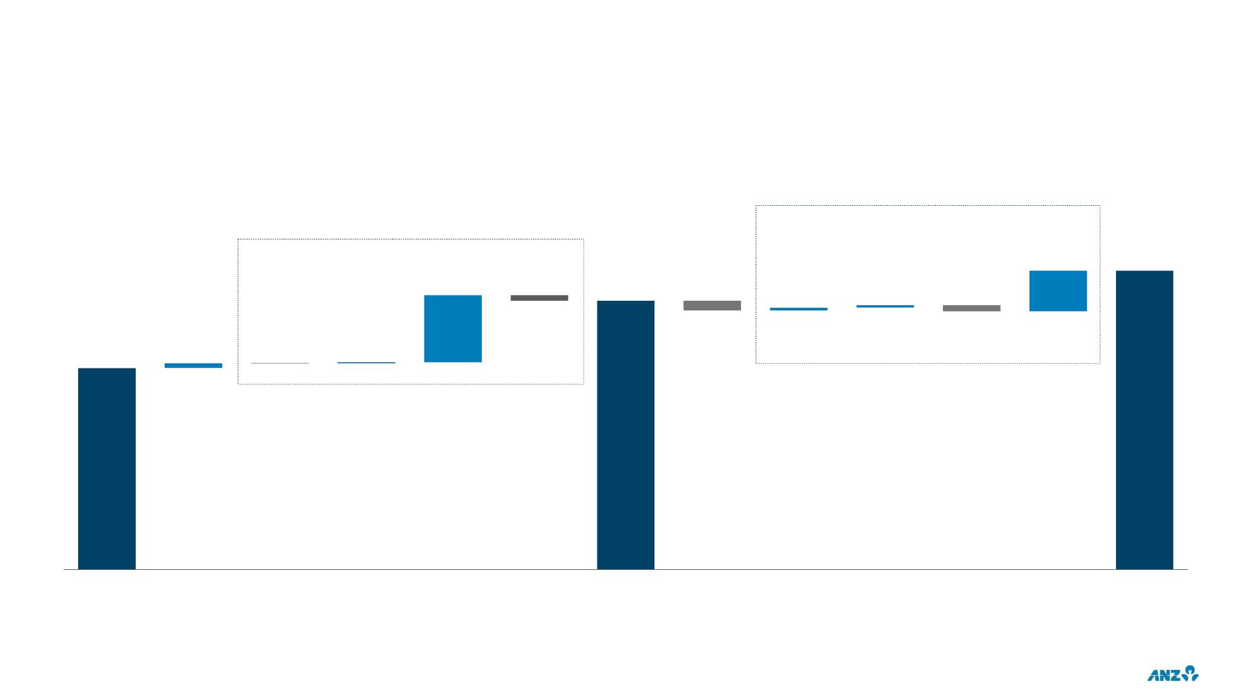
COLLECTIVE PROVISION CHARGE & BALANCE
CONTINUING OPERATIONS
DRIVERS
$m
2H20 CP charge: $669m
(3Q: $236m 4Q: $433m)
1H20 CP charge: $1,048m
685
5,008
1,124
4,501
46
44
-93
-162
-106
3,376
77
0
17
Sep-19
FX
Volume /
Mix
Change
in Risk
Economic
forecast and overlays¹
scenario
Additional
Mar-20
FX
Volume /
Mix
Change
in Risk
Economic
forecast and overlays
scenario
Additional
Sep-20
weights
weights
1. Reduction due to release of overlays no longer required due to the CP uplift from base case & scenario weights
25

Slide 27
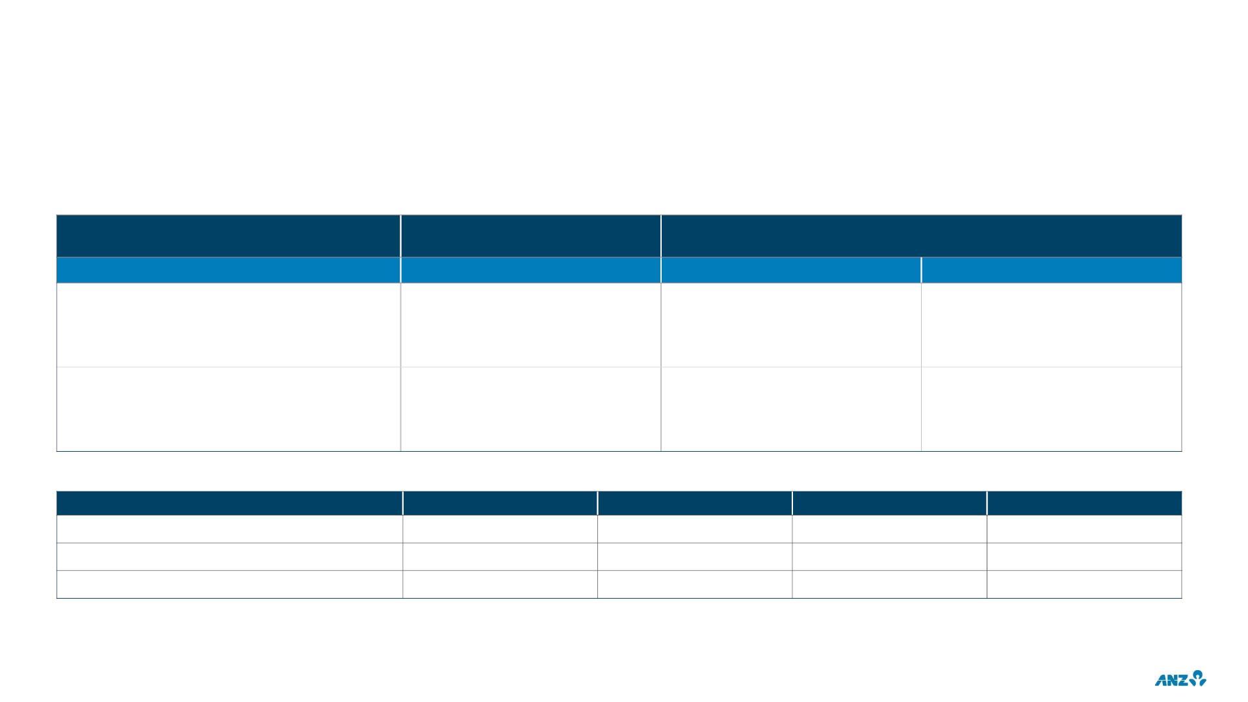
CAPITAL & DIVIDENDS
IMPACT OF CREDIT PORTFOLIO MIGRATION
RWA IMPACT ON CAPITAL
PREVIOUS EXPECTATION¹
CURRENT EXPECTATION
Base case
Base case
Downside
~100bps
18bps
Total CET1 impact (FY20 & FY21)
- FY20 CET1 (actual)
- FY21 CET1
~110bps
~65bps
18bps
~50bps
~82bps
Drivers of CET1 impact²
- Institutional
~70%
~30%
~50%
~50%
~60%
~40%
- Non Institutional
DIVIDEND
1H19
80c
2H19
80c
1H20
25c
2H20
Dividends per share
Franking
35c
100%
49%
100%
71%
70%
82%
100%
46%
Dividend Payout Ratio³
1. Expectations at March 2020
2. Composition of the drivers for ‘Previous expectation’ are for the FY20 & FY21 period. Composition of the drivers for ‘Current expectation’ are for FY21
26
3. Statutory basis

Slide 28
2020
FULL YEAR RESULTS
INVESTOR DISCUSSION PACK
GROUP & DIVISIONAL FINANCIAL PERFORMANCE

Slide 29
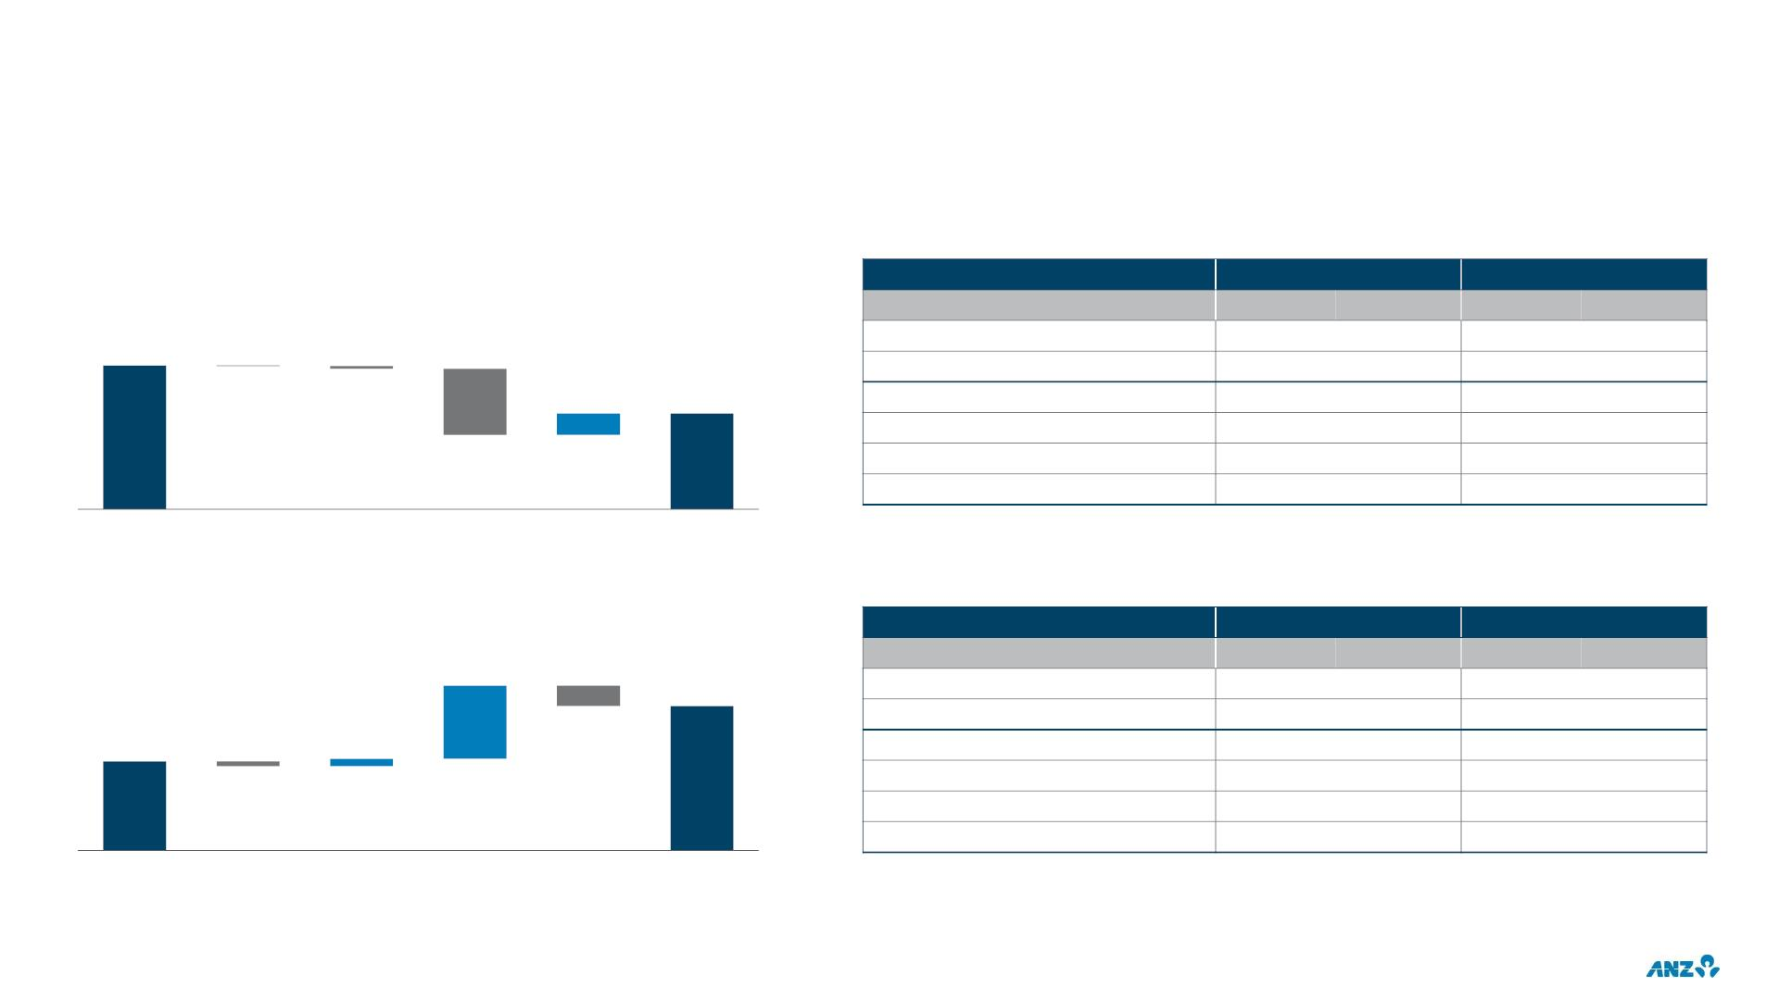
FINANCIAL PERFORMANCE
CONTINUING OPERATIONS
FY20 CASH PROFIT DRIVERS
EXCLUDING LARGE / NOTABLE ITEMS
$m
6,701
$m
Profit before provisions
Cash NPAT
FY20
8,369
-1,746
10,115
5,444
3,371
1,932
FY20 v FY19
-16%
Large
FY20
FY20 v FY19
-42%
Large
Continuing operations
Large/Notable items (L/N)
Continuing operations ex L/N
Australia Retail & Commercial
Institutional
3,758
-1,539
5,297
2,658
1,930
1,144
-14
-87
631
5,297
-1%
-21%
-26%
-7%
-1,934
+29%
-8%
+4%
0%
Revenue
+1%
+248%
-23%
-21%
FY20
New Zealand (NZD)
-22%
FY19
Expenses Provisions Tax & NCI
2H20 CASH PROFIT DRIVERS
EXCLUDING LARGE / NOTABLE ITEMS
$m
Profit before provisions
Cash NPAT
$m
2H20
4,395
-672
2H20 v 1H20
+11%
-37%
2H20
2,345
-528
2H20 v 1H20
+66%
-48%
593
Continuing operations
Large/Notable items (L/N)
Continuing operations ex L/N
Australia Retail & Commercial
Institutional
2,873
-163
2,424
1H20
60
5,067
2,648
1,855
933
0%
2,873
1,291
1,308
546
+19%
-6%
-41
0%
-5%
-1%
-36%
+17%
+19%
2H20
+22%
-7%
+110%
-9%
New Zealand (NZD)
Revenue
Expenses Provisions Tax & NCI
28

Slide 30
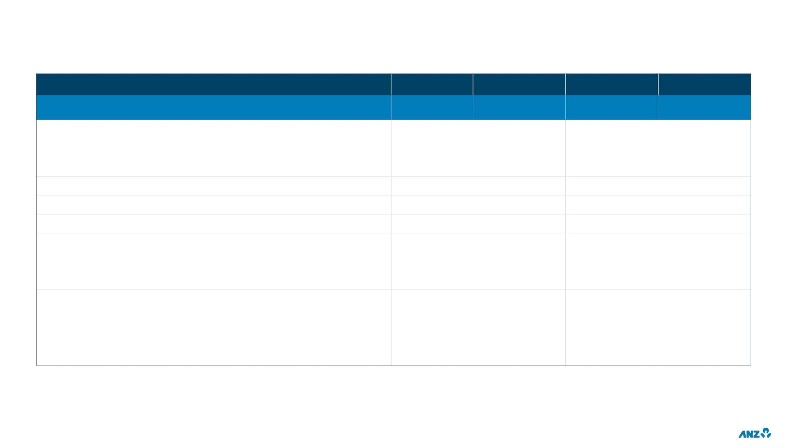
LARGE / NOTABLE ITEMS
$m
FY19
-231
FY20
1H20
2H20
-528
TOTAL
-1,539
-1,011
27
Divestments
308
205
23
-34
-4
-34
Gain/(Loss) on sale from divestments
Divested business results
Customer remediation
103
57
27
30
-475
-54
-279
-115
-138
-881
-815
-66
-91
-74
-188
-41
-138
-66
Restructuring
Accelerated software amortisation
Asian associates impairment / adjustment
Asian associates impairment
Asian associate AASB 9 adjustment
Accounting policy / other
Goodwill write-off
-815
-815
-66
-91
-77
-14
-10
-149
-77
-58
Lease-related items
-72
-58
Royal Commission legal costs
-10
Further detail on Large / Notable items is provided within ANZ’s Full Year 30 September 2020 Consolidated Financial Report, Dividend Announcement and Appendix 4E,
page 14 to 18
29

Slide 31
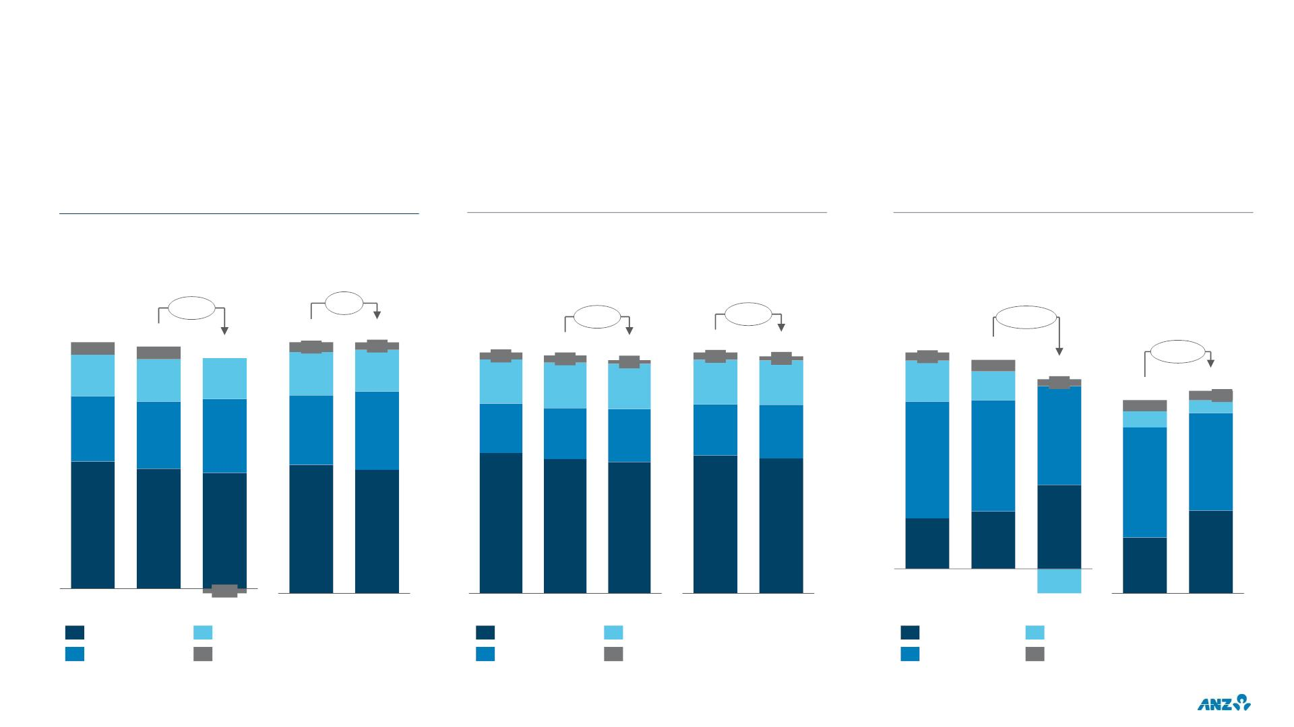
TOTAL OPERATING INCOME
CONTINUING OPERATIONS
TOTAL INCOME BY DIVISION
NET INTEREST INCOME BY DIVISION
OTHER OPERATING INCOME
$b
$b
$b
Continuing
Continuing ex L/N
Continuing
Continuing ex L/N
Continuing
Continuing ex L/N
-7%
0%
-2%
-2%
-21%
19.4
1.0
19.0
1.0
18.7
0.8
18.7
0.6
14.5
0.4
14.3
0.4
14.3
0.4
14.1
0.3
4.9
0.2
17.8
14.0
0.2
4.7
0.3
+5%
3.3
3.3
3.2
3.2
3.1
0.9
3.7
0.2
4.7
2.7
3.0
2.7
3.1
2.7
2.6
3.0
2.6
0.6
4.5
0.3
0.4
0.2
0.3
5.1
5.3
5.8
9.1
5.2
5.9
3.2
3.2
2.2
1.9
2.6
2.5
2.3
2.5
10.0
9.4
9.6
9.2
8.4
8.1
7.9
8.2
8.0
1.1
1.3
1.9
1.3
-0.4
-0.6
FY18
FY19
FY20
FY19
FY20
FY18
FY19
FY20
NZ
FY19
FY20
FY18
FY19
FY20
Other
FY19
FY20
Australia R&C
Institutional
NZ
Australia R&C
Institutional
Markets
Other
Other
Fee & comm.
Assoc. profit
30

Slide 32
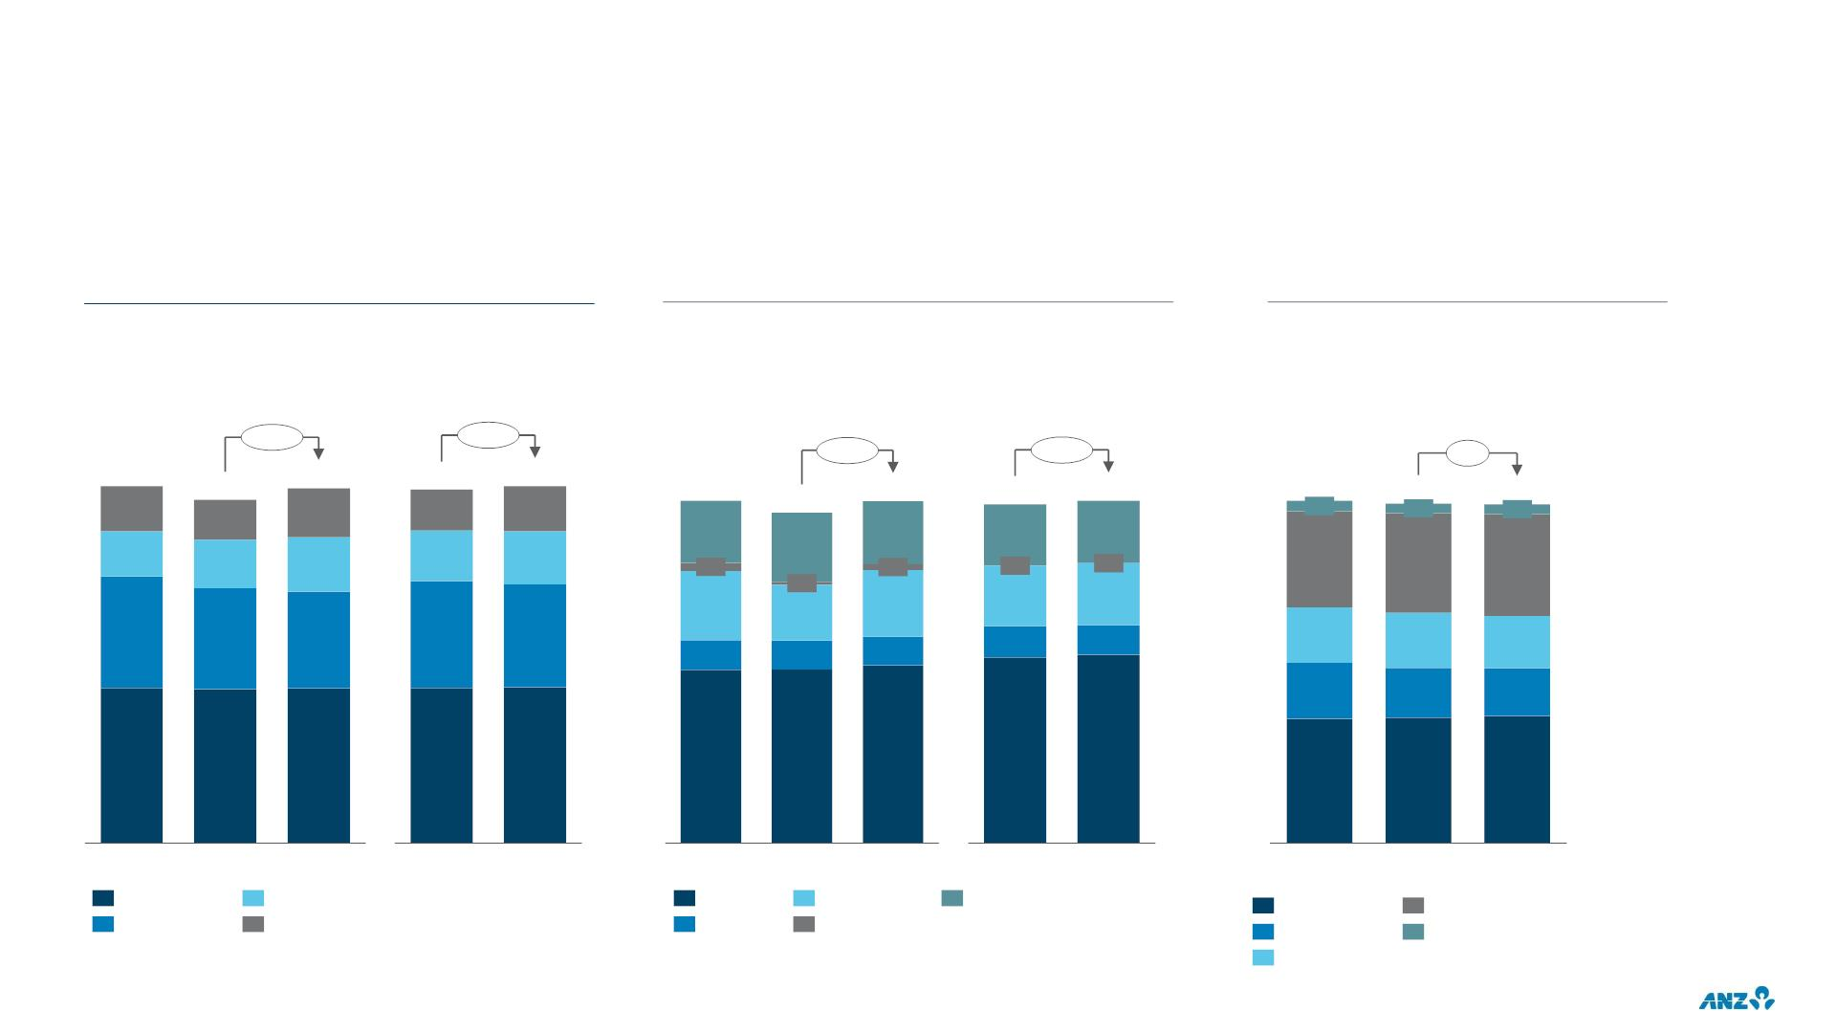
EXPENSE MANAGEMENT
CONTINUING OPERATIONS
TOTAL EXPENSES BY DIVISION
TOTAL EXPENSES BY CATEGORY
FULL TIME EQUIVALENT STAFF
$b
$b
000s
Continuing
Continuing ex L/N
Continuing
Continuing ex L/N
Continuing
+3%
+1%
+3%
+1%
0%
9.4
1.2
9.1
1.0
9.4
1.3
8.5
1.0
8.6
1.1
9.4
9.4
8.5
8.6
37.9
1.1
37.6
1.1
37.5
1.1
9.1
1.9
1.7
0.2
1.7
0.2
1.8
1.5
0.0
1.5
1.6
0.0
1.6
1.2
1.3
1.4
2.6
1.2
1.3
2.5
10.6
11.0
11.3
0.1
1.5
1.9
0.8
2.9
2.7
2.6
0.8
0.8
0.8
6.2
6.2
6.1
5.5
5.8
5.3
0.8
4.1
4.1
4.1
3.7
3.8
4.8
4.8
4.9
4.7
4.7
13.7
13.9
14.1
FY18
FY19
FY20
FY19
FY20
FY18
FY19
FY20
FY19
FY20
Sep-18
Sep-19
Sep-20
Australia R&C
Institutional
NZ
Personnel
Premises
Technology
Other
Australia R&C
Institutional
NZ
TSO & Group Centre
Pacific
Other
Restructuring
31

Slide 33
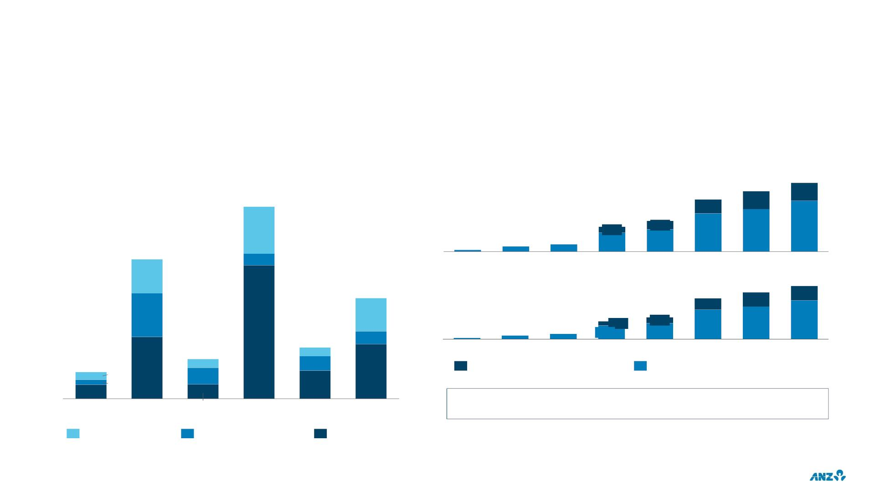
CUSTOMER REMEDIATION
CUSTOMER REMEDIATION
CUMULATIVE CUSTOMER REMEDIATION
CONTINUING OPERATIONS
CONTINUING & DISCONTINUED OPERATIONS
PRE TAX $m
PRE TAX $m
1,832
546
2,088
548
485
1,579
422
753
181
572
928
256
119
1,157
2H19
1,286
1H20
1,540
2H20
51
153
220
672
352
29
1H17
2H17
1H18
2H18
1H19
86
POST TAX $m
1,401
428
1,591
430
254
84
1,216
334
110
534
127
657
180
477
112
2H17
157
882
973
1,161
2H20
337
129
22
32
40
407
100
1H17
1H18
2H18
1H19
2H19
1H20
67
35
156
22
36
138
Discontinued (Wealth businesses)
Continuing operations
19
13
42
71
36
Balance Sheet¹
1H18
2H18
1H19
2H19
1H20
2H20
$1,109m provisions on Balance Sheet at Sep-20 ($1,094m at Mar-20)
Net interest income
Other operating income
Expenses
1. Includes provisions for expected refunds to customers, remediation project costs and related customer and regulatory claims, penalties and litigation outcomes
32

Slide 34
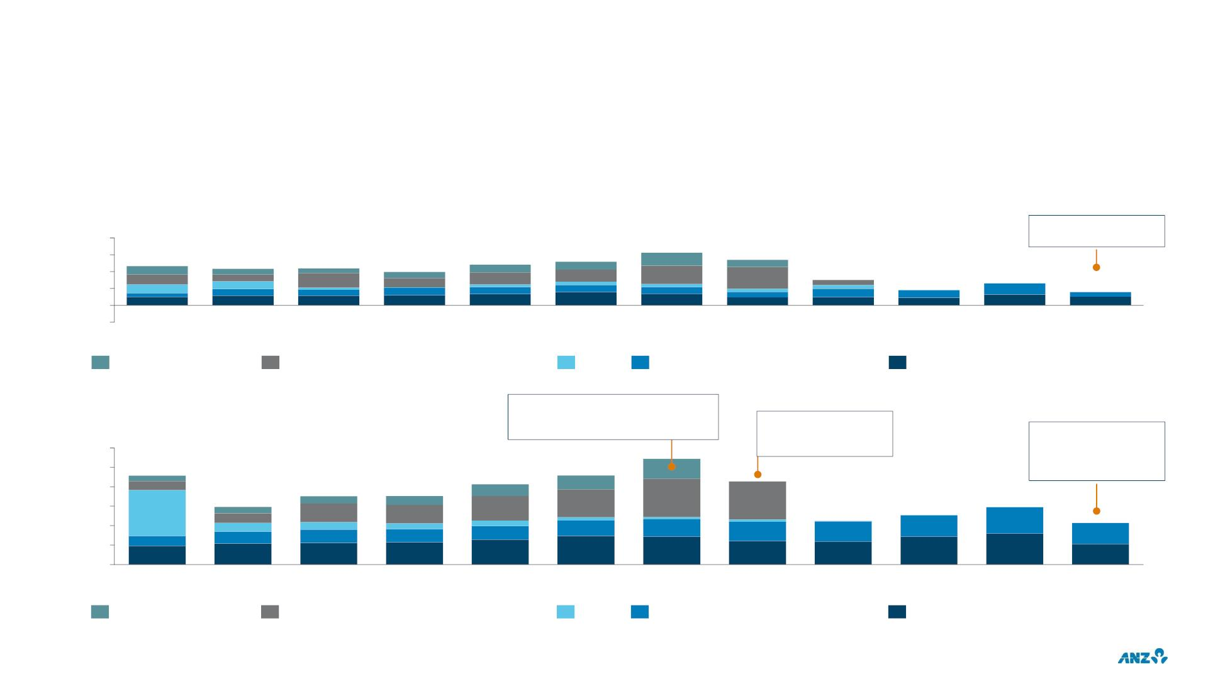
INVESTMENTS IN ASSOCIATES
SHARE OF ASSOCIATES’ PROFIT
$m
800
$223m excl. large /
notable items
600
400
200
0
465
482
517
625
541
433
436
395
300
183
262
155
-200
FY09
FY10
FY11
FY12
FY13
FY14
FY15
FY16
FY17
FY18
FY19
FY20
Bank of Tianjin (BOT)
Shanghai Rural Commercial Bank (SRCB)
Other³
P.T. Bank Pan Indonesia (PT Panin)
AMMB Holdings Berhad (AmBank)
CARRYING VALUE OF ASSOCIATES¹
• BOT: Cessation of equity accounting
from Mar-16 following dilution of
ownership interest (now FVOCI)
$b
6
• SRCB: Sold in FY17
Impairments recognised
in 1H20²:
• PT Panin: $220m
• AmBank: $595m
•
AmBank: FY16 $260m
impairment recognised
5
4
3
2
1
0
Sep-09
Sep-10
Sep-11
Sep-12
Sep-13
Sep-14
Other³
Sep-15
Sep-16
Sep-17
Sep-18
Sep-19
Sep-20
Bank of Tianjin (BOT)
Shanghai Rural Commercial Bank (SRCB)
P.T. Bank Pan Indonesia (PT Panin)
AMMB Holdings Berhad (AmBank)
1. Investment in banking associates and minority interests are treated as a deduction from Common Equity Tier 1 Capital as noted in Table 2 of ANZ’s capital management disclosures (refer ANZ Full
Year 2020 Consolidated Financial Report and Dividend Announcement and Appendix 4E – Supplementary information)
2. Information on the impairment of AMMB and PT Panin is contained within ANZ Full Year 2020 Consolidated Financial Report and Dividend Announcement and Appendix 4E – Note 1
3. Other includes joint venture with ING (up to Nov-09)
33

Slide 35
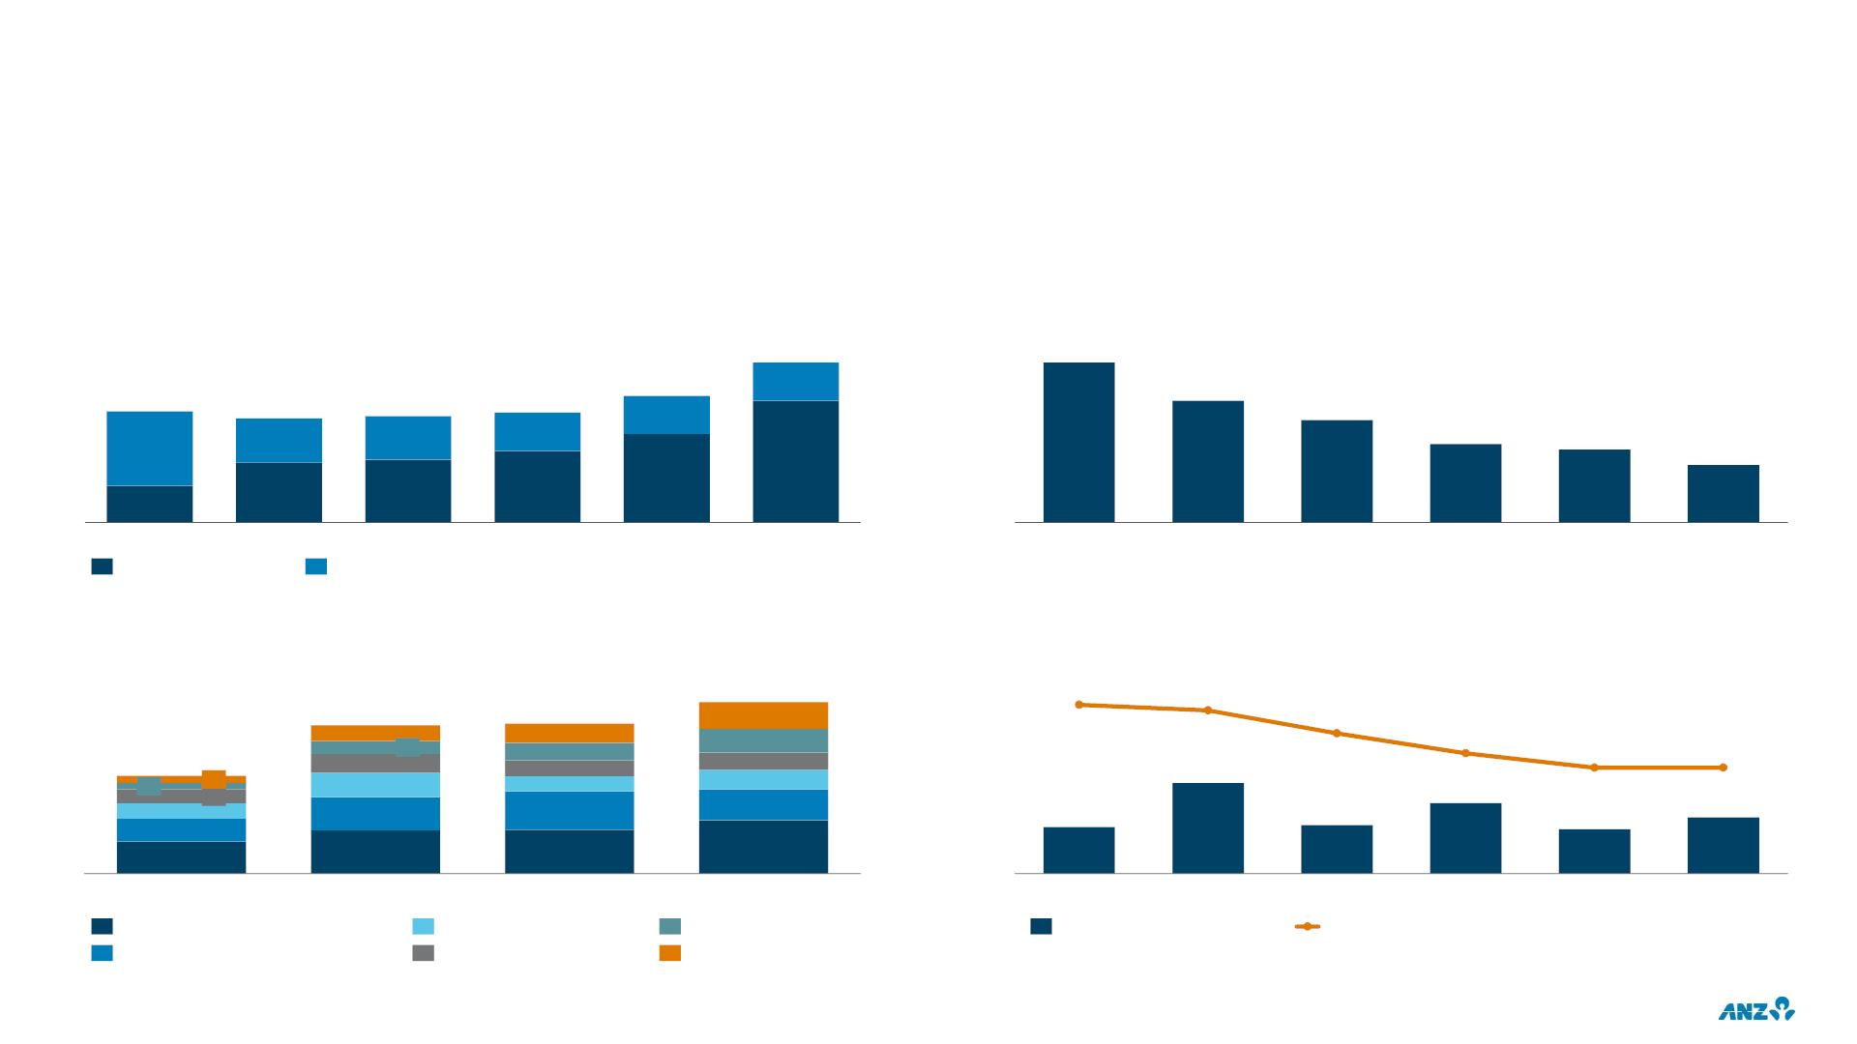
INVESTMENT SPEND
CONTINUING OPERATIONS
TOTAL INVESTMENT SPEND¹
CAPITALISED SOFTWARE BALANCE²
Capex and Opex $m
$m
1,772
24%
2,893
1,234
67%
1,179
41%
1,218
1,403
30%
2,202
1,856
1,153
42%
35%
1,421
1,323
76%
FY20
1,039
58%
FY16
59%
65%
FY18
70%
FY19
33%
FY15
FY17
Sep-15
Sep-16
Sep-17
Sep-18
Sep-19
Sep-20
Investment Expensed
Investment Capitalised
TOTAL INVESTMENT SPEND BY DIVISION¹
AMORTISED SOFTWARE²
$m
939
4.9
4.7
825
833
132
3.9
78
93
62
94
85
78
115
86
95
3.2
2.7
2.7
578
35
66
1,056
33
77
119
163
75
820
657
186
151
542
565
517
111
255
360
310
315
1H19
2H19
1H20
2H20
FY15
FY16
FY17
FY18
FY19
FY20
Australia Retail & Commercial
Enablement, Property & Operations
Technology Infrastructure
Institutional
Digital & Data
New Zealand
Software amortisation ($m)
Avg. amortisation period (yrs)
1. Prior periods restated from previously reported information to include technology infrastructure spend, property projects and scaled agile delivery
2. FY15 & FY16 include discontinued operations
34

Slide 36
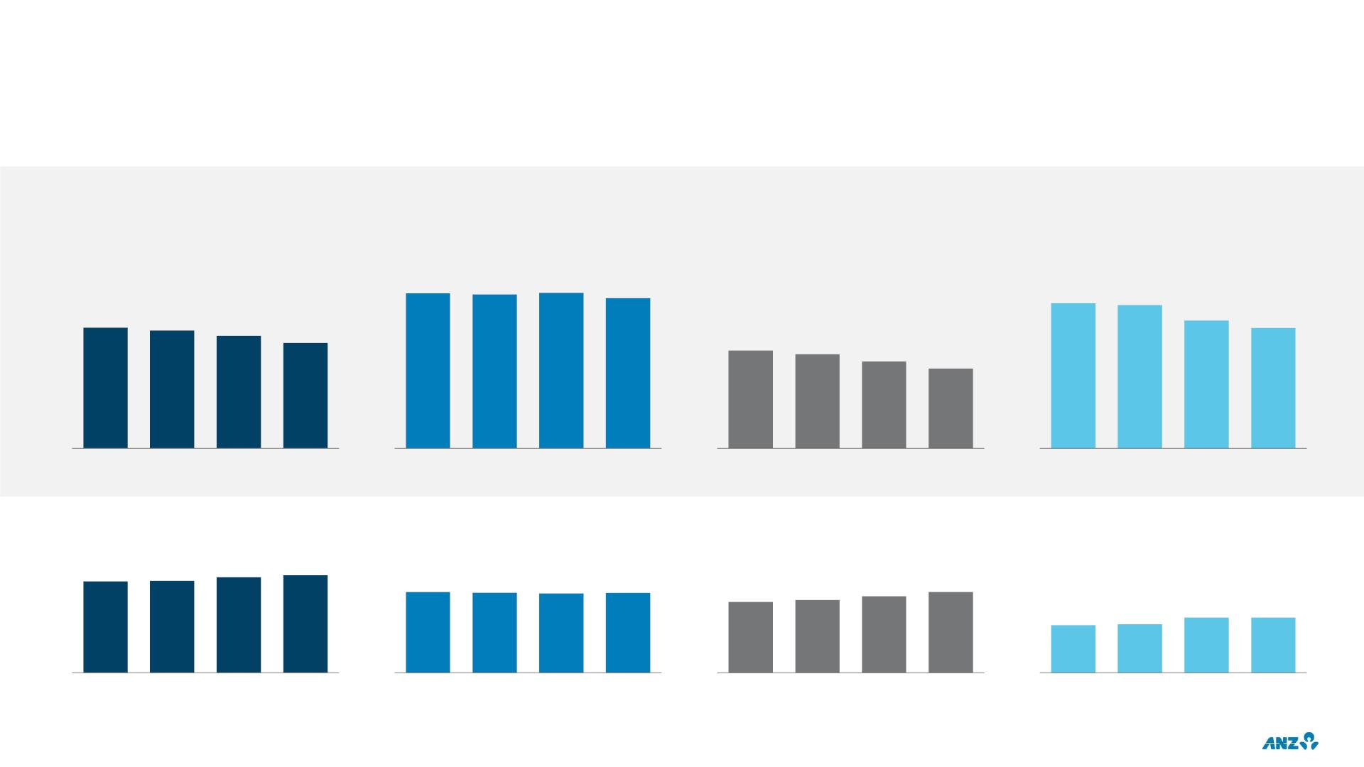
RISK ADJUSTED PERFORMANCE
CONTINUING OPERATIONS EXCLUDING LARGE / NOTABLE ITEMS¹
GROUP^{2,3}
AUSTRALIA R&C
INSTITUTIONAL^{2,3}
NEW ZEALAND³
NET INTEREST INCOME / AVERAGE CREDIT RISK WEIGHTED ASSETS
%
5.86
5.81
5.88
5.68
5.38
5.32
4.54
4.43
4.23
4.74
4.47
3.96
2.33
2.24
2.07
1.90
1H19
2H19
1H20
2H20
1H19
2H19
1H20
2H20
1H19
2H19
1H20
2H20
1H19
2H19
1H20
2H20
AVERAGE CREDIT RISK WEIGHTED ASSETS
$b
307
309
321
328
141
139
138
139
110
113
119
125
49
50
57
57
1H19
2H19
1H20
2H20
1H19
2H19
1H20
2H20
1H19
2H19
1H20
2H20
1H19
2H19
1H20
2H20
1. In AUD
2. Excluding Markets business unit
3. Adjusted for Balance Sheet impacts of divestments
35

Slide 37
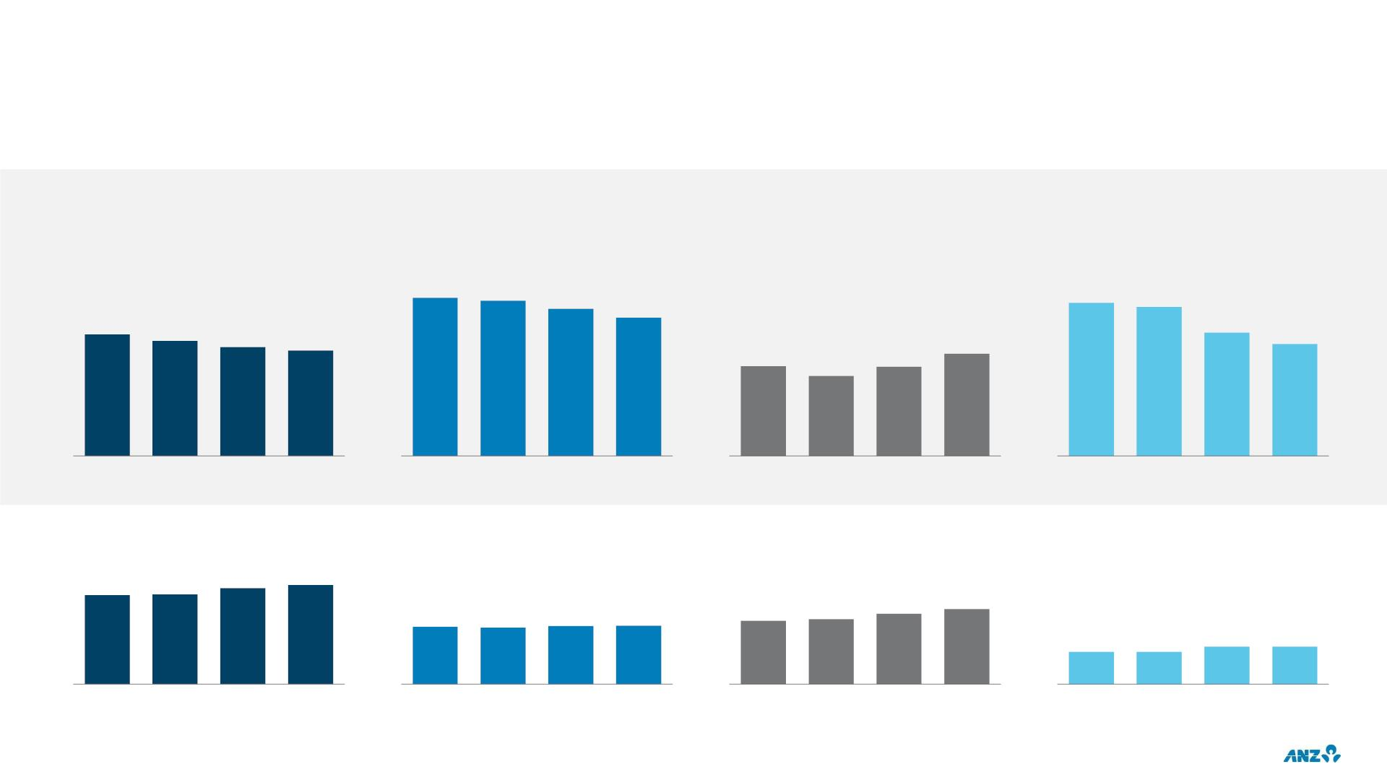
RISK ADJUSTED RETURN
CONTINUING OPERATIONS EXCLUDING LARGE / NOTABLE ITEMS¹
GROUP²
AUSTRALIA R&C
INSTITUTIONAL²
NEW ZEALAND²
PROFIT BEFORE PROVISIONS / AVERAGE TOTAL RISK WEIGHTED ASSETS (%)
%
3.71
3.64
3.45
3.64
3.54
3.24
2.93
2.68
2.54
2.40
2.66
2.33
1.88
1.65
1.47
1.64
1H19
2H19
1H20
2H20
1H19
2H19
1H20
2H20
1H19
2H19
1H20
2H20
1H19
2H19
1H20
2H20
AVERAGE TOTAL RISK WEIGHTED ASSETS
$b
390
393
421
435
166
171
185
197
160
158
162
163
56
56
65
65
1H19
2H19
1H20
2H20
1H19
2H19
1H20
2H20
1H19
2H19
1H20
2H20
1H19
2H19
1H20
2H20
1. In AUD
2. Adjusted for Balance Sheet impacts of divestments
36

Slide 38
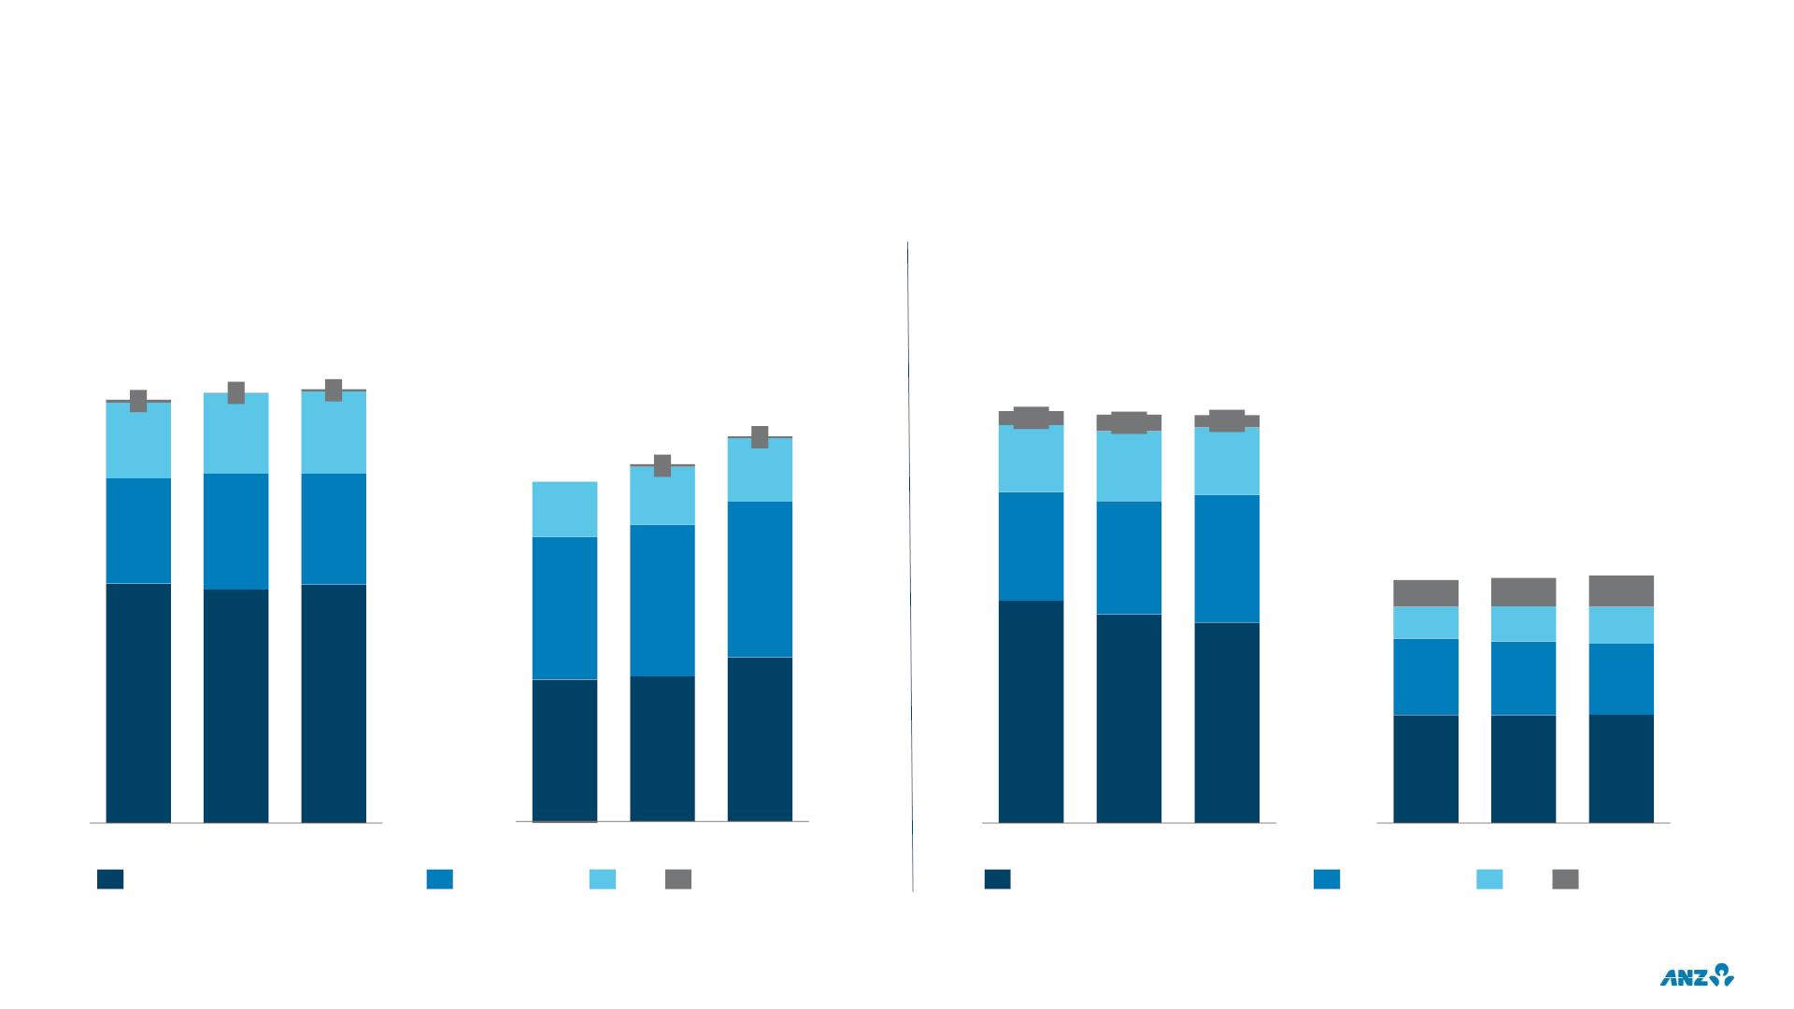
DIVISIONAL PERFORMANCE
CONTINUING OPERATIONS EX LARGE / NOTABLE ITEMS
NET LOANS & ADVANCES
CUSTOMER DEPOSITS
REVENUE
EXPENSES
$b
$b
$b
$b
602
4
612
1
617
3
552
3
18.9
0.6
18.7
0.8
18.7
0.6
108
114
117
512
4
485
79
91
3.1
3.2
3.1
83
149
165
158
5.0
5.2
5.9
8.5
0.9
1.1
8.5
1.0
1.2
8.6
1.1
223
205
217
1.3
2.7
2.6
2.5
341
332
339
10.2
FY18
9.6
9.2
203
208
235
3.8
3.7
3.8
FY18
FY19
FY20
FY18
FY19
FY20
FY19
FY20
FY18
FY19
NZ
FY20
Australia Retail & Commercial
Institutional
NZ
Other
Australia Retail & Commercial
Institutional
Other
37

Slide 39
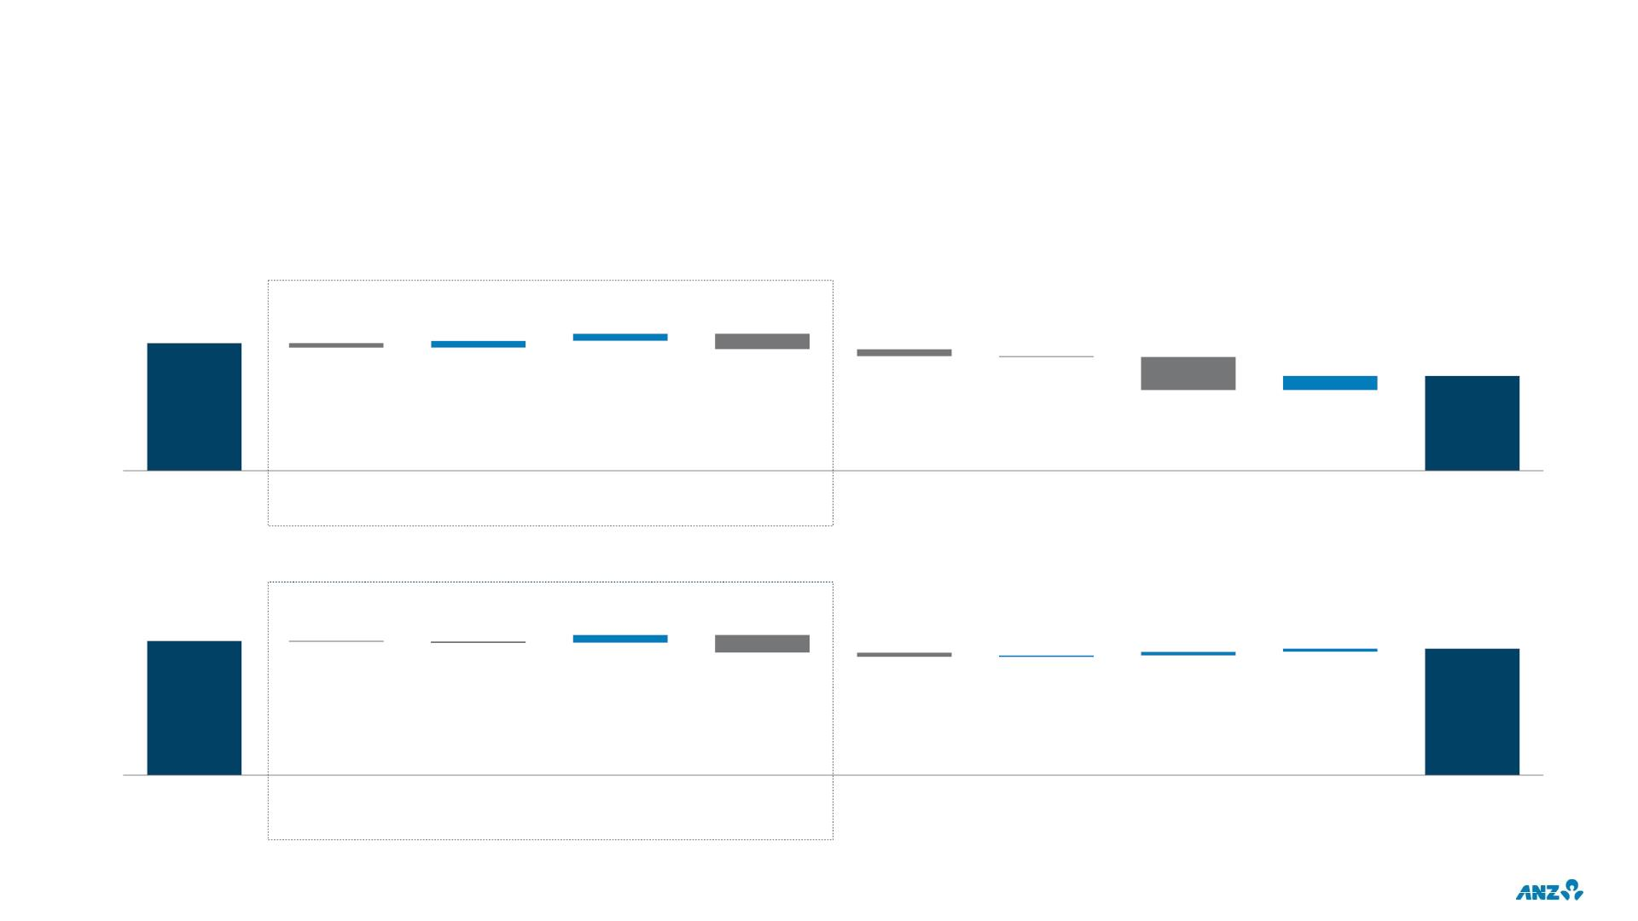
AUSTRALIA RETAIL & COMMERCIAL
CASH PROFIT DRIVERS: CONTINUING OPERATIONS EXCLUDING LARGE / NOTABLE ITEMS
FY20 CASH PROFIT DRIVERS
$m
Net Interest Income (NII)
3,581
192
198
-132
-437
-190
-19
400
2,658
-935
-2%
-14%
+1%
+131%
-26%
-26%
FY19
Retail
volume
Retail
margin
Commercial
volume
Commercial
margin
Other
Operating
Income
Expenses
Provisions
Tax
FY20
2H20 CASH PROFIT DRIVERS
$m
Net Interest Income (NII)
1,367
78
39
33
1,291
-6
-11
12
-178
-43
-3%
-7%
-1%
-5%
-6%
-6%
1H20
Retail
volume
Retail
margin
Commercial
volume
Commercial
margin
Other
Operating
Income
Expenses
Provisions
Tax
2H20
38

Slide 40
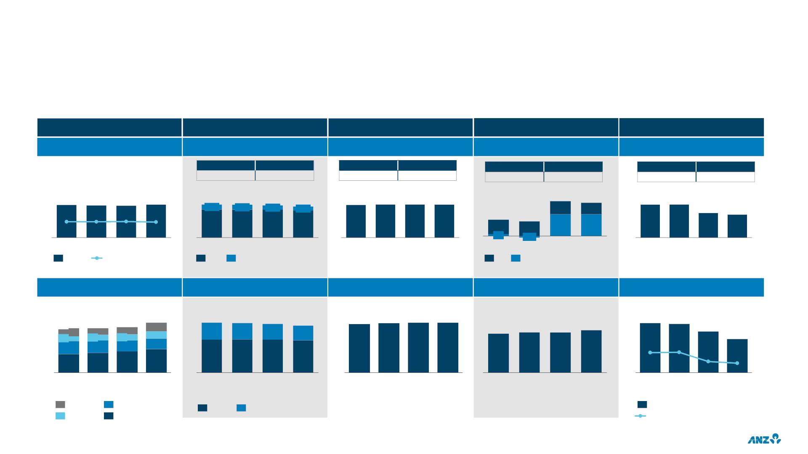
AUSTRALIA RETAIL & COMMERCIAL
FINANCIAL PERFORMANCE: CONTINUING OPERATIONS EXCLUDING LARGE / NOTABLE ITEMS
Balance sheet
Income
Expenses / FTE
Credit Quality / RWAs
Profit and Returns
NLAs¹ ($b) & NIM
NII/OOI² contribution ($m)
Expenses ($m)
Total Provisions ($m)
Cash Profit ($m)
FY19
9,575
FY20
9,206
FY19
3,743
FY20
3,762
FY19
712
FY20
1,647
FY19
3,581
FY20
2,658
337
332
330
339
4,807
693
4,768
704
4,683
625
4,523
582
1,858 1,885 1,887 1,875
843
804
278
1,786 1,795
2.63%
2.62%
2.65%
2.58%
396
316
318
1,367
1,291
2H20
4,114
4,064
4,058
3,941
2H20
350
46
355
-39
525
526
1H19
2H19
1H20
2H20
1H19
NII
2H19
OOI
1H20
1H19
2H19
1H20
2H20
1H19
IP
2H19
CP
1H20
2H20
1H19
2H19
1H20
NLAs
NIM%
Customer Deposits ($b)
Business contribution ($m)
FTE
Risk Weighted Assets EOP ($b)
Return
203
28
208
30
213
33
235
4,807
1,590
4,768
1,524
4,683
1,469
4,523
1,371
13,660 13,903 14,061 14,078
167
6.04% 6.02%
5.78%
1.69%
1H20
41
33
50
159
162
162
5.54%
1.58%
27
27
28
2.24%
1H19
2.26%
2H19
61
87
58
52
93
99
111
3,217
1H19
3,244
2H19
3,214
1H20
3,152
2H20
Mar-19 Sep-19 Mar-20 Sep-20
Mar-19 Sep-19 Mar-20 Sep-20
Mar-19 Sep-19 Mar-20 Sep-20
2H20
Transact
Offset
Term Deposit
Savings
Retail
Commercial
Revenue / Avg RWA
Return on Avg RWA³
1. NLAs: Net Loans & Advances
2. NII: Net Interest Income; OOI: Other Operating Income
3. Cash profit divided by average Risk Weighted Assets
39

Slide 41
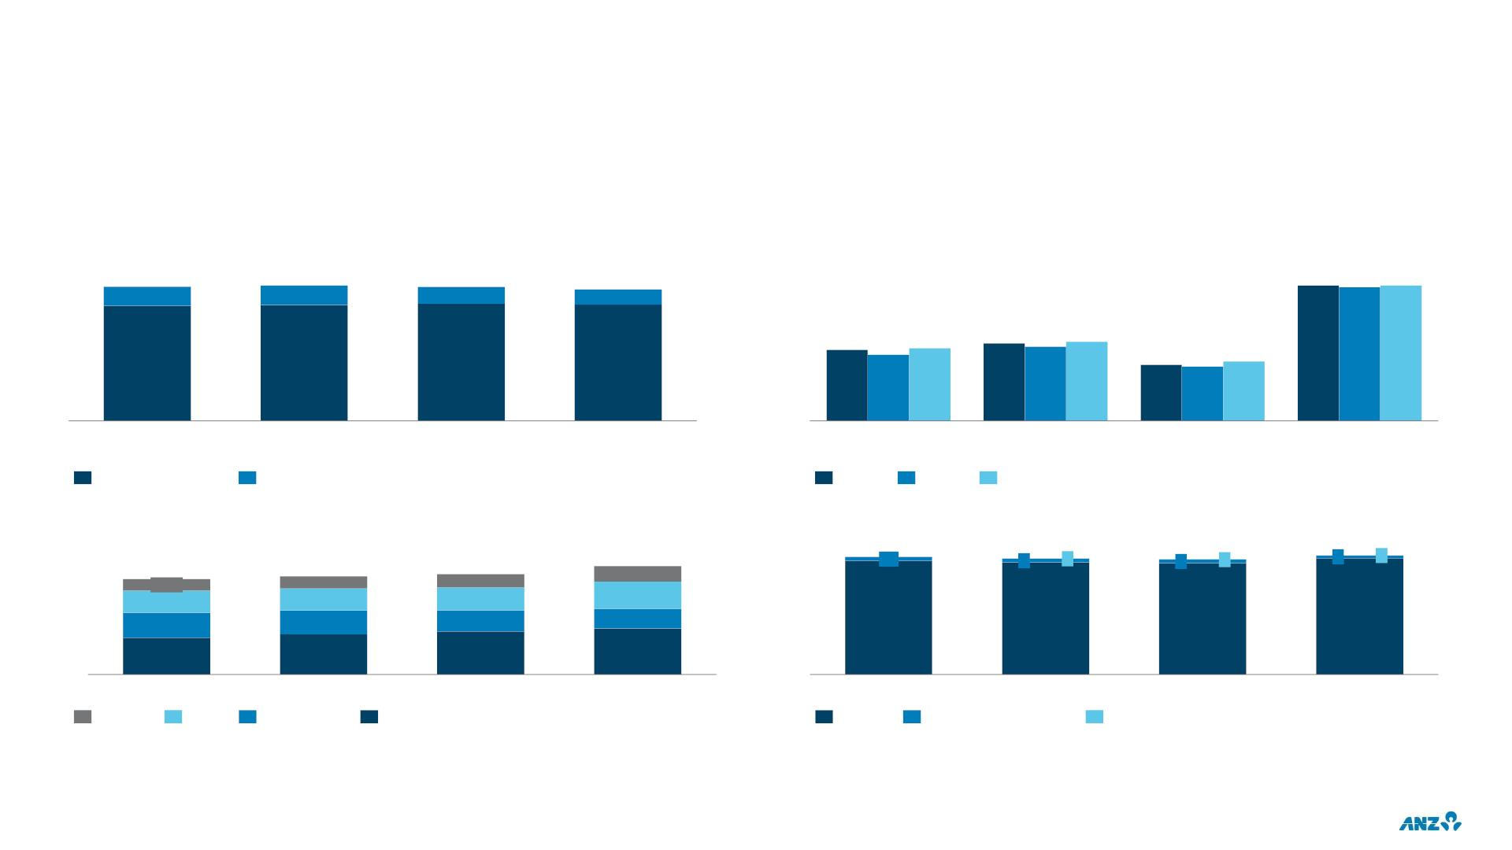
AUSTRALIA RETAIL
CONTINUING OPERATIONS EXCLUDING LARGE / NOTABLE ITEMS
INCOME
MARKET SHARE¹
$m
3,217
14%
3,244
14%
3,214
13%
3,152
12%
%
18.2 18.1 18.2
14.3
14.0
14.4
14.7
14.5
14.8
86%
86%
87%
88%
13.4 13.3
Housing
13.6
1H19
2H19
1H20
2H20
Housing
(Total)
Housing
(Owner occupier)
(Investor)
Credit Cards
Net Interest Income
Other Operating Income
Sep-19
Mar-20
Aug-20
CUSTOMER DEPOSITS
NET LOANS & ADVANCES
$b
133.5
$b
279
10
275
273
282
0
117.4
14.4
26.9
120.9
15.1
27.1
123.4
16.4
28.1
9
1
8
1
7
19.4
33.2
24.2
30.9
45.2
29.4
26.0
269
265
264
275
49.3
52.9
56.7
Mar-19
Sep-19
Mar-20
Sep-20
Mar-19
Sep-19
Mar-20
Sep-20
Transact
Offset
Term Deposit
Savings
Housing
Cards & Personal loans
Other
Additional portfolio disclosures (exposure by state, repayment profile and dynamic LVR) are provided in the customer support (COVID-19) section of the Investor Discussion Pack
1. Source: APRA Monthly Authorised Deposit-taking Institution Statistics
40

Slide 42
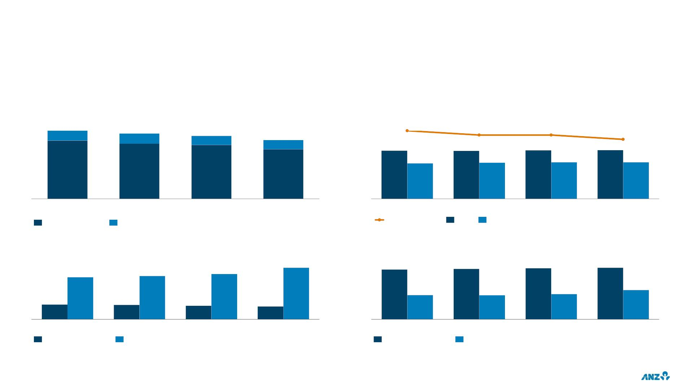
AUSTRALIA COMMERCIAL
CONTINUING OPERATIONS EXCLUDING LARGE / NOTABLE ITEMS
INCOME
RISK WEIGHT INTENSITY
$m
1,590
15%
$b
65.7%
64.7%
64.7%
71.2
1,524
16%
1,469
15%
1,371
16%
63.7%
71.3
70.7
70.3
52.0
52.9
53.5
53.7
85%
84%
85%
84%
1H19
2H19
1H20
2H20
1H19
2H19
1H20
2H20
Net Interest Income
Other Operating Income
Total CRWA/EAD
EAD
RWA
SMALL BUSINESS BANKING
BUSINESS BANKING
$b
49.9
$b
40.8
41.3
41.8
42.3
40.6
41.8
43.8
19.8
19.7
20.6
23.9
14.3
13.8
13.0
12.3
Mar-19
Net Loans & Advances
Sep-19
Customer Deposits
Mar-20
Sep-20
Mar-19
Net Loans & Advances
Sep-19
Customer Deposits
Mar-20
Sep-20
Additional portfolio disclosures (exposure by state, security profile & industry) are provided in the customer support (COVID-19) section of the Investor Discussion Pack
41

Slide 43
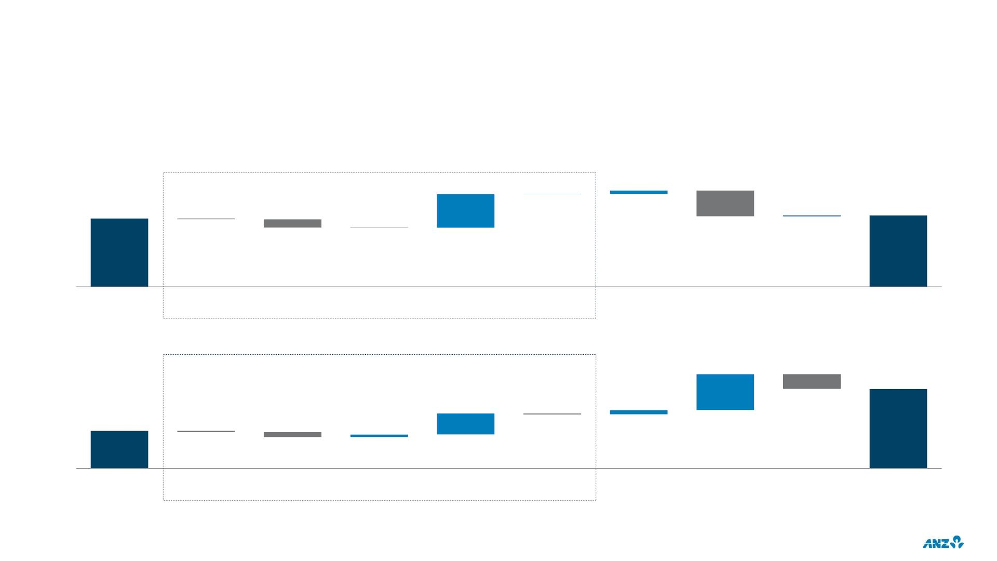
INSTITUTIONAL
CASH PROFIT DRIVERS: CONTINUING OPERATIONS EXCLUDING LARGE / NOTABLE ITEMS
FY20 CASH PROFIT DRIVERS
$m
Total income
5
95
906
1,852
26
1,930
-30
-218
PCM¹
-696
-10
+13%
-4%
Large
-3%
+4%
FY19
Trade¹
Corporate
Finance
Markets
Other
Expenses
Provisions
Tax
FY20
2H20 CASH PROFIT DRIVERS
$m
Total income
589
1,308
344
70
-242
622
43
-14
-22
-82
+10%
-5%
-92%
+96%
+110%
1H20
Trade¹
PCM¹
Corporate
Finance
Markets
Other
Expenses
Provisions
Tax
2H20
1. Trade: Trade & Supply Chain; PCM: Payments & Cash Management
42

Slide 44
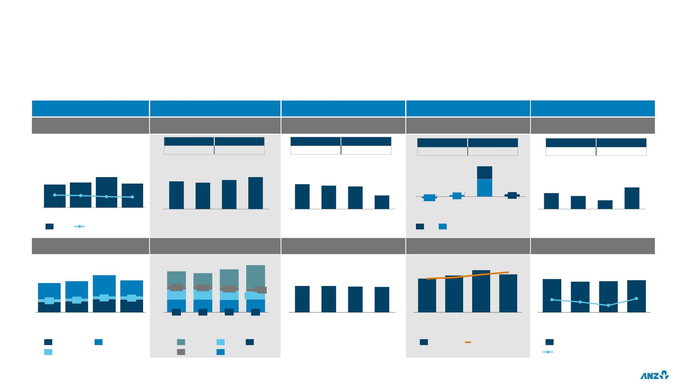
INSTITUTIONAL
FINANCIAL PERFORMANCE: CONTINUING OPERATIONS EXCLUDING LARGE / NOTABLE ITEMS
Balance sheet
Income
Expenses / FTE
Credit Quality / RWAs
Profit and Returns
NLAs¹ ($b) & NIM
Customer & Non-customer ($m)
Expenses ($m)
Total Provisions ($m)
Cash Profit ($m)
FY19
5,198
FY20
5,851
FY19
2,575
FY20
2,480
FY19
-3
FY20
693
FY19
1,852
FY20
1930
641
152
165
199
158
2,657
2,541
2H19
2,791
1H20
3,060
1,293
272
369
2.07%
1,282
2H19
1,275
1,004
1H19
1,308
1.99%
1.81%
1.75%
1,205
2H20
-13
-21
-34
31
33
-2
52
49
848
622
3
Mar-19 Sep-19 Mar-20 Sep-20
NLA NIM ex Markets
1H19
2H20
1H19
1H20
1H19
2H19
CP
1H20
2H20
2H19
1H20
2H20
IP
Customer Deposits ($b)
Product contribution² ($m)
FTE
Risk Weighted Assets ($b)
Return
2,657
940
2,791
1,164
3,060
207
259
223
2,541
826
234
652
166
181
187
3.22%
1.22%
3.11%
1.33%
204
113
217
122
1,508
209
5,469
5,458
5,350
5,291
171
(avg)
185
(avg)
197
(avg)
2.97%
0.99%
3.02%
147
112
236
644
231
580
166
(avg)
18
73
18
77
19
92
21
90
498
0.67%
1H20
815
23
810
19
786
31
829
Mar-19 Sep-19 Mar-20 Sep-20
16
Mar-19 Sep-19 Mar-20 Sep-20
Mar-19 Sep-19 Mar-20 Sep-20
1H19
2H19
2H20
1H19
2H19
1H20
2H20
Aust & PNG
NZ
International
Markets
Trade
PCM
CF
Other
RWA EOP
RWA AVG
Revenue/Avg RWA
Return on Avg RWA³
1. NLAs: Net Loans & Advances
2. Trade: Trade & Supply Chain; PCM: Payments & Cash Management; CF: Corporate Finance
3. Cash profit divided by average risk weighted assets
43

Slide 45
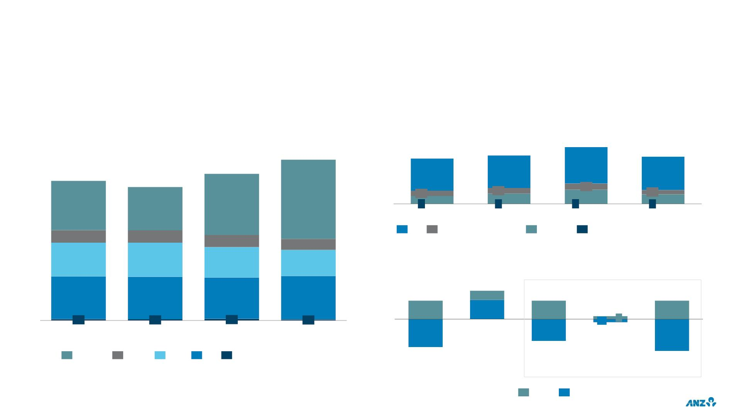
INSTITUTIONAL
CONTINUING OPERATIONS EXCLUDING LARGE / NOTABLE ITEMS
INSTITUTIONAL INCOME COMPOSITION¹
NET LOANS & ADVANCES^{1,2}
$m
$m
162
190
3,060
152
107
158
111
2,791
109
19
122
20
2,657
940
2,541
826
1,508
18
34
48
14
32
26
Mar-19
CF Transaction Banking
1,164
0
0
0
0
Sep-19
Mar-20
Others
Sep-20
236
644
234
652
Markets
231
580
209
498
CREDIT RWA MOVEMENTS
Net $1b increase in credit RWA year on year
$b
9
excl. FX & Risk Migration
815
810
786
829
3
6
6
6
0
6
23
19
31
16
-1
1
1H19
2H19
1H20
2H20
-9
-7
-10
-3
-1
Markets
Trade
PCM
CF
Other
-4
FX
Risk Migration
Aus & PNG
1H20
NZ
International
1. Trade: Trade & Supply Chain; PCM: Payments & Cash Management; CF: Corporate Finance
2. Prior periods are FX adjusted
2H20
44

Slide 46
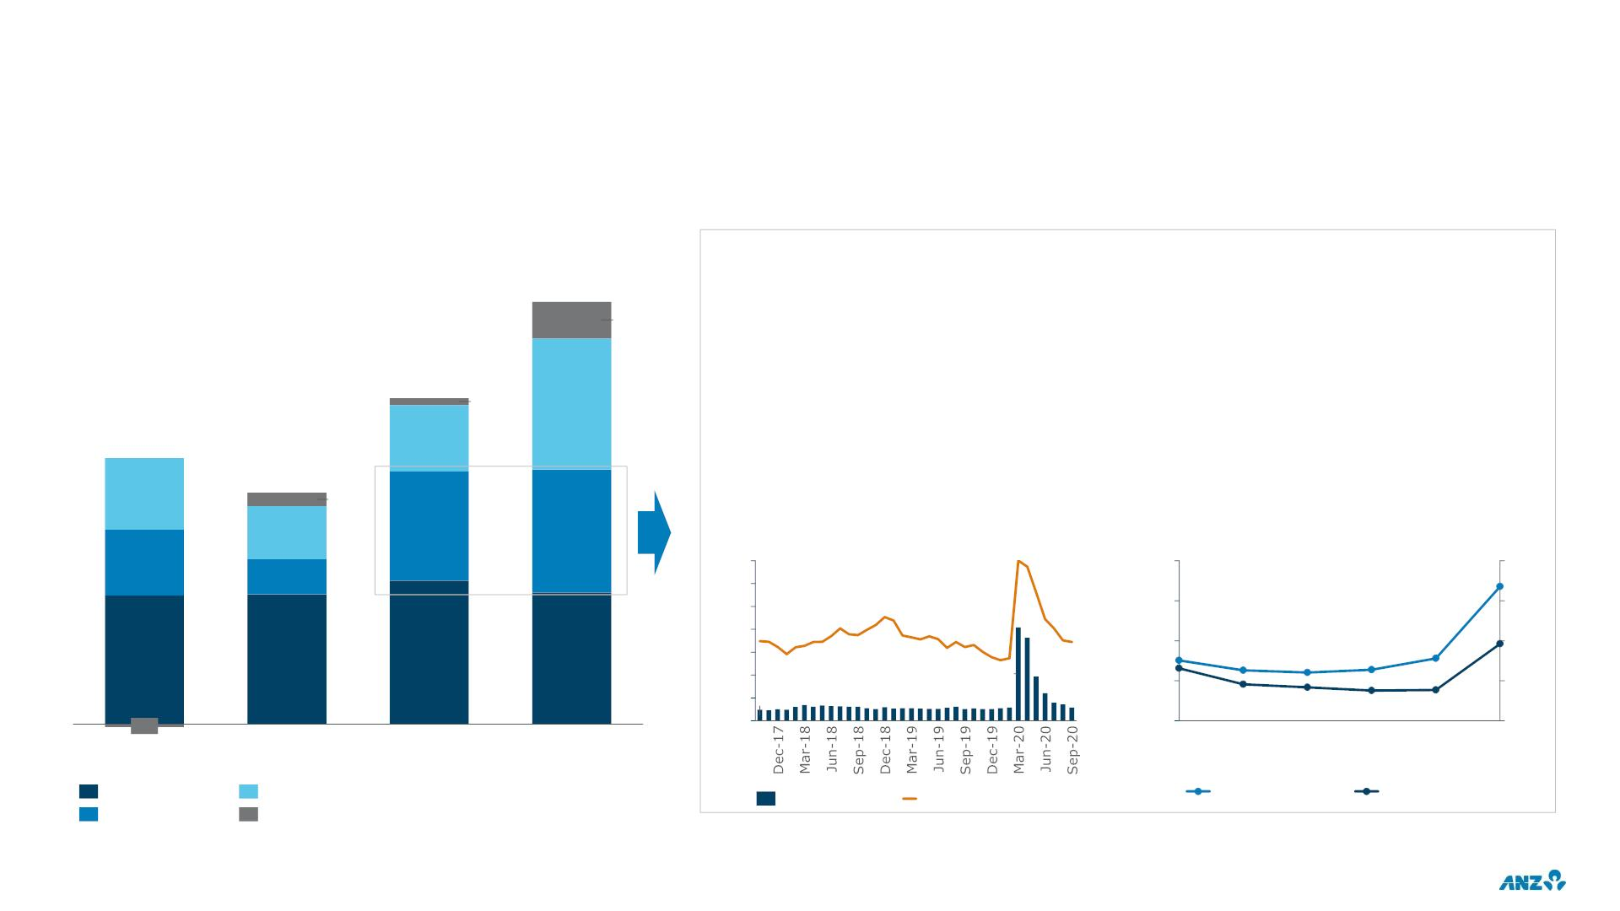
INSTITUTIONAL
CONTINUING OPERATIONS EXCLUDING LARGE / NOTABLE ITEMS
MARKETS INCOME COMPOSITION
DRIVERS OF FRANCHISE TRADING REVENUE GROWTH
$m
1. Customer-led revenue growth resulting from supporting customer hedging activity, while the market was
1,508
468
trading at wider bid-offer spreads
131
2. Revenue uplift was not reliant on increased risk. VaR increase driven by COVID volatility rolling into
VaR windows and higher liquid asset holdings.
1,164
238
3. Supported customers by remaining ‘open for business’ amidst market volatility, providing two-way
24
pricing for customers
940
256
4. Operational capability to attract and clear additional volume, that was at times 20%+ above average
(achieved while operating hubs were operating under Business Continuity Plan arrangements)
826
48
AUS. CORPORATE CREDIT DEFAULT
SWAP & BID OFFER SPREADS
MARKETS AVG VALUE AT RISK (99% VAR)
190
126
388
438
bps
$m
235
459
14
12
10
8
145
80
40
30
20
10
60
67
67
40 30
20
31
463
513
471
6
25
24
26
19
4
8.2
13
2 1.0
9
8
8
8
-10
1H18
2H18
1H19
2H19
1H20
2H20
1H19
2H19
1H20
2H20
Franchise Sales
Balance Sheet
Bid Offer (LHS)
Credit Spread (RHS)
Non-traded (LHS)
Traded (RHS)
Franchise Trading
Derivative val/n adj.
45

Slide 47
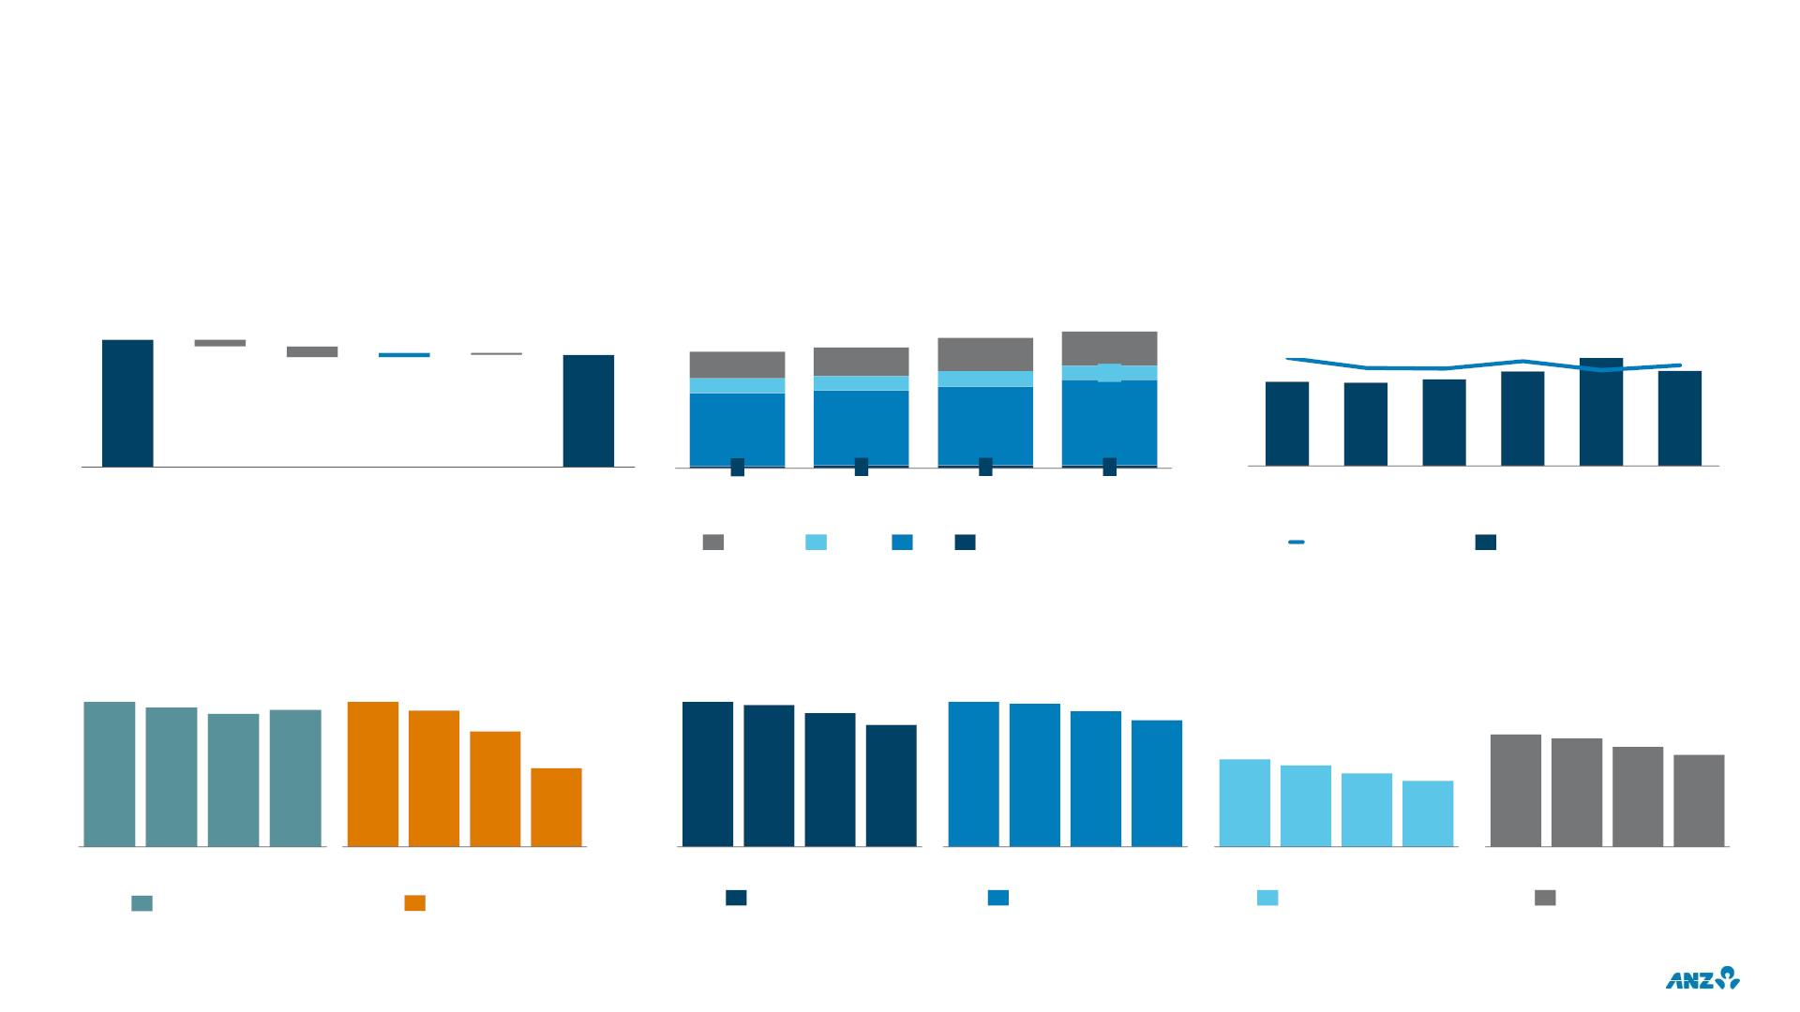
INSTITUTIONAL
RISK WEIGHTED ASSETS & RISK ADJUSTED RETURNS: CONTINUING OPERATIONS EXCLUDING LARGE / NOTABLE ITEMS
CREDIT RWA (EOP)
CREDIT RWA (AVG)¹
CREDIT RWA INTENSITY (EOP)
$b
178
$b
167
$b
6
157
142
147
159
34.5%
34.0%
-9
-3
33
18
35
18
41
19
42
17
33.1%
33.0%
32.8%
178
33.5%
-15
89
91
96
104
139
138
143
156
157
Mar-20
FX
Volume
Risk
migration
Derivatives Sep-20
2
4
4
4
Mar-18
Sep-18
Mar-19
Sep-19
CRWA
Mar-20
Sep-20
1H19
2H19
1H20
2H20
Markets
Trade
CF
Other
Credit RWA / EAD
NIM
RISK ADJUSTED NIM⁴
bps
bps
134
129
123
127
84
79
268
262
247
256
252
239
224
67
225
233
224
181
168
207
190
46
152
136
1H19 2H19 1H20 2H20
Lending NIM²
1H19 2H19 1H20 2H20
Deposit NIM³
1H19 2H19 1H20 2H20
Aus & PNG
1H19 2H19 1H20 2H20
NZ
1H19 2H19 1H20 2H20
International
1H19 2H19 1H20 2H20
Institutional
1. Trade: Trade and Supply Chain; CF: Corporate Finance
2. Lending NIM represents Corporate Finance and Trade
3. Deposit NIM represents Payments & Cash Management (PCM)
4. Institutional ex-Markets Net Interest Income divided by average Credit Risk Weighted Assets
46

Slide 48
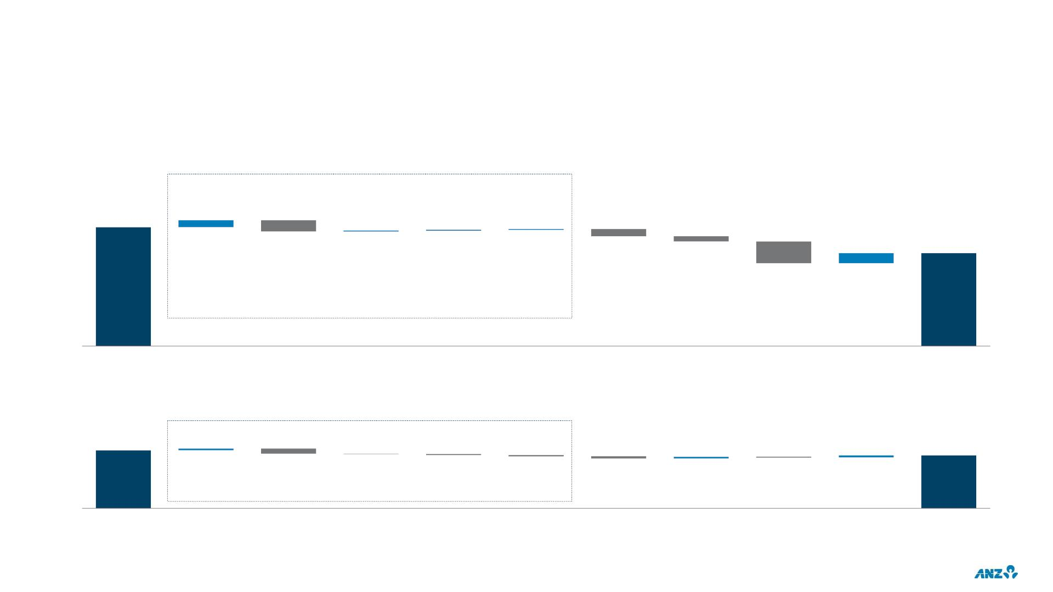
NEW ZEALAND DIVISION
CASH PROFIT DRIVERS: CONTINUING OPERATIONS EXCLUDING LARGE / NOTABLE ITEMS
FY20 CASH PROFIT DRIVERS
NZDm
Net interest income (NII)
1,460
86
10
12
9
-139
-88
-65
123
-22%
Tax
1,144
-22%
FY20
-264
-1%
-15%
5%
Large
FY19
Retail
volume
Retail
margin
Commercial
volume
Commercial
margin
Other net
interest
income
Other
Operating
Income
Expenses
Provisions
2H20 CASH PROFIT DRIVERS
NZDm
Net interest income (NII)
598
17
18
22
546
-52
-2
-13
-10
-24
-8
-4%
-9%
-3%
5%
-9%
-9%
1H20
Retail
volume
Retail
margin
Commercial
volume
Commercial
margin
Other net
interest
income
Other
Operating
Income
Expenses
Provisions
Tax
2H20
47

Slide 49
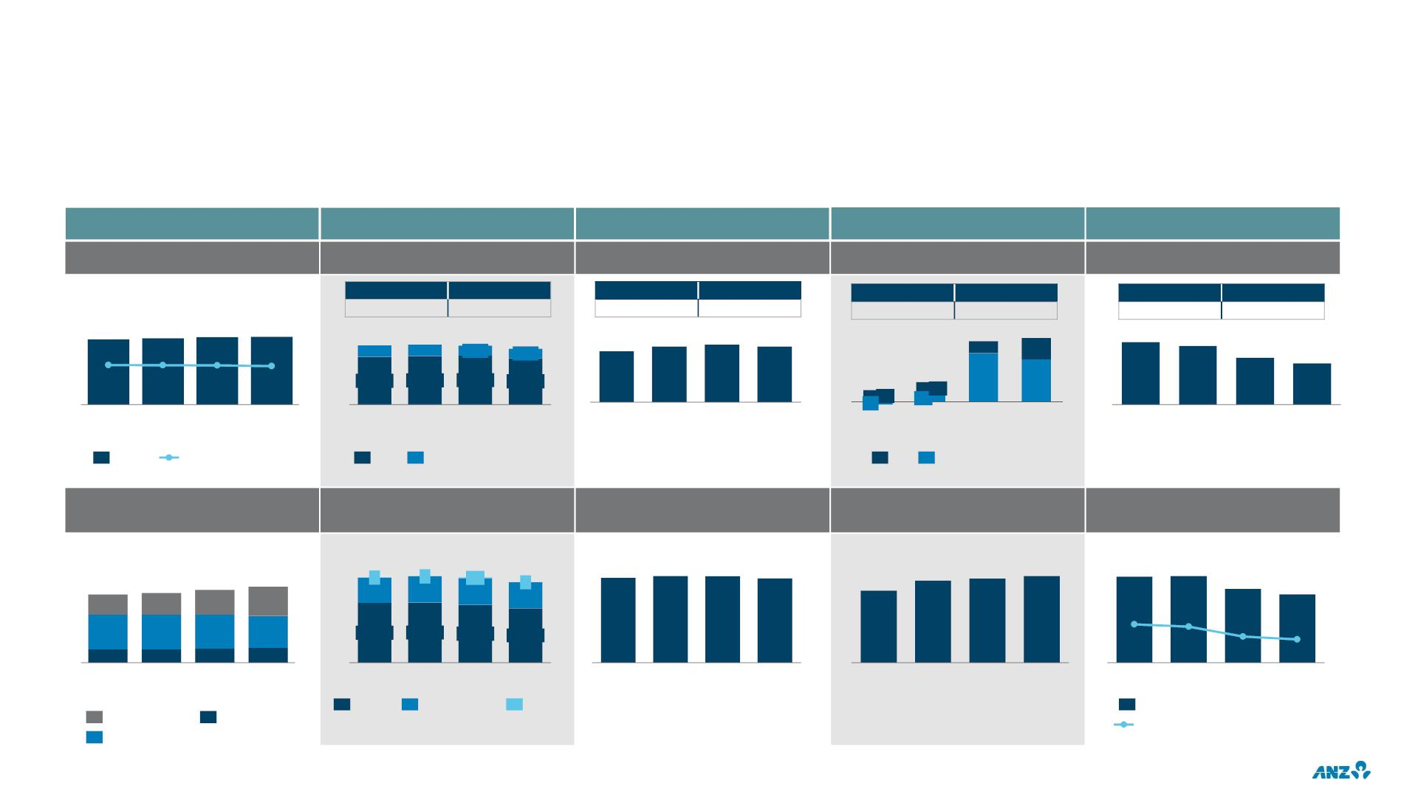
NEW ZEALAND DIVISION
FINANCIAL PERFORMANCE: CONTINUING OPERATIONS EXCLUDING LARGE / NOTABLE ITEMS
Balance sheet
Income
Expenses / FTE
Credit Quality / RWAs
Profit and Returns
NLAs¹ (NZDb) & NIM
NII/OOI² contribution (NZDm)
Expenses (NZDm)
Total Provisions (NZDm)
Cash Profit (NZDm)
FY19
3,396
FY20
3,286
FY19
1,289
FY20
1,354
FY19
78
FY20
342
FY19
1,460
FY20
1,144
121
123
125
126
1,687 1,709 1,685
295 301 266
1,601
242
622
667
686
668
167
33
175
59
749
711
2.33%
2.30%
2.28%
2.16%
598
546
1,392 1,408 1,419 1,359
1H19 2H19 1H20 2H20
24
32
54
35
134
116
1H19
2H19
1H20
2H20
-8
1H19
19
2H19
1H19
2H19
1H20
2H20
1H20
2H20
1H19
2H19
1H20
2H20
NLAs
NIM%
NII
OOI
IP
CP
Customer Deposits (NZDb)
Business contribution (NZDm)
FTE
Risk Weighted Assets EOP
(NZDb)
Return
1,687 1,709 1,685
1,601
5
469
5,796 5,910 5,897 5,761
68
69
71
5.76% 5.80%
88
26
90
28
94
32
98
38
6
7
13
484
59
4.94%
1.75%
4.58%
458
474
2.56%
2.41%
1.56%
2H20
45
17
45
17
44
18
41
19
1,223 1,228 1,188
1,127
2H20
Mar-19 Sep-19 Mar-20 Sep-20
1H19
Retail
2H19
1H20
Mar-19 Sep-19 Mar-20 Sep-20
Mar-19 Sep-19 Mar-20 Sep-20
1H19
2H19
1H20
Transact
Savings
Commercial
Other
Revenue / Avg RWA
Return on Avg RWA³
Term Deposit
1. NLAs: Net Loans & Advances
2. NII: Net Interest Income; OOI: Other Operating Income
3. Cash profit divided by average Risk Weighted Assets
48

Slide 50
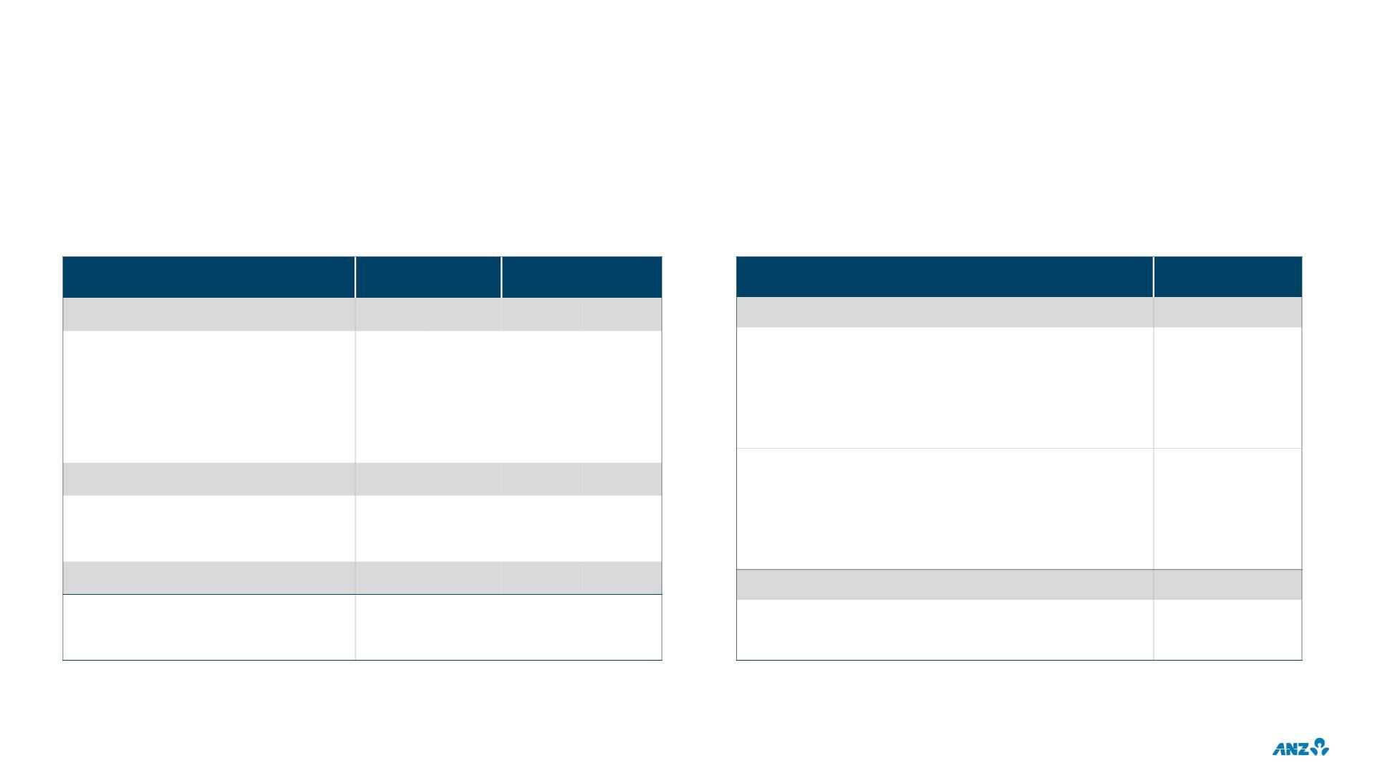
NEW ZEALAND GEOGRAPHY
PROFIT & LOSS / BALANCE SHEET
DEPOSITS & WHOLESALE FUNDING
Half Year
Full Year
FY19
NZDb
Sep-20
NZDm
1H20
1,992
1,648
344
2H20
2,057
1,581
476
FY20
4,049
3,229
820
TOTAL DEPOSITS
120.9
98.3
41.4
40.3
16.6
22.6
8.7
Operating Income
4,326
3,232
1,094
1,585
2,741
99
Retail & Commercial (New Zealand Division)
Term deposits
Net Interest Income
Other Operating Income
Operating Expenses
Profit before provisions
Credit impairment charge
Income tax expense
Interest bearing deposits
Non interest bearing deposits
Institutional
828
908
1,736
2,313
401
1,164
232
1,149
169
Term deposits
Interest bearing deposits
Non interest bearing deposits
WHOLESALE FUNDING
Short term
9.6
255
286
709
541
4.3
Cash profit
677
694
1,933
133.3
109.2
1,371
133.0
120.9
28.0
4.2
Net loans and advances (NZDb)
Customer deposits (NZDb)
135.7
113.4
133
120.9
Long term
23.8
49

Slide 51
2020
FULL YEAR RESULTS
INVESTOR DISCUSSION PACK
TREASURY

Slide 52
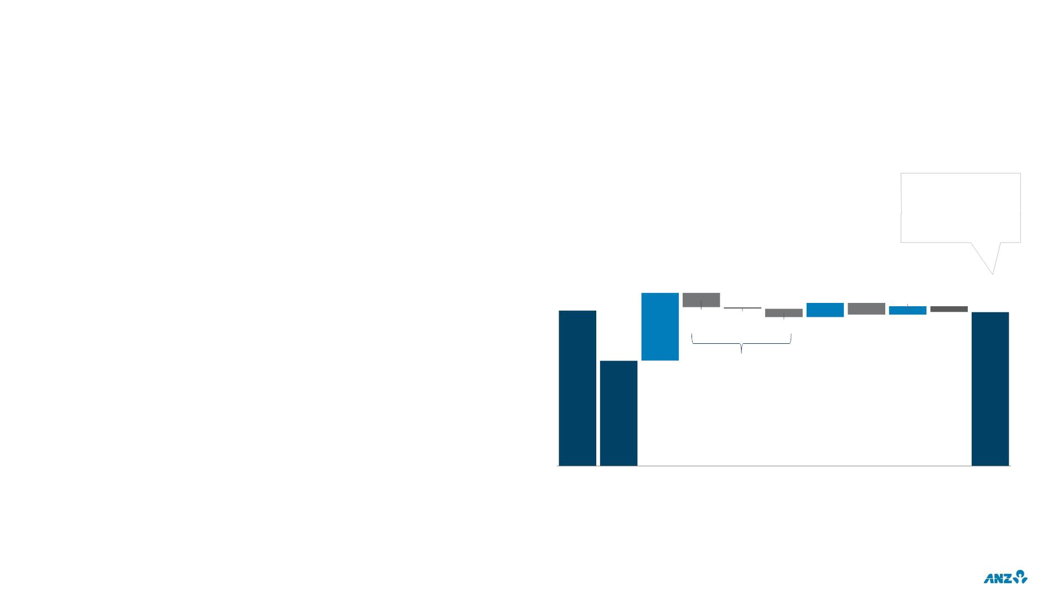
REGULATORY CAPITAL
CAPITAL UPDATE
.
Level 2 CET1 ratio of 11.3% (~11.4% pro-forma) and 16.7% on an Internationally
Comparable basis¹), which is well in excess of ‘Unquestionably Strong’ benchmark²
APRA LEVEL 2 COMMON EQUITY TIER 1 RATIO (CET1)
.
Credit impacts of -29bps for the half;
%
.
Comprises $669m CP, $395m IP and $3.9b of CRWA migration (mainly
Institutional)
Pro-Forma CET1
.
.
.
The above were partially offset by a reduction in underlying CRWA of $13.9b
(~+36bps) predominantly in the International business
ratio of ~11.4%
with conversion of
NZ$500m Capital
Note
Underlying non-CRWA increased $7.4b (-19bps), including Interest Rate Risk in
the Banking Book (IRRBB) from higher volatility and increased liquid assets.
Completion of announced asset sale of UDC added 10bps to the Level 2 CET1
ratio
.
.
.
CET1 ratio is broadly restored to Sep-19 levels (pre COVID-19) despite absorbing
76bps of credit impacts ($2.7b of CIC and $6.5b of CRWA Migration)
0.81
0.17
11.36
0.10
11.34
APRA Level 1 CET1 ratio of 11.2%. Level 1 primarily comprises ANZ BGL (the
Parent including offshore branches) but excludes offshore banking subsidiaries³
-0.17
-0.02
-0.10
-0.14
-0.07
Leverage ratio of 5.4% (or 6.0% on an Internationally Comparable basis)
10.76
Dividend
Total impact of -29bps
.
.
Interim Dividend of 25 cps paid in September (~10.6% DRP/BOP participation)
Final Dividend of 35 cps fully franked representing 49% DPOR on 2H20 statutory
earnings. On a Cash ex LNI basis, the Final 20 Dividend represents ~35% DPOR
Regulatory Update
.
APRA has extended the exemption to treat loans granted repayment deferrals as
part of COVID-19 support package as restructured for capital treatment purposes
until 31 March 2021 at the latest
Sep-19 Mar-20
Cash
Profit
(ex. CIC)⁴
CIC
(net of
tax)
Net DTA
on CIC Migration Business Dividends Divest-
RWA (net of ments
Movement DRP)
Risk Underlying Interim
Asset
_{Other}5
Sep-20
.
APRA will commence consultation on capital reforms incorporating APRA’s
unquestionably strong framework, Basel III and measures to improve
transparency, comparability and flexibility
1. Internationally Comparable methodology aligns with APRA’s information paper entitled International Capital Comparison Study (13 July 2015). Basel III Internationally Comparable ratios do not
include an estimate of the Basel I capital floor 2. Based on APRA information paper “Strengthening banking system resilience – establishing unquestionably strong capital ratios” released in July
2017. 3. Refer to ANZ Basel III APS330 Pillar 3 disclosures 4. Excludes large / notable items & one-off items 5. Other impacts include capital deductions (which mainly comprises the movement
in retained earnings in deconsolidated entities and capitalised software), net imposts, movements in non-cash earnings, net foreign currency translation and impacts from large/notable
adjustments (non-capital deduction related)
51

Slide 53
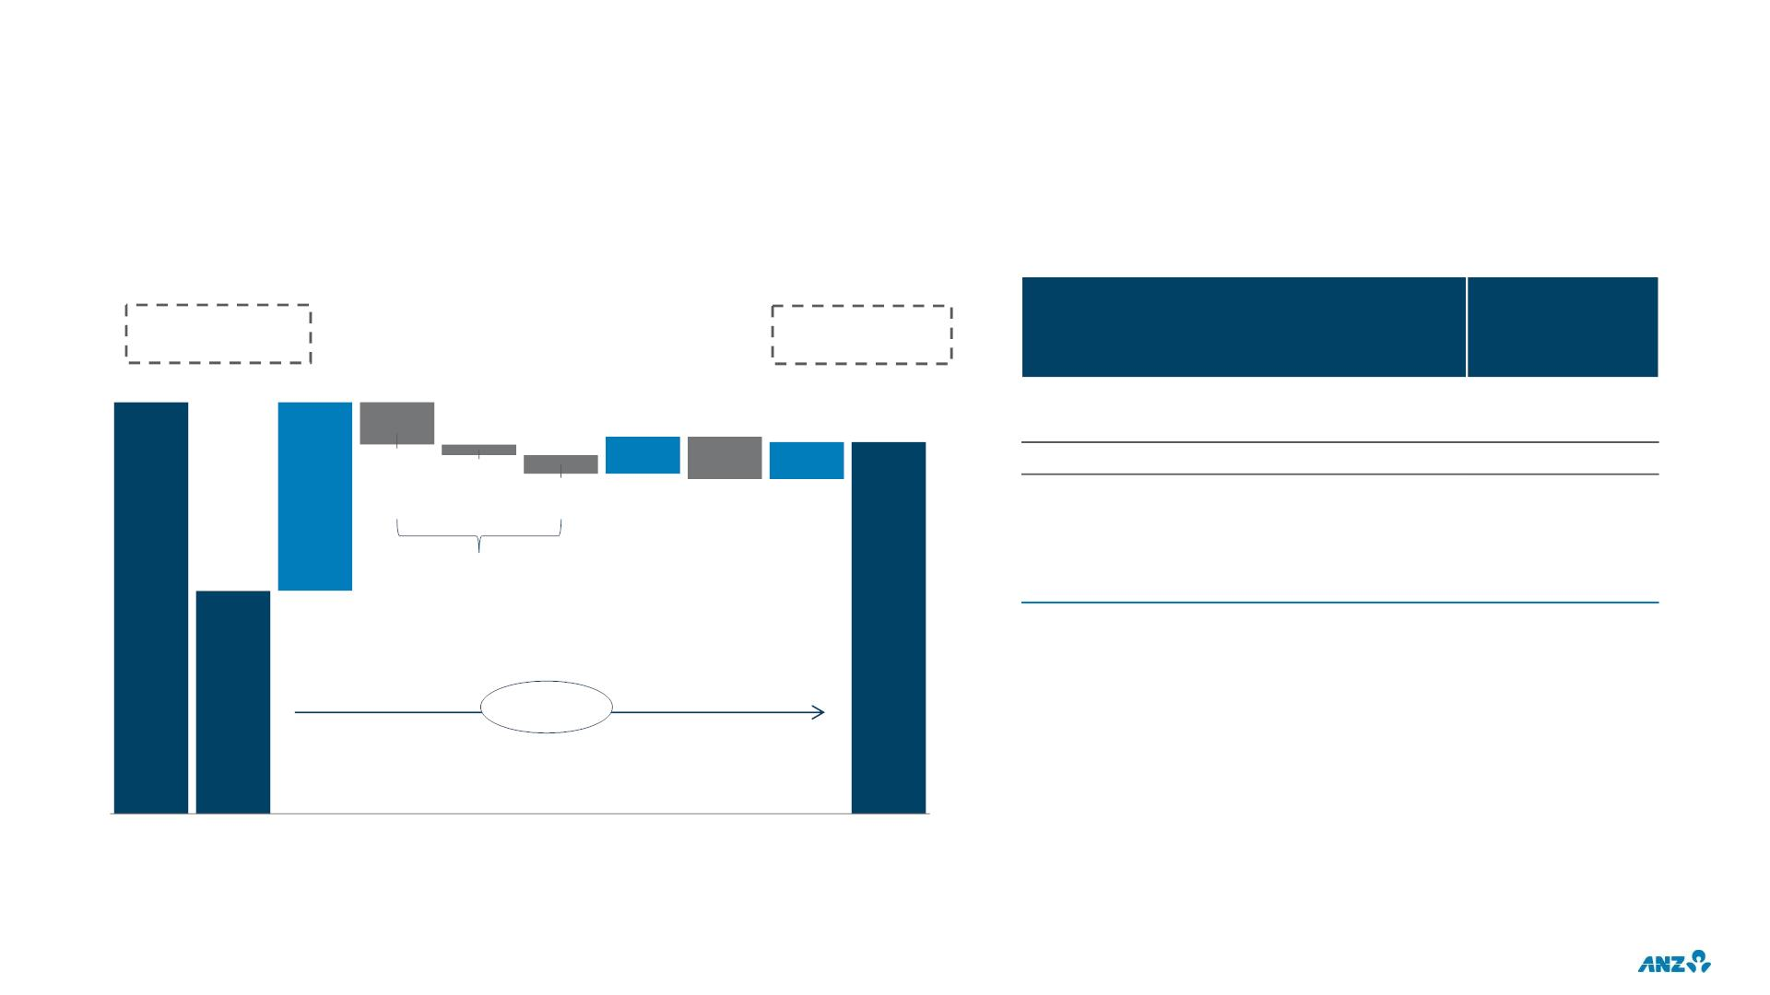
REGULATORY CAPITAL
APRA LEVEL 1 CET1 RATIO
%
Level 2:
10.76
Level 2:
11.34
APRA LEVEL 2 VS LEVEL 1 CET1 RATIOS
Bps
11.35
0.71
Level 2 HoH mvmt
Level 1 HoH mvmt
Level 2 vs Level 1 Mvmt
Explained by
58
56
2
0.14
0.14
11.20
-0.16
-0.04
-0.07
-0.16
Cash Profit¹
10
10
Total impact of -27bps
Asset Divestment
Other
10.64
-18
. Level 2 includes Cash earnings and RWA movement from ANZ
subsidiaries (e.g. ANZ Bank New Zealand) that are outside of
Level 1.
+56bps
. Level 2 CET1 ratio HoH increase is +2bps higher than Level 1:
. +20bps due to retention of earnings and benefits from
UDC asset sale in ANZ NZ and not remitted as dividends
into the Level 1 entity;
Sep-19
Mar-20 Cash Profit
CIC
Net DTA
on CIC
Risk
Underlying
Interim
Other²
Sep-20
(ex. CIC)¹ (net of tax)
Migration Business Dividends
. Largely offset by 18bps of L1 benefit (not in L2) from
RWA
Movement
(net of
DRP)
decline in IG RWA and net FX impacts.
1. Excludes large/notable items & one-off items 2. Other impacts include capital deductions (which mainly comprises the movement in retained earnings in deconsolidated entities and capitalised
software), net imposts, movements in non-cash earnings, net foreign currency translation and impacts from large/notable adjustments (non-capital deduction related)
52

Slide 54
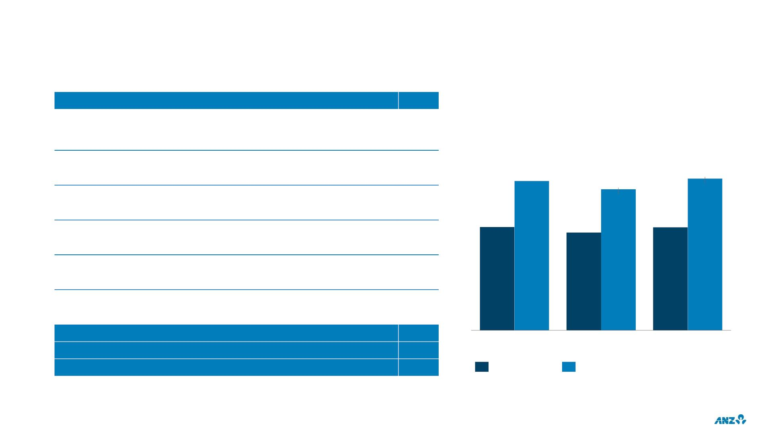
INTERNATIONALLY COMPARABLE¹ REGULATORY CAPITAL POSITION
APRA Level 2 CET1 Ratio– 30 September 2020
11.3%
Level 2 CET1 Ratio
Corporate
undrawn EAD
and unsecured
LGD adjustments
Australian ADI unsecured corporate lending LGDs and undrawn
CCFs exceed those applied in many jurisdictions
1.7%
%
Equity
Investments &
DTA
APRA requires 100% deduction from CET1 vs. Basel framework
which allows concessional threshold prior to deduction
0.9%
1.3%
0.8%
0.4%
0.3%
16.4
16.7
15.5
APRA requires use of 20% mortgage LGD floor vs. 10% under
Basel framework. Additionally, APRA also requires a higher
correlation factor vs 15% under Basel framework
Mortgages
11.4
10.8
11.3
Specialised
Lending
APRA requires supervisory slotting approach which results in
more conservative risk weights than under Basel framework
IRRBB RWA
Other
APRA includes in Pillar 1 RWA. This is not required under the
Basel framework
Includes impact of deductions from CET1 for capitalised
expenses and deferred fee income required by APRA, currency
conversion threshold and other retail standardised exposures
Basel III Internationally Comparable CET1 Ratio
Basel III Internationally Comparable Tier 1 Ratio
Basel III Internationally Comparable Total Capital Ratio
16.7%
19.1%
23.3%
Sep-19
Mar-20
Sep-20
APRA Level 2
Internationally Comparable¹
1. Internationally Comparable methodology aligns with APRA’s information paper entitled International Capital Comparison Study (13 July 2015). Basel III Internationally Comparable ratios
do not include an estimate of the Basel I capital floor
53

Slide 55
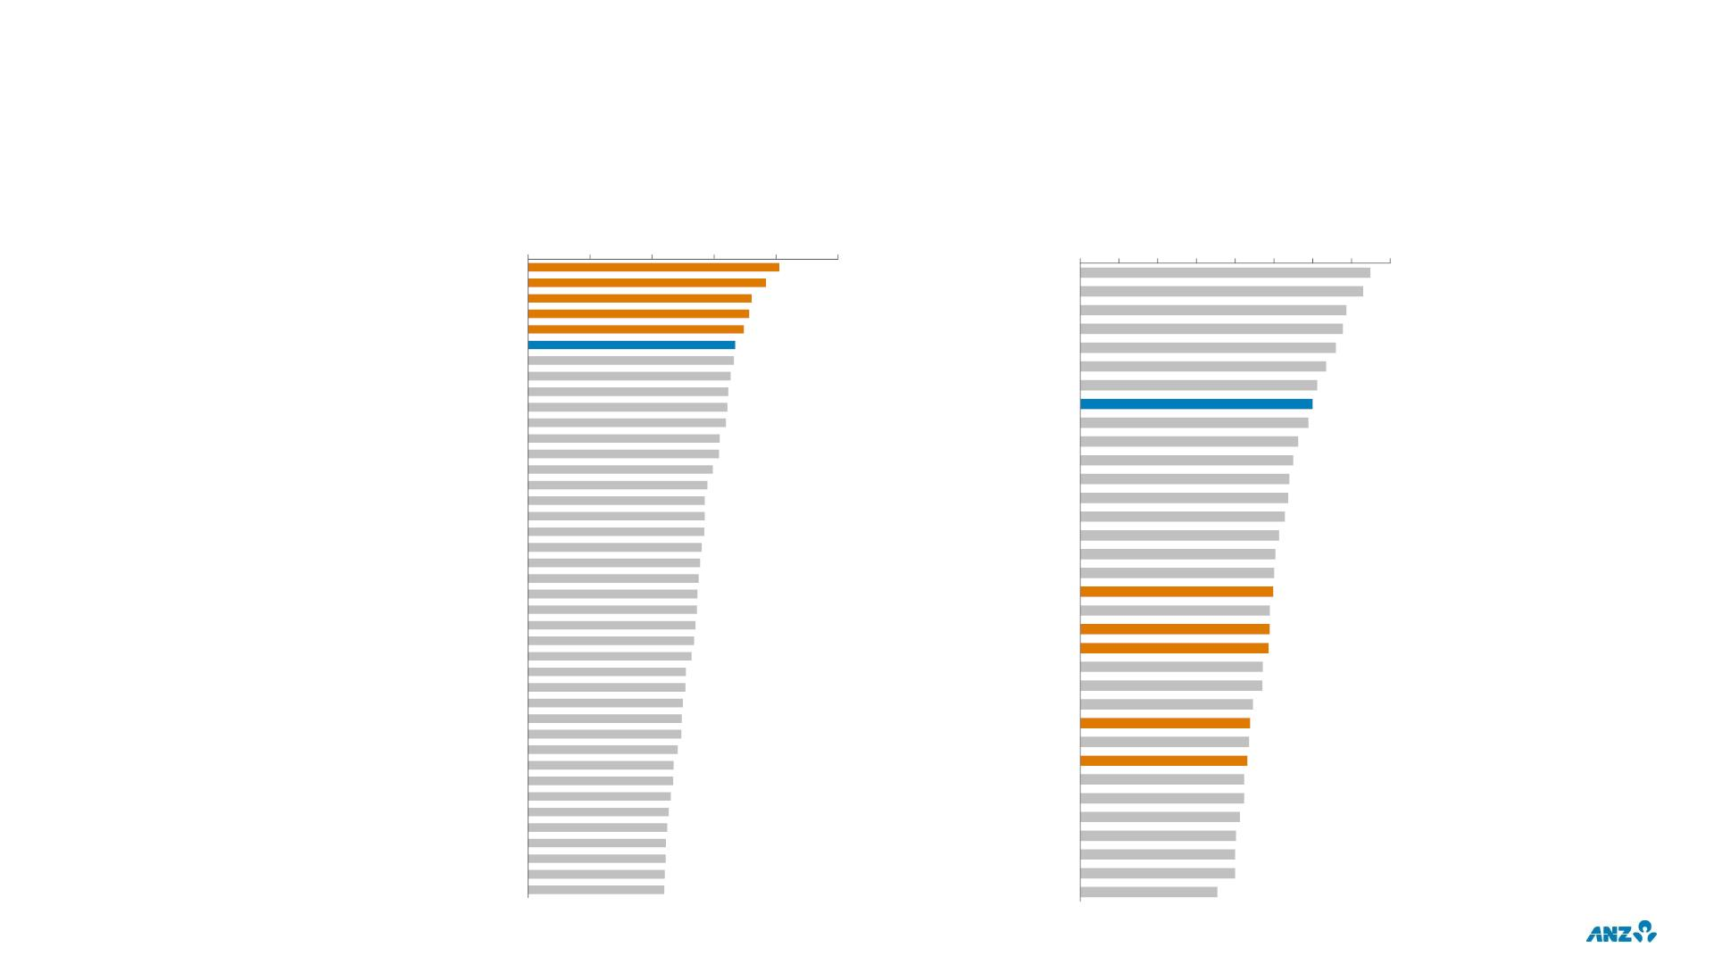
CET1 AND LEVERAGE IN A GLOBAL CONTEXT
CET1 RATIOS^{1,2}
LEVERAGE RATIOS^{1,2,3}
0%
SEB
5%
10%
15%
20%
25%
0% 1% 2% 3% 4% 5% 6% 7% 8%
Svenska Handelsbanken
Swedbank
ABN Amro
Danske Bank
ANZ
OCBC
UOB
Intesa Sanpaolo
DBS
CET1
.
.
Regulators globally have
provided specific COVID-19
related transitional
Rabobank
Natwest
Erste Bank
Raiffeisen Bank International (RBI)
BBVA
Leverage
ANZ compares equally well
on leverage, however
international comparisons
are more difficult to make
given the favourable
treatment of derivatives
under US GAAP
arrangements, ANZ has utilised
public CET1 levels and adjusted
for Capital treatment of ECL
provisioning where available
No adjustments have been
made for RWA concessions
related to COVID-19 (i.e.
mortgage deferrals)
Nordea
ANZ
Rabobank
UBS
Credit Suisse
HSBC
Morgan Stanley
Credit Agricole Group
ING Group
Groupe BPCE
HSBC
Intesa Sanpaolo
Standard Chartered
OCBC
UniCredit
Credit Agricole Group
Natwest
Standard Chartered
Nordea
Erste Bank
UOB
UniCredit
UBS
DBS
ABN Amro
Groupe BPCE
Swedbank
SEB
Commerzbank
Santander
ING Group
Danske Bank
Barclays
Raiffeisen Bank International (RBI)
Barclays
Commerzbank
Deutsche Bank
JP Morgan
State Street
Credit Suisse
BNP Paribas
Societe Generale
TD
RBC
Svenska Handelsbanken
Societe Generale
Deutsche Bank
Scotia
Goldman Sachs
Santander
BMO
BBVA
BMO
BNP Paribas
RBC
Citibank
Bank of America
Scotia
Wells Fargo
TD
1. CET1 and leverage ratios are based on ANZ estimated adjustment for accrued expected future dividends, COVID-19 transitional arrangements for expected credit loss and leverage exposure concessional adjustments where details have been externally
disclosed. ANZ ratios are on an Internationally Comparable basis. All data sourced from company reports and ANZ estimates based on last reported half/full year results assuming Basel III capital reforms fully implemented 2. Based on Group 1 banks as
identified by the BIS (internationally active banks with Tier 1 capital of more than €3 billion) 3. Includes adjustments for transitional AT1 where applicable. Exclude US banks as leverage ratio exposures are based on US GAAP accounting and therefore
incomparable with other jurisdictions which are based on IFRS
54

Slide 56
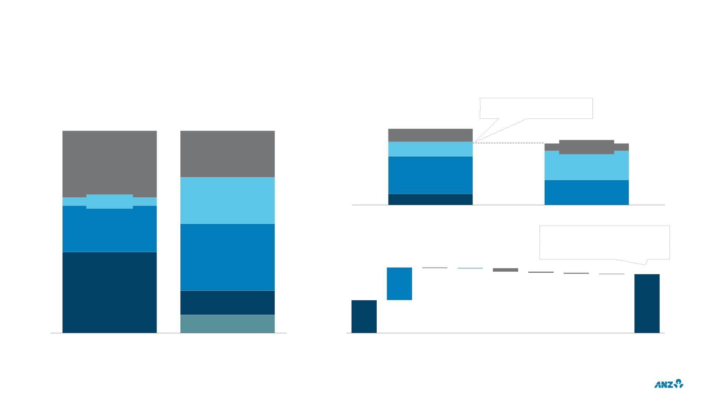
BALANCE SHEET STRUCTURE¹
BALANCE SHEET COMPOSITION
NSFR COMPOSITION
Sep-20
Sep-20
~$106b surplus of ASF above
regulatory minimum
$b
551
Wholesale
Funding & Other⁴
Non Financial
Corporates
445
Liquids
and Other Assets⁵
Short Term Wholesale Debt &
Other Funding²
Liquid and Other Assets
33% (-1% HoH)
23% (-5% HoH)
Other
Loans⁶
Retail/SME
Capital
Residential
Mortgages^{7,8}
<35%
FI Lending
4% (-2% HoH)
Corporate, PSE & Operational
Deposits
23% (flat HoH)
Available
Required
Non-FI Lending
23% (-1% HoH)
Stable Funding
Stable Funding
NSFR MOVEMENT
Pro-forma NSFR is ~128%¹⁰ inclusive
of remaining available TFF, and
Retail & SME Deposits
33% (+4% HoH)
~122%^{10,11} inclusive of remaining
available TFF and CLF reduced to zero.
9.3
0.0
123.8
-0.2
-1.0
-0.3
-0.3
-0.1
Mortgages
40% (+4% HoH)
116.4
Long Term Wholesale Debt³
12% (flat HoH)
Capital Incl. Hybrids & T2
9% (+1% HoH)
Assets
Funding
Sep-19
Retail/
Corp/
Loans
Captital & LT Debt³
Hybrids
Liquids
FI/Bank
& Repo
Other⁹
Sep-20
Operational
Deposits
1. NSFR Required Stable Funding (RSF) and Available Stable Funding (ASF) categories and all figures shown are on a Level 2 basis per APRA prudential standard APS210 2. Includes FI/Bank deposits, Repo funding and other
short dated liabilities 3. Includes drawn TFF of $12b 4. Wholesale Funding includes $12b drawn TFF, ‘Other’ includes Sovereign, and non-operational FI Deposits 5. ‘Other Assets’ include Off Balance Sheet, Derivatives, Fixed
Assets and Other Assets 6. All lending >35% Risk weight 7. Includes NSFR impact of self-securitised assets backing the Committed Liquidity Facility (CLF) 8. <35% Risk weighting as per APRA Prudential Standard 112
Capital Adequacy: Standardised Approach to Credit Risk 9. Net of other ASF and other RSF 10. Remaining TFF includes ~$8n of Supplementary TFF and ~$4.4b of Additional TFF as at 1 October 2020 11. CLF is ~36b as at 30
September 2020
55

Slide 57
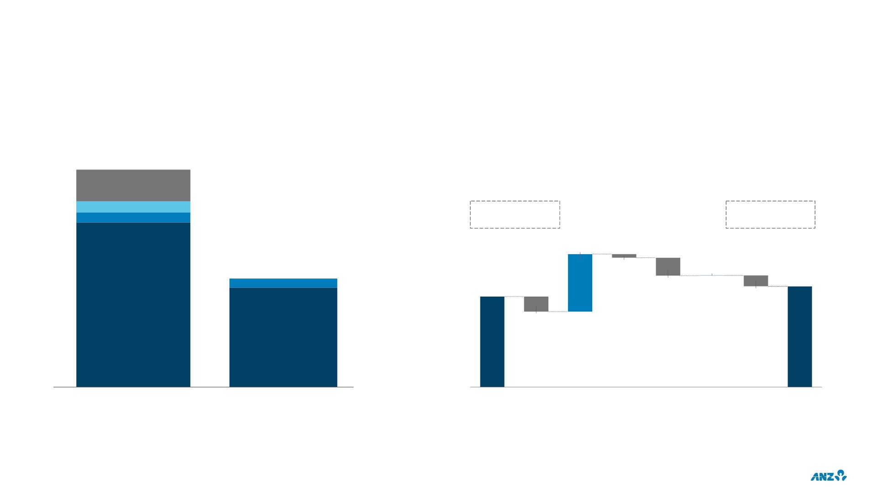
LIQUIDITY COVERAGE RATIO (LCR) SUMMARY¹
LCR COMPOSITION (AVERAGE)
MOVEMENT IN AVERAGE LCR SURPLUS⁴ ($b)
FY20
$b
214
Internal RMBS
Other ALA²
HQLA2
FY19
Avg. LCR 140%
FY20
Avg. LCR 139%
34
154
-2
0
Wholesale funding
-11
60
54
-6
HQLA1
-9
Customer deposits
& other³
Liquid Assets
Net Cash Outflow
FY19
CLF⁵
Liquid
Assets
Retail/SME Corp/FI/ Wholesale
PSE Funding
Other
FY20
LCR Surplus
LCR Surplus
1. All figures shown on a Level 2 basis as per APRA Prudential Standard APS210 2. Comprised of assets qualifying as collateral for the Committed Liquidity Facility (CLF), excluding internal RMBS,
up to approved facility limit; and any assets contained in the RBNZ’s liquidity Policy – Annex: Liquidity Assets – Prudential Supervision Department Document BS13A 3. ‘Other’ includes off-balance
sheet and cash inflows 4. LCR surplus excludes surplus liquids considered non-transferrable across the Group. At 30 Sep 20, this included $16b of surplus liquids held in NZ, up from $8b at 30 Sep
2019 5. RBA CLF decreased by $12.3b from 1 January 2020 to $35.7b (2019: $48.0b)
56

Slide 58
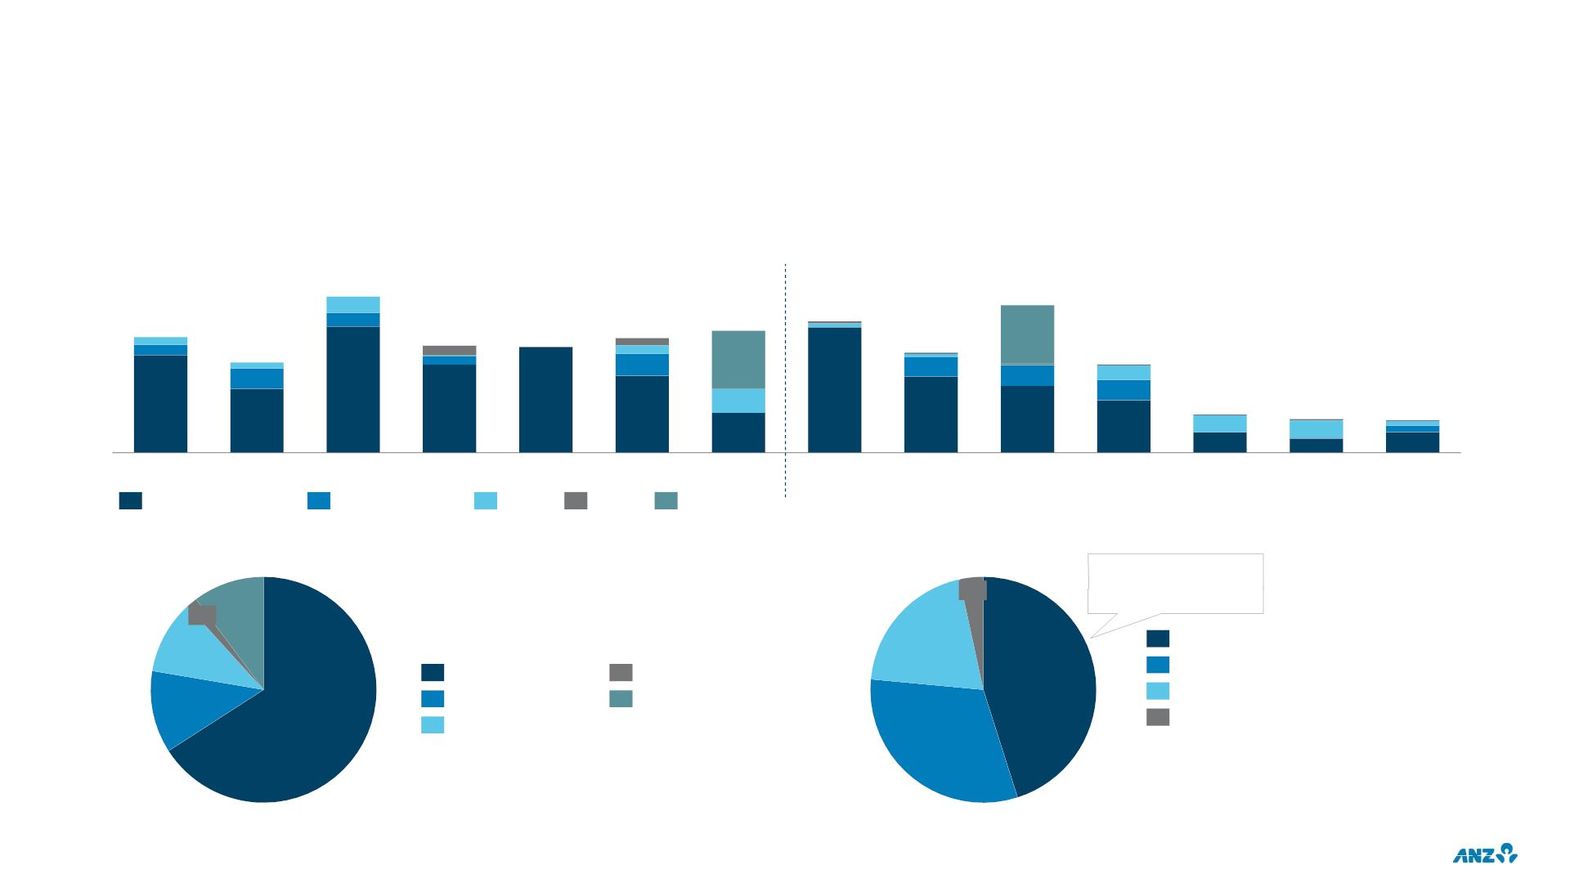
TERM WHOLESALE FUNDING PORTFOLIO¹
•
•
•
ANZ’s term funding requirements depend on market conditions, balance sheet needs and exchange rates, amongst other factors
RBA Term Funding Facility (TFF) Initial Allocation of $12b fully drawn in 2H20. Remaining TFF comprises Supplementary and Additional Allocations, ~$12b² undrawn
ANZ estimates minimal senior debt term funding requirements for FY2021
ISSUANCE
MATURITIES
$b
32
30
24
24
25
27
19
22
22
21
18
8
7
7
FY14
FY15
FY16
FY17
FY18
FY19
FY20
FY21
FY22
FY23
FY24
FY25
FY26
FY27+
Senior Unsecured
Covered Bonds
Tier 2
RMBS
TFF
PORTFOLIO BY CURRENCY
PORTFOLIO
Domestic portfolio up
from 33% in FY18 and
38% in FY19
10%
4%
2%
11%
20%
Domestic (AUD, NZD)
Senior Unsecured
Covered Bonds
Tier 2
RMBS
TFF
45%
North America (USD, CAD)
UK & Europe (£, €, CHF, NOK)
Asia (JPY, HKD, SGD, CNY)
12%
66%
31%
1. All figures based on historical FX and exclude AT1. Includes transactions with an original call or maturity date greater than 12 months as at the respective reporting date. Tier 2 maturity
profile is based on the next callable date 2. As at 1 October 2020
57

Slide 59
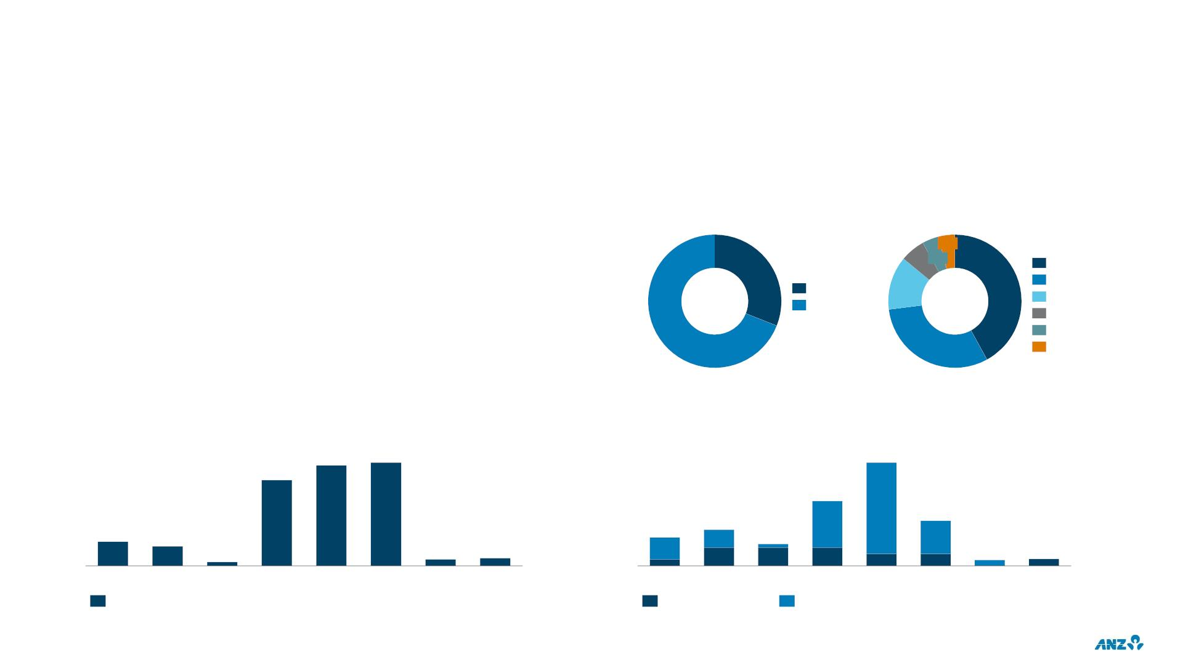
ANZ’S TIER 2 CAPITAL PROFILE¹
ANZ’S TIER 2 CAPITAL REQUIREMENT TO PROGRESSIVELY
TIER 2 CAPITAL
INCREASE TO MEET TLAC REQUIREMENT
Notional amount
•
•
•
Issued AUD $7.0b since July 2019 across AUD, EUR, and USD
FY21 T2 issuance expected to be ~$4-5b
By Format
By Currency
Required portfolio increase from $12.1b to ~$22b by January 2024 (based on
5% of current RWAs²)
4%
6%4%
USD
•
•
Planned issuance in multiple currencies in both callable and bullet format
31%
AUD Domestic
EUR
Bullet
13%
42%
Increased T2 issuance expected to be offset by reduction in other senior
unsecured funding
Callable
AUD Offshore
JPY
•
Well managed amortisation profile provides flexibility regarding issuance tenor
69%
31%
SGD
FUNDING PROFILE
CAPITAL AMORTISATION PROFILE³
Notional amount, $m
3,437
3,532
$m
3,893
2,937
FY24
2,444
1,368
FY22
1,706
FY26
831
674
1,068
FY21
824
131
225
265
225
FY27
265
FY28+
FY21
FY22
FY23
FY25
FY26
FY27
FY28+
FY23
FY24
FY25
Scheduled Bullet and Call Date Profile
Bullet Amortisation
Callable
1. Profile is AUD equivalent based on historical FX, excluding Perpetual Floating rate notes issued 30 October 1986 (which loses Basel III transitional relief in 2021). Comprises Tier 2 capital in the
form of Capital Securities only (i.e. does not include other Tier 2 capital such as eligible General reserve for impairment of financial assets)
2. Current RWAs $429b as at 30 September 2020
3. Amortisation profile is modelled based on scheduled first call date for callable structures and in line with APRA’s amortisation requirements for bullet structures
58

Slide 60

IMPACTS OF RATE MOVEMENTS
BILLS/OIS SPREAD
CAPITAL & REPLICATING
DEPOSITS PORTFOLIO
CAPITAL² & REPLICATING
DEPOSITS PORTFOLIO
bps
(AUSTRALIA)
50
3.0
2.5
2.0
1.5
1.0
0.5
0.0
%
45
40
35
30
25
20
15
10
5
AUST
NZ
~27b
APEA
~10b
Flat
Volume ($A)
~75b
Volume change (YoY) ~15b increase
~7b increase
Target Duration
Rolling 3 to 5 years
Various
Various
Proportion Hedged
~60%
~80%
0
-5
-10
Oct- Nov- Dec- Jan- Feb- Mar- Apr- May- Jun- Jul- Aug- Sep-
19 19 19 20 20 20 20 20 20 20 20 20
Oct-
18
Jan-
19
Apr-
19
Jul-
19
Oct-
19
Jan-
20
Mar-
20
Jun-
20
Sep-
20
Spot 3mth Bills / OIS Spread
Rolling 90 days
3mth BBSW (Monthly Average)
Portfolio Earnings Rate
FY19 Ave¹: 37.5bps
FY19 Ave: 2.08%
1H19 Ave: 2.21%
1H19 Ave: 48.0bps
2H19 Ave: 27.0bps
2H19 Ave: 1.95%
FY20 Ave¹: 13.2bps
FY20 Ave: 1.40%
1H20 Ave: 21.1bps
2H20 Ave: 5.3bps
1H20 Ave: 1.64%
2H20 Ave: 1.20%
1. 90 day rolling average of spot 3mth Bills/OIS spread
2. Includes other Non-Interest Bearing Assets & Liabilities
59

Slide 61

CAPITAL FRAMEWORK
CURRENT REGULATORY PROPOSALS AND RECENT REVISED IMPLEMENTATION DATES¹
2019
1H20
2H20
1H21
2H21
Original
Implementation
Date
Revised
Implementation
Date
RBNZ Capital Framework
Leverage ratio
Finalise
2027
2022
2022
2022
2021
2023
2022
2024
2028²
2023
2023
2023
2023
2024
2023
-
Finalise
Finalise
Standardised Approach to
Credit Risk
Consultation
Consultation / Finalise
Consultation / Finalise
Internal Ratings-based
Approach to Credit Risk
Consultation
Operational Risk
Fundamental Review of
the Trading Book
Consultation
Interest Rate Risk in the
Banking Book
Consultation
Consultation / Finalise
Consultation / Finalise
Loss Absorbing Capacity
(LAC)³
Transition
Capital Treatment for
Investments in
Subsidiaries (Level 1)
Consultation
2021
2021
Expected 2022
2022
Associations with Related
Entities
Finalise
1. Timeline is based on APRA’s 2020 Policy and Supervision Priorities (published January 2020) and revised following APRA’s deferral of capital reform implementation in response to COVID-19
circumstances
60
2. 7 year transition period from 1 July 2021 (subject to change)
3. Only in relation to the 3% of RWA increase in Total Capital requirements announced in July 2019

Slide 62

LIQUIDITY AND FUNDING ENVIRONMENT
CURRENT EXCESS LIQUIDITY IS LIKELY TO PERSIST
DECLINING FUNDING GAP¹ ACROSS AUSTRALIAN SYSTEM
• Large increase in deposits in 2H20 led to a significant Funding Gap¹
$b
reduction (10x higher than a full year during the GFC) across the Australian
system
750
700
• In addition to the quantum of deposits increasing, the quality of deposits is
simultaneously improving (higher household and operational deposits) with
very high household savings rates and conservative corporate settings
650
600
550
500
450
400
• Term Funding Facility (TFF) has contributed further funding to the banking
system
• Implications of the narrowing of the Funding Gap include;
• Negates near term senior term debt requirements (although T2
2015
2016
2017
2018
2019
2020
requirements unchanged)
• Elevated Exchange Settlement Account balances
• The medium term influences on the system Funding Gap include
• Demand for credit
AUSTRALIAN MONETARY AND FISCAL POLICY ACTIONS
Action
GFC
COVID-19
Change in Cash Rate Target
-425bps
-50ps
• Tax cuts and future fiscal measures, including state government
• Outright QE
Term Funding Support
Government Guarantee
Term Funding Facility
Yes
• Offshore wholesale funding requirement to significantly decrease as a
Unconventional Monetary Policy
No
proportion of total funding
Excess System Cash (RBA Exchange Settlement
Account Surplus)²
Up to ~$15b
Up to ~$90b
• Similar operating environment in New Zealand
Funding Gap Reduction (Loans – Deposits)¹
~$20b
(12 months to Sept 09)
~$200b
(5 Months to Sept 20)
Fiscal Stimulus³
$88b (~6% of GDP)
$276b (~14% of GDP)
1. Funding Gap is calculated from APRA Monthly Authorised Deposit-taking Institution Statistics as Loans minus Deposits. Loans includes “Total residents loans and finance leases” and Deposits includes
“Deposits by non-financial businesses”, “Deposits by financial institutions”, “Deposits by general government”, “Deposits by households” and “Deposits by community service organisations” 2. RBA
Statistical Tables – “Monetary Policy Operations – Current – A3” at https://www.rba.gov.au/statistics/tables/ and “Open Market Operations – 2003 to 2008 – A3” at
https://www.rba.gov.au/statistics/historical-data.html 3. ANZ Economics estimates
61

Slide 63
2020
FULL YEAR RESULTS
INVESTOR DISCUSSION PACK
CUSTOMER SUPPORT (COVID-19)

Slide 64

OVERVIEW
AUSTRALIA & NZ HOME LOAN AND AUSTRALIA BUSINESS LOAN PORTFOLIO & ACTIVE LOAN DEFERRALS
Total ANZ
Portfolio
(30 Sep-20)
Total active
deferrals¹
(15 Oct-20)
ACTIVE LOAN DEFERRALS¹
End of month net position
Account numbers (000s)
Home loans – Australia
125
22
124
22
124
21
Total number of home loans
Total $ value of home loan balance ($b)
Home Loans – New Zealand
Total number of home loans
Total $ value of home loan balance (NZ$b)
Commercial Loans – Australia
Total number
1,008k
275
51k
19
112
21
110
20
20
18
17
529k
90
10k
3
81
21
16
20
20
71
10
10
236k
68
10k
4
83
84
86
74
70
Total $ value ($b EAD)
51
Total ANZ Portfolio (30 Sep-20) for Commercial includes
business loans, asset finance & other lending products.
Total Active deferrals are business loans only
41
5
3
2
Mar-20 Apr-20 May-20 Jun-20
Jul-20
Aug-20 Sep-20 Oct-20
(15th)¹
Home Loans - Australia
Home Loans - NZ
Business Loans - Australia
Refer last page of section for footnote references
63

Slide 65

COVID-19 CUSTOMER SUPPORT MEASURES
AUSTRALIA – HOME LOAN DEFERRALS
PORTFOLIO SUMMARY
Accounts
ACTIVE LOAN DEFERRALS¹
DEFERRAL ROLL-OFF SUMMARY
1,008k
~55k loans have completed / exited the 6 month
deferral period or advised intended action as at 15
October 2020
End of month net position
Accounts (000s)
83
84
86
70
74
79%
51
11
1%
41
20%
<1%
136k
95k
$1b
3
$15b
$26b
$31b
$31b
$32b
$27b
40
$19b
Completed / Advised intention to complete deferral
Restructured
Total portfolio
(Sep-20)
Total Enquiries
for assistance
Total loans
that received
repayment
deferrals
Mar-20
Apr-20
May-20
Jun-20
Jul-20
Aug-20
Sep-20
Oct-20
(15th)
Further 4 month deferral approved/applied
Initial Deferral
Further 4 month deferral
Transferred to hardship
Refer last page of section for footnote references
64

Slide 66

COVID-19 CUSTOMER SUPPORT MEASURES
AUSTRALIA – HOME LOAN DEFERRAL METRICS¹
Loan repayment deferrals
Total Active deferrals
Total AUS.
Home Loan
Portfolio
Of the current ~40k active 6 month loan deferrals:
31 Jul 2020
15 Oct 2020
(30 Sep 2020)
• ~ 25% have made at least one payment while on deferral
Total number of home loans
84k
$31b
$1b
51k
$19b
$1b
1,008k
$275b
$33b
56%
• ~ 50% have at least a 3 month payment or greater savings ‘buffer’²
• ~ 20% have Lenders Mortgage Insurance
Total $ value of home loan balance
Offset balances
Avg. Dynamic LVR (Ex. offset)⁵
Average Loan Size
68%
$371k
92%
73%
68%
$379k
95%
72%
Of those with ANZ associated transaction account data:
• ~ 80% have stable or improved income³
$273k
87%
• ~ 10% in JobKeeper/JobSeeker payment scheme⁴
% Principal & Interest⁶
% Owner Occupied⁶
68%
Of the ~11K loan deferrals that have requested and received an approval
for a 4 month extension:
ACCOUNTS ENTERING & SCHEDULED FOR EXIT/EXPIRY FROM DEFERRAL
• ~ 50% are from Victoria (impacted by the extended lockdown period)
• ~ 85% have DLVR <90%⁵
40k
20k
0k
-20k
-40k
-60k
Mar-20 Apr-20 May-20 Jun-20 Jul-20 Aug-20 Sep-20 Oct-20 Nov-20 Dec-20 Jan-21 Feb-21 Mar-21
Deferrals added in the month
Deferrals exited/expired (or scheduled) in the month
Deferrals extended for further 4 months
Refer last page of section for footnote references
65

Slide 67

COVID-19 CUSTOMER SUPPORT MEASURES
AUSTRALIA – HOME LOAN DEFERRALS – PORTFOLIO PROFILES
REPAYMENT PROFILE
LOAN PURPOSE
(% of accounts)
(% of accounts)^{3,4}
1,008k
accounts
~40k¹
accounts
~11k
accounts
7%
3%
5%
26%
9%
29%
71%
0%
25%
75%
0%
93%
97%
95%
65%
Total housing portfolio
(30 Sep-20)
Initial 6 month deferral – still to
determine action on maturity
(15 Oct-20)
Loan deferrals - 4
month extension
(15 Oct-20)²
Total housing portfolio
(30 Sep-20)
Initial 6 month deferral – still to
determine action on maturity
(15 Oct-20)
Loan deferrals - 4
month extension
(15 Oct-20)²
Principal and interest (including Equity Manager)
Interest only
Owner Occupier
Investor
Equity Manager
DYNAMIC LOAN TO VALUE RATIO
PORTFOLIO BY STATE
(% of accounts)^{3,4}
(% of accounts)
11%
8%
15%
16%
15%
18%
13%
13%
18%
14%
9%
6%
9%
30%
17%
13%
34%
35%
35%
32%
26%
26%
26%
51%
30%
34%
46%
Total housing portfolio
(30 Sep-20)
Initial 6 month deferral – still to
determine action on maturity
(15 Oct-20)
Loan deferrals - 4
month extension
(15 Oct-20)²
Total housing portfolio
(30 Sep-20)
Initial 6 month deferral – still to
determine action on maturity
(15 Oct-20)³
Loan deferrals - 4
month extension
(15 Oct-20)²
0-60%
61% - 80%
81% - 90%
>90%
VIC
NSW
QLD
WA
Other
Refer last page of section for footnote references
66

Slide 68

COVID-19 CUSTOMER SUPPORT MEASURES
AUSTRALIA – COMMERCIAL BUSINESS LOAN DEFERRALS
PORTFOLIO SUMMARY
Accounts
ACTIVE LOAN DEFERRALS¹
DEFERRAL ROLL-OFF SUMMARY⁴
236k
$6.8b loans (~15k accounts) have completed / exited
the 6 month deferral period or advised intended action
as at 15 October 2020
End of month net position
Accounts (000s)
22
22
20
21
21
20
1
86%
4%
19
10
2
9%
1%
24k
23k
2
8
$1.4b
$9.0b
$9.7b
$10b
$9.5b
Jul-20
$8.6b
$8.3b
$4b
Completed / Advised intention to complete deferral
Convert to Interest Only
Total portfolio
Enquiries for
assistance²
Total loans
that received
repayment
deferrals³
Mar-20
Apr-20
May-20
Jun-20
Aug-20
Sep-20
Oct-20
(15th)
Further 4 month deferral approved/applied
Initial Deferral
Further 4 month deferral
Transferred to hardship
Refer last page of section for footnote references
67

Slide 69

COVID-19 CUSTOMER SUPPORT MEASURES
AUSTRALIA – COMMERCIAL LOAN DEFERRAL METRICS
31 July 2020
15 October 2020
All customers are contacted 4-6 weeks pre-expiry. Those with a relationship
manager and any customer deemed ‘at risk’ also receive a phone call.
Assistance Provided
at 31 July 2020
Accounts
EAD⁴
Accounts
EAD⁵
Total Commercial lending
~240k
~22k
~13k
$69b
$10b
$0.9b
~236k
~10k⁸
~10k
$68b
$4b⁸
Of the current ~8k active 6 month loan deferrals (where still to determine action
on maturity as at 15 October), for those with ANZ associated transaction account
data¹ (compared to the same time last year):
Business loan deferrals
• ~20% have increased cash inflows by >30%²
Asset Finance loan deferrals
$0.7b
• ~25% have reduced cash outflows by >30%²
Temporary overdraft
increases
~11k
~3k
$1.2b
$0.2b
~10k
~3k
$1b
• ~50% are receiving JobKeeper payments from the ATO²
• ~65% have higher cash balances since March 2020 (Pre-COVID)³
JobKeeper and SME
Guarantee Scheme
$0.2b
1.6k business loan deferrals have received a 4 month extension:
• ~60%⁶ are from Victoria impacted by the longer lockdown period
ACCOUNTS ENTERING & SCHEDULED FOR EXIT/EXPIRY FROM DEFERRAL
20k
15k
10k
5k
o
Of which, ~30% are within Accommodation, Cafés and Tourism and
~20% within Retail Trade industries
• ~40% have a ‘savings buffer’ of 10 months or more⁷
0k
-5k
-10k
-15k
Mar-20 Apr-20 May-20 Jun-20 Jul-20 Aug-20 Sep-20 Oct-20 Nov-20 Dec-20 Jan-21 Feb-21 Mar-21
Deferrals added in the month
Deferrals exited/expired (or scheduled) in the month
Deferrals extended for further 4 months
Refer last page of section for footnote references
68

Slide 70

COVID-19 CUSTOMER SUPPORT MEASURES
AUSTRALIA – COMMERCIAL BUSINESS LOAN DEFERRALS PORTFOLIO PROFILES
BUSINESS LOAN DEFERRALS PROVIDED¹
BY SECURITY PROFILE (% OF EAD)²
BY STATE (% OF EAD)³
BY INDUSTRY (% OF EAD)
$68b
$4b
$0.6b
$68b
$4b
$0.6b
$68b
$4b
$0.6b
5%
6%
1%
1%
1%
3%
6%
8%
12%
8%
6%
13%
5%
15%
20%
20%
9%
27%
25%
30%
11%
13%
22%
60%
5%
9%
21%
9%
15%
6%
9%
7%
30%
10%
25%
74%
74%
71%
26%
19%
13%
3%
11%
16%
28%
37%
24%
20%
10%
1%
Total Commercial
portfolio
Initial 6 month
deferral - still to
determine action
on maturity
Business loan
deferrals -
4 month extension
(15 Oct-20)⁴
Total Commercial
portfolio
Initial 6 month
deferral - still to
determine action
on maturity
Business loan
deferrals –
4 month extensions
(15 Oct-20)⁴
Total Commercial
portfolio
Initial 6 month
deferral - still to
determine action
on maturity
Business loan
deferrals –
4 month extensions
(15 Oct-20)⁴
(30 Sep-20)
(30 Sep-20)
(30 Sep-20)
(15 Oct-20)
(15 Oct-20)
(15 Oct-20)
Fully Secured
Partially Secured
Unsecured
Others
VIC/TAS
QLD
WA
SA/NT
Other
Comm. Property & Construction
Agri., Forestry & Fishing
Retail Trade
Accom. Cafes & Restaurants
Health & Community Services
Other Industries
NSW/ACT
Other Property & Bus. Services
Refer last page of section for footnote references
69

Slide 71

COVID-19 CUSTOMER SUPPORT MEASURES
NEW ZEALAND
PORTFOLIO SUMMARY
• Financial support provided to ~43,000 personal, home and
Accounts
business loans customers through repayment deferrals,
moving to interest only, or loan adjustments covering
lending of NZD27b
529k
NUMBER OF ACTIVE HOME LOANS WITH REPAYMENTS DEFERRED
• Deferred repayments on ~24,000 home loans and moved
Accounts (000s)
~21,000 home loans to interest only
• Granted 2,780 temporary overdraft facilities to businesses
20
21
20
<2% of the
home loan
portfolio
needing more working capital, worth ~NZD46m
18
17
16
LOAN REPAYMENT DEFERRALS
Total NZ
Home Loan
Portfolio
Jul-20
18k
Sep-20
16k
15-Oct-20
10k
(Sep-20)
10
Total number of home
loans
529k
90b
Total $ value of home loan
balance (NZD)
4.7b
4.1b
2.7b
NZD 0.1b
5.0b
5.3b
5.1b
4.7b
4.4b
4.1b
2.7b
0.1
Median LVR
62.4%
256k
62.9%
258k
62.9%
276k
51.4%
169k
Mar-20
Apr-20
May-20
Jun-20
Jul-20
Aug-20
Sep-20
Oct-20
(15th)
Average Loan Size (NZD)
~24k
Total Home
Total loans
Loan portfolio that received
repayments
deferrals
Refer last page of section for footnote references
70

Slide 72

COVID-19 CUSTOMER SUPPORT MEASURES
NEW ZEALAND HOUSING REPAYMENT DEFERRAL PORTFOLIO PROFILES
REPAYMENT PROFILE
LOAN PURPOSE
LOAN TO VALUE RATIO
(% of accounts)
(% of accounts)
(% of accounts)¹
529k
accounts
10k
accounts
529k
accounts
10k
accounts
529k
accounts
2%
10k
accounts
2%
21%
79%
18%
3%
7%
25%
25%
75%
32%
63%
48%
43%
75%
82%
Total housing
portfolio (30 Sep-20)
Loan deferrals -
portfolio (15 Oct-20)²
Total housing
portfolio (30 Sep-20)
Loan deferrals -
portfolio (15 Oct-20)²
Total housing
portfolio (30 Sep-20)
Loan deferrals -
portfolio (15 Oct-20)²
Principal and interest
Interest only
Owner Occupier
Investor
0 - 60%
61% - 80%
81% - 90%
>90%
Refer last page of section for footnote references
71

Slide 73

CUSTOMER SUPPORT (COVID-19)
Page
Footnote reference
OVERVIEW
1.
‘Home Loans – Australia’, ‘Home Loans – New Zealand’ and ‘Business Loans – Australia’ numbers exclude accounts due to expire / exit where customers have already confirmed they will recommence repayment
Australia & New Zealand Home loan and Australia
Business loan portfolio & active loan deferrals
COVID-19 CUSTOMER SUPPORT MEASURES
1.
Excludes accounts currently deferred where customer has indicated return to payment at expiry
Australia – Home loan deferrals
COVID-19 CUSTOMER SUPPORT MEASURES
Australia – Home loan deferral metrics
1.
2.
3
COVID-19 loan deferrals are available to customers if either their Home Loan repayments are less than 30 days past due, or if their repayments are less than 90 days past due and were up to date at 1 March 2020
Buffers are calculated at customer level, incorporating all Retail debts within the customer cluster at ANZ, and all funds available in ANZ redraw, offset and transaction and savings accounts
Based on deferral customers where ANZ can identify salary income, this represents ~32% of Home Loan customers. Salary income excludes other income types and segments such as self-employed. Stable is defined as income at or
above 80% of income in Feb-2020
4.
Based on ANZ transactional data, does not capture payment flows to non-ANZ accounts. JobSeeker accounts are based on customers who received one or more JobSeeker transactions between 1 Sep and 30 Sep. JobKeeper accounts
are based on customers that ANZ can identify as being on JobKeeper between 1 Sep and 30 Sep 2020 but due to identifying complexities, there may be customers receiving JobKeeper that ANZ have not been able to identify.
5.
6.
1.
Unweighted based on # accounts; Includes capitalised LMI premiums, valuations for DLVR updated to Aug-20 where available, includes Non Performing Loans, excludes accounts with a security guarantee, and unknown DLVR
% based of balances as at 30 Sep 2020
COVID-19 CUSTOMER SUPPORT MEASURES
Australia – Home loan deferrals portfolio profiles
Current loans on active repayment deferral on initial 6 month deferral – still to determine action on maturity and excludes loans extended/requested for a further 4 months and customers who have indicated they will return to
repayments at expiry)
2.
3.
4.
1.
2.
3.
4.
Current loan deferrals that have requested and received an approval for a 4 month extension
Includes capitalised LMI premiums, valuations for DLVR updated to Aug-20 where available, includes Non Performing Loans, excludes accounts with a security guarantee, and unknown DLVR
DLVR does not incorporate offset balances
COVID-19 CUSTOMER SUPPORT MEASURES
Australia – Commercial Loan deferrals
Excludes accounts currently deferred where customer has indicated return to payment at expiry
57.5k for all Commercial products (excl Trade Product assistance and merchant fee waivers). 24.4k of these were enquiries for Business Loan deferrals
Total business loan deferrals that have had a deferral over the COVID19 period (including the unwind/rolled off population) – excludes Asset finance and other commercial facilities
% based on September 2020 EAD associated with customers where original deferral period has concluded (expired/unwound relief) or advised intended action. Accounts paid out/closed are excluded from EAD
Note: Commercial is made up Small Business Banking (lending <$1m), Business Banking (typically lending <$10m), and Specialist Distribution (typically $10m-$40m). Note excludes Private Banking
COVID-19 CUSTOMER SUPPORT MEASURES
Australia – Commercial loan deferral metrics
1.
Transactional data flows able to contribute to this analysis include 91% of customers associated with the 8k deferred
business loans
5.
EAD as at 30 September 2020
2.
Small Business Banking & Business Banking only, via ANZ transactional banking data (excluding trust accounts).
Inflows exclude gvt. payments
6.
% is based on volumes
3.
4.
Quarter on Quarter PCP: June-Aug 20 vs Jun-Aug19. Includes govt payments and excludes trust accounts.
EAD as at 30 June 2020
7.
8.
Savings buffer is where savings compared to debt repayment ratio would cover 10+ months
Includes deferral extensions, but excludes accounts of customers who have indicated an intent to
return to repayments
COVID-19 CUSTOMER SUPPORT MEASURES
Australia – Commercial loan deferral portfolio
profiles
1.
Active deferrals as at 15 October 2020, EAD as at 30 September 2020
2.
3
Fully Secured on a market value basis. Other includes loans secured by cash or via sovereign backing
States based on primary postcode and Other represents where none recorded in system. Some postcodes occur across two states
4.
-
Current loan deferrals that have requested and received an approval for a 4 month extension
-
COVID-19 CUSTOMER SUPPORT MEASURES
New Zealand
COVID-19 CUSTOMER SUPPORT MEASURES
New Zealand - Housing repayment deferral
portfolio profiles
1.
2.
LVR is origination LVR. Note if calculated as % of portfolio then total housing is 49% (0-60), 44% (61-80), 5% (81-90) & 2% (>90) and LRD is 34% (0-60), 54% (61-80), 9% (81-90) & 3% (>90)
Home loans with Loan Repayment Deferral in place as at 15/10/2020
72

Slide 74
2020
FULL YEAR RESULTS
INVESTOR DISCUSSION PACK
RISK MANAGEMENT

Slide 75

RISK MANAGEMENT
LONG RUN PROVISIONS & LOSS RATES
TOTAL CREDIT IMPAIRMENT CHARGE
$m
1,800
1,500
1,200
900
600
300
0
-300
1H08 2H08 1H09 2H09 1H10 2H10 1H11 2H11 1H12 2H12 1H13 2H13 1H14 2H14 1H15 2H15 1H16 2H16 1H17 2H17 1H18 2H18 1H19 2H19 1H20 2H20
Consumer IP Commercial IP Institutional IP CP Charge / (Release)
ANZ HISTORICAL LOSS RATES¹ (basis points)
LONG RUN LOSS RATE (INTERNAL EXPECTED LOSS) (%)
250
Division
Mar-16 Sep-16 Mar-17 Sep-17 Mar-18 Sep-18 Mar-19 Sep-19 Mar-20 Sep-20
200
150
100
50
Aus. R&C
0.35
0.25
0.33
0.26
0.33
0.26
0.33
0.22
0.31
0.29
0.29
0.29
0.28
0.27
New
Zealand
0.21
0.19
0.19
0.18
0.19
0.16
Institutional 0.37
0.36
1.79
0.33
0.35
1.60
0.33
0.30
1.69
0.30
0.32
1.95
0.30
0.27
1.78
0.27
0.27
1.60
0.27
0.25
1.40
0.26
0.25
1.30
0.26
0.30
1.46
0.26
Pacific
1.47
Subtotal
0.34
Asia Retail
1.50
1.51
1.51
2.75
0
0
0
0
0
0
0
Sep-
90
Total
0.37
0.35
0.35
0.32
0.30
0.27
0.27
0.26
0.26
0.26
Sep-
93
Sep-
96
Sep-
99
Sep-
02
Sep-
05
Sep-
08
Sep-
11
Sep-
14
Sep-
17
Sep-
20
Increase in Institutional due to credit migration following re-rating of 93% Institutional EAD post
on-set of COVID
NZ reduction primarily driven by UDC divestment and improved mix with reduced unsecured
retail volumes
•
•
IP Loss Rate
Median Annual IP Loss Rate (excl. current period)
1. IP as a % of average Gross Loans and Advances (GLA)
74

Slide 76

RISK MANAGEMENT
INDIVIDUAL PROVISION CHARGE
INDIVIDUAL PROVISION CHARGE
INDIVIDUAL PROVISION CHARGE BY DIVISION
$m
$m
1,047
892
1,047
787
969
892
82
826
554
812
626
807
81
787
86
430
612
343
594
398
592
395
500
435
61
626
1
922
380
532
339
43
210
61
554
79
55
430
28
272
35
343
380
395
495
34
31
15
5
35
7
6
62
49
229
153
136
116
122
93
158
93
175
429
469
430
453
-259
-274
-245
-274
-280
337
375
350
355
318
278
-335
-394
-298
-373
-352
-33
-52
-12
1H16
2H16
1H17
2H17
1H18
2H18
1H19
2H19
1H20
2H20
1H16
2H16
1H17
2H17
1H18
2H18
1H19
2H19
1H20
2H20
New
Increased
Writebacks & Recoveries
Australia R&C
New Zealand
Institutional
Pacific / Other
Ratios
1H16
31
2H16
36
1H17
27
2H17
19
1H18
15
2H18
12
1H19
2H19
1H20
20
2H20
IP loss rate (bps)¹
12
13
13
13
12
33
Total loss rate (bps) ¹
32
36
25
16
14
9
53
IP balance / Gross Impaired Assets
43%
41%
43%
48%
50%
43%
42%
40%
42%
36%
1. Annualised loss rate as a % of Gross Loans and Advances (GLA)
75

Slide 77

RISK MANAGEMENT
COLLECTIVE PROVISION BALANCE & CHARGE
MOVEMENT IN COLLECTIVE PROVISION BALANCE YOY
COLLECTIVE PROVISION CHARGE
$m
Collective Provision Charge
592
5,008
$m
1H19
13
2H19
4
1H20
1,048
0
2H20
669
46
1,018
CP charge
3,376
46
61
Volume/Mix
-28
-40
99
-51
19
31
5
-85
FX
Change in Risk
Economic forecast scenario weights
Additional overlays
17
44
$1,717m
1,124
-93
-106
685
-18
Sep-19
Volume /
Mix
Change
in Risk
Economic
forecast and
scenario
Additional
overlays
Sep-20
weights
MOVEMENT IN COLLECTIVE PROVISION BALANCE HOH
$m
Collective Provision Charge
Collective Provision Charge
1,124
4,501
44
685
5,008
46
3,376
77
FX
0
17
-93
-162
-106
$1,048m
$669m
Sep-19
Volume /
Mix
Change in Risk
Economic
forecast and
scenario
Additional
overlays¹
Mar-20
FX
Volume /
Mix
Change in Risk
Economic
forecast and
scenario
Additional
overlays
Sep-20
weights
weights
1. Reduction due to release of overlays no longer required due to the CP uplift from base case & scenario weights
76

Slide 78

RISK MANAGEMENT
COLLECTIVE PROVISION (CP) BALANCE
CP BALANCE BY CATEGORY
CP BALANCE BY DIVISION
$m
1.17%
1.39%
$m
5,008
80
0.94%
5,008
696
4,501
50
570
4,501
11
3,376
38
541
3,376
104
374
1,590
1,513
4,490
4,312
1,169
3,272
1,795
2,320
2,845
Sep-19
Mar-20
Sep-20
Sep-19
Mar-20
Sep-20
Modelled ECL
Additional overlays
CP Coverage (%)¹
Australia R&C
Institutional
New Zealand
Pacific / Other
PROVISION BALANCE BY STAGE
$m
PROVISION BALANCE BY STAGE – DIVISIONAL ALLOCATION
$m
30 Sep-19
30 Sep-20
30 Sep-19
30 Sep-20
2,704
2%
13%
1,820
16%
1,412
1%
1,530
1%
8%
1%
1,375
3%
14%
2,704
11%
12%
1,248
3%
13%
484
17%
9%
58%
434
814
1,820
62%
16%
72%
Stage 3
New Zealand
70%
1,412
1,530
71%
71%
891
26%
33%
Stage 1
Stage 2
Stage 3
Stage 1
Stage 2
Stage 3
Stage 1
Stage 2
Stage 1
Stage 2
Stage 3
Stage 1 CP
Stage 2 CP
Stage 3 CP
Stage 3 IP
Australia R&C
Institutional
Pacific / Other
1. CP as a % of Credit Risk Weighted Assets (CRWA)
77

Slide 79

RISK MANAGEMENT
PORTFOLIO COMPOSITION AND COVERAGE RATIOS
PORTFOLIO COMPOSITION
Sovereign
Bank
Corporate
Resi. Mortgage
Retail¹
Other
Gross loans & advances
Credit RWA
Exposure at default
Exposure at default
(Ex. Sovereign & Bank)
Expected credit loss
(Collective Provision balance)
$1,010.4b
$5.0b
1%
1%
18%
4%
$781.4b
44%
$622.1b
2%
51%
21%
3%
32%
34%
$360.0b
2%
4%
57%
52%
31%
39%
5%
50%
25%
1%
2%
4%
4%
7%
0%
6%
Sep-20
Sep-20
Sep-20
Sep-20
Sep-20
Coverage ratios
CP coverage
%
%
%
%
0.81
0.95
1.39
1.64
0.50
0.58
0.63
0.75
Total coverage²
Coverage rates by asset classes are available in the ANZ risk template available at https://www.anz.com/shareholder/centre/reporting/results-announcement/
1. Qualifying Revolving and Other Retail categories
2. Individual Provision balance and Collective Provision balance
78

Slide 80

EXPECTED CREDIT LOSS
ECONOMIC SCENARIOS – MODELLED OUTCOMES
Downside Scenario
Characterisation²
COLLECTIVE PROVISION BALANCE SCENARIOS^{5,6}
ECONOMIC SCENARIOS
BASE CASE¹
Weightings are applied to scenarios to determine CP balance
30 SEP-20
CY2020
CY2021
CY2022
CY2021
CY2022
Sep-20
11%
50%
33%
6%
AUSTRALIA
$m
6,315
GDP change³
-4.3%
7.3%
1.6%
8.8%
-4.8%
4.0%
7.7%
2.0%
-1.3%
9.0%
-0.1%
9.2%
1.0%
5,008
696
5,144
Unemployment rate⁴
Resi Property price change³
NEW ZEALAND
Additional overlays
4,011
-2.2%
-5.9%
Modelled
ECL
4,312
1,898
GDP change³
-5.6%
5.7%
2.0%
9.1%
0.9%
5.6%
6.5%
4.1%
-5.3%
10.4%
-8.8%
0.2%
10.8%
0.0%
CP balance
(ECL)
100% upside
100% base case 100% downside
100% severe
Unemployment rate⁴
Resi Property price change³
-0.3%
ILLUSTRATION: RWA IMPACT OF PORTFOLIO CREDIT MIGRATION
Actual impact to date
Potential total impact across FY20 &
FY21 from Portfolio Credit Migration
Actual impact to date
Potential total impact across FY20 &
FY21 from Portfolio Credit Migration
CET1 ratio impact (bps)
1H20
2H20
10
Base case
Downside
RWA ($b)
1H20
2.6
2H20
3.9
6.2
Base case
Downside
Total CET1 impact
Institutional
7
~65
~100
Credit RWA increase
Institutional
~25
~40
8
-1
0
16
-7
1
Inclusive of FY20 actual
3.0
Inclusive of FY20 actual
Aus. Retail & Commercial
New Zealand
Aus. Retail & Commercial
New Zealand
-0.3
-0.1
-2.7
0.4
1. Subset of a range of economic indicators shown. Economic forecasts also undertaken for international markets
2. As a fixed scenario, the Downside Scenario (like the Upside and Severe Scenarios) is specified in terms of an index of economic stress. The economic variables shown represent a characterisation of
the scenario to facilitate a comparison to the base case
3. CY2020, CY2021 & CY2022: 12 months to December Year on Year change
4. Annual average: 12 months to December
5. Illustration of the impact on ANZ’s modelled ECL
79
6. The Upside, Downside and Severe Scenarios are fixed scenarios which do not move with changes to the Base Case forecast

Slide 81

RISK MANAGEMENT
IMPAIRED ASSETS
CONTROL LIST
NEW IMPAIRED ASSETS BY DIVISION
Index Sep 09 = 100
$m
150
2,000
1,500
1,000
500
1,784
1,844
1,787
1,570
1H20
1,425
1,145
1,219
2H20
100
50
0
963
890
1,117
2H19
0
1H16
2H16
1H17
2H17
1H18
2H18
1H19
Sep-
09
Sep-
10
Sep-
11
Sep-
12
Sep-
13
Sep-
14
Sep-
15
Sep-
16
Sep-
17
Sep-
18
Sep-
19
Sep-
20
Control List by Limits
Control List by No. of Groups
Australia R&C
New Zealand
Institutional
Pacific / Other
GROSS IMPAIRED ASSETS BY DIVISION
GROSS IMPAIRED ASSETS BY EXPOSURE SIZE
$m
$m
4,000
3,000
2,000
1,000
0
0.51% 0.55% 0.51%
0.41%
2,384
0.34% 0.35% 0.35% 0.33%
0.39% 0.40%
2,599
4,000
3,173
2,883
3,173
2,940
3,000
2,000
1,000
0
2,883
2,940
2,139
2,459
2,384
2,139
2,599
2,459
2,034
2,128
1H19
2,029
2H19
2,034
2,128
2,029
1H16
2H16
1H17
2H17
1H18
2H18
1H20
2H20
Mar-16 Sep-16 Mar-17 Sep-17 Mar-18 Sep-18 Mar-19 Sep-19 Mar-20 Sep-20
< 10m 10m to 100m > 100m
Australia R&C
New Zealand
Institutional
% of GLA
Pacific / Other
80

Slide 82

RISK MANAGEMENT
RISK WEIGHTED ASSET AND EXPOSURE AT DEFAULT (EAD) – DIVISIONAL VIEW
TOTAL RISK WEIGHTED ASSETS
CREDIT RWA DRIVERS
$b
449
$b
417
48
15
429
48
2.7
360.0
396
396
358.1
6.5
-1.0
391
47
12
37
16
38
16
38
13
22
-3.1
-0.5
-2.7
156
178
157
141
139
144
Sep-19
FX
Volume
/ Mix
UDC
Divestment
Risk
Model /
Method.
CVA (incl.
Hedges)
Sep-20
8
8
7
8
8
EAD BY DIVISION¹
8
52
50
53
57
62
56
$b
1,075
18
930
12
944
13
968
16
977
13
148
1,010
27
134
132
141
137
137
393
407
423
447
529
455
143
141
141
138
138
139
392
392
387
380
380
392
Mar-18
Sep-18
Mar-19
Sep-19
Mar-20
Sep-20
Mar-18
Sep-18
Mar-19
Sep-19
Mar-20
Sep-20
Aus. R&C CRWA
NZ CRWA
Other CRWA
Instit. CRWA
Mkt. & IRRBB RWA
Op-RWA
Australia R&C
Institutional
New Zealand
Pacific / Other
1.
EAD excludes amounts for ‘Securitisation’ and ‘Other Assets’ Basel classes. Data provided is on a Post CRM basis, net of credit risk mitigation such as guarantees, credit derivatives, netting and financial collateral
81

Slide 83

RISK WEIGHTED ASSETS (RWA) & EXPOSURE AT DEFAULT (EAD)
EAD COMPOSITION¹
EAD & CRWA MOVEMENT
$b
$b (Mar-20 movement vs Sep-20) FX Adjusted
1,075
14.3
4.2
8.9
977
5%
5%
1,010
930
944
968
5%
5%
-0.5
-0.9
-1.2
-0.4
-0.2
6%
4%
6%
4%
5%
4%
-16.2
7%
4%
30%
24%
-42.1
28%
23%
Aus HL
Aus. Non HL
NZ
Other
Institutional
27%
20%
28%
21%
28%
21%
30%
21%
CRWA Volume / Mix
EAD growth
CREDIT RWA/EAD BY PORTFOLIO
%
65
64
63
61
62
61
60
60
56
59
57
56
63
38
62
39
62
38
59
37
58
37
56
36
56
36
55
36
37
36
41%
40%
39%
38%
35%
39%
17
24
13
25
26
27
26
27
28
11
28
10
28
9
13
12
12
12
12
11
Mar-18
Sep-18
Mar-19
Sep-19
Mar-20
Sep-20
Mar-16
Sep-16
Mar-17
Sep-17
Mar-18
Sep-18
Mar-19
Sep-19
Mar-20
Sep-20
Residential Mortgage
Sovereign & Bank
Corporate
Specialised Lending
Retail (QRR & Other Retail)
Other
Total Group
Retail (QRR & Other Retail)
Sovereigns & Banks
Corporate & Specialised
Residential Mortgage (Housing)
1. EAD excludes Securitisation and Other assets whereas CRWA is inclusive as per APS 330. EAD data provided is on a Post CRM basis, net of credit risk mitigation such as guarantees, credit derivatives, netting and financial collateral
82

Slide 84

RISK MANAGEMENT
TOTAL PORTFOLIO COMPOSITION
EXPOSURE AT DEFAULT (EAD) DISTRIBUTION
Category
% of Group EAD
% of Portfolio in Non
Performing
Portfolio Balance
in Non Performing
TOTAL GROUP EAD (Sep-20)
= $1,010b¹
Sep-19 Mar-20 Sep-20
Sep-19 Mar-20 Sep-20
Sep-20
Consumer Lending
37.6%
20.3%
7.0%
5.1%
3.6%
7.3%
3.0%
2.2%
2.2%
1.6%
1.8%
1.3%
1.3%
5.8%
34.6%
24.1%
6.9%
5.3%
3.4%
7.0%
2.9%
2.0%
2.2%
1.6%
1.8%
1.4%
1.2%
5.7%
37.6%
20.4%
7.2%
4.7%
3.4%
8.2%
2.4%
2.0%
2.1%
1.6%
1.7%
1.4%
1.2%
6.0%
0.1%
0.0%
0.2%
0.3%
1.1%
0.0%
0.3%
0.7%
0.3%
1.0%
0.2%
0.1%
1.7%
0.4%
0.2%
0.0%
0.3%
0.2%
1.1%
0.0%
1.2%
0.9%
0.5%
1.0%
0.2%
0.1%
1.3%
0.4%
0.2%
0.1%
0.3%
0.3%
1.4%
0.0%
0.4%
1.6%
0.7%
1.1%
0.2%
0.1%
1.4%
0.5%
$611m
Finance, Investment & Insurance
Property Services
$127m
$186m
$130m
$481m
$0m
6.0%
1.2%
1.7%
1.4%
Manufacturing
2.1%
1.6%
Agriculture, Forestry, Fishing
Government & Official Institutions
Wholesale trade
2.0%
2.4%
37.6%
$102m
$316m
$157m
$173m
$31m
8.2%
Retail Trade
Transport & Storage
Business Services
3.4%
Resources (Mining)
Electricity, Gas & Water Supply
Construction
4.7%
$15m
$167m
$280m
7.2%
Other
20.4%
Total
100%
100%
100%
$2,778m
Total Group EAD¹
$977b $1,075b $1,010b
1. EAD excludes amounts for ‘Securitisation’ and ‘Other Assets’ Basel classes. Data provided is on a Post CRM basis, net of credit risk mitigation such as guarantees, credit derivatives, netting and
financial collateral
83

Slide 85

RISK MANAGEMENT
SEGMENTS OF INTEREST
COMMERCIAL PROPERTY OUTSTANDINGS BY REGION
•
•
Growth in the portfolio over the last 5 years has been focused in Australia. At the same time
commercial property lending in New Zealand has only increased marginally and APEA has declined
significantly.
$b
6.9%
7.6%
6.5%
6.5%
6.4%
6.6%
47.1
2.1
FY20 growth of ~AUD4b was predominantly driven by higher lending to strongly rated REITs
requesting liquidity support at the onset of COVID-19 in March 20 quarter. Growth has moderated
since March with credit quality portfolio remaining stable.
42.9
2.8
40.2
2.9
10.9
•
Decline in residential development lending is due to lower market activity. Growth in retail has
been very selective to non-discretionary and large diversified counterparties. Majority of lending to
office sector is to A-Grade properties least likely to be affected by current COVID-19 constraints.
37.5
4.7
37.9
3.6
37.5
2.4
10.5
9.8
8.4
9.5
9.7
COMMERCIAL PROPERTY OUSTANDINGS BY SECTOR
%
3%
4%
3%
6%
4%
6%
2%
8%
34.1
23%
23%
21%
18%
27.5
29.6
24.4
24.8
25.4
27%
27%
28%
29%
15%
27%
14%
26%
15%
26%
17%
27%
Sep-15
Sep-16
Sep-17
Sep-18
Sep-19
APEA¹
Sep-20
Sep-17
Retail
Sep-18
Offices
Sep-19
Tourism
Sep-20
% of Group GLA (RHS)
Australia
New Zealand
Industrial
Residential
Other
1. APEA = Asia Pacific, Europe & America
84

Slide 86

RISK MANAGEMENT
INSTITUTIONAL & COMMERCIAL PORTFOLIO
EXPOSURE AT DEFAULT (EAD) DISTRIBUTION
Category
GLA
Credit Related
Commitments and
Contingencies
EAD (Sep-20)
= $630b¹
($b)
55
55
27
31
3
($b)
Finance, Investment & Insurance
Property Services
Manufacturing
49
17
9.6%
41
2.3%
Agriculture, Forestry, Fishing
Govt. & Official Institutions
Wholesale trade
4
2.7%
2.5%
3.4%
1.9%
32.7%
2
14
13
13
11
7
21
Retail Trade
9
3.2%
3.9%
Transport & Storage
Business Services
Resources (Mining)
Electricity, Gas & Water Supply
Construction
9
7
14
6
9
13.2%
11.5%
8
7
Other
45
$289b
22
5.5%
7.6%
TOTAL
$211b
Sep-16
Sep-17
Sep-18
Sep-19
Sep-20
Investment grade % of EAD
65%
66%
69%
40%
71%
41%
71%
CRWA / EAD
46%
42%
39%
IEL as a % of GLA
0.45%
0.40%
0.37%
0.35%
0.38%
1. EAD excludes amounts for ‘Securitisation’ and ‘Other Assets’ Basel classes. Data provided is on a Post CRM basis, net of credit risk mitigation such as guarantees, credit derivatives, netting and
financial collateral
85

Slide 87

RISK MANAGEMENT
EXPOSURE TO SOME INDUSTRIES MORE IMPACTED BY DOWNGRADES DURING THE COVID-19 PANDEMIC^{1,2}
TOTAL GROUP EAD
All exposures on an EAD basis in $b
$1,010b (Sep-20)
RETAIL TRADE
ACCOMMODATION, CAFES & RESTAURANTS
11.4
49%
10.6
53%
13.9
4%
13.9
4%
20%
19%
28%
30%
51%
47%
48%
47%
Mar-20
Sep-20
Mar-20
Sep-20
Personal & Household Goods Retailing
Motor Vehicle Retailing & Services
Clubs (Hospitality)
Pubs, Taverns & Bars
Accommodation
966
44
Cafes & Restaurants
TRANSPORT & STORAGE
EDUCATION, CULTURAL & RECREATION
12.9
6%
11.5
7%
7.0
7.8
22%
20%
40%
3.8
Industries most impacted
by downgrades
19%
35%
41%
44%
29%
Balance of total ANZ
wholesale portfolio
31%
37%
36%
Mar-20
Sep-20
Mar-20
Sep-20
Other Services to Transport
Water transport & Services
Services to Air Transport
Air and Space Transport
Other
Sport & Recreation
Education
1. EAD excludes amounts for ‘Securitisation’ and ‘Other Assets’ Basel classes. Data provided is on a Post CRM basis, net of credit risk mitigation such as guarantees, credit derivatives, netting and
financial collateral
86
2. Exposure represents a subset of sectors within the respective ANZSIC industry group

Slide 88

RISK MANAGEMENT
ANZ INSTITUTIONAL PORTFOLIO
INSTITUTIONAL PORTFOLIO SIZE & TENOR BY COUNTRY OF
INCORPORATION¹ (EAD²)
ANZ INSTITUTIONAL INDUSTRY COMPOSITION
EAD (Sep-20): A$454.9b²
$b
Finance (Banks and Central Banks)
Government Admin.
450
25%
28%
18%
400
350
Services to Fin. & Ins.
Property Services³
2%
Basic Material Wholesaling
Machinery & Equip Mnfg
Electricity & Gas Supply
Petroleum Coal Chem & Assoc Prod Mnfg
Other⁴
53%
2%
3%
4%
300
250
200
150
100
50
9%
9%
40%
60%
ANZ INSTITUTIONAL PRODUCT COMPOSITION
EAD (Sep-20): A$454.9b²
47%
13%
Loans & Advances
28%
72%
0%
12%
25%
Traded Securities (e.g. Bonds)
Contingent Liabilities & Commitments
Trade & Supply Chain
Derivatives & Money Market Loans
Gold Bullion
22%
0
78%
China
Total Institutional
Tenor < 1 Yr
APEA⁵
Asia
8%
Tenor 1 Yr+
17%
25%
Other
1. Country is defined by the counterparty’s Country of Incorporation
2. EAD excludes amounts for ‘Securitisation’ & ‘Other Assets’ Basel classes. Data provided is on a Post CRM basis, net of credit risk mitigation such as guarantees, credit derivatives, netting & financial collateral
3. ~90% of the ANZ Institutional “Property Services” portfolio is to entities incorporated in either Australia or New Zealand
4. Other is comprised of 47 different industries with none comprising more than 2.1% of the Institutional portfolio
5. APEA: Asia, Pacific, Europe & America
87

Slide 89

RISK MANAGEMENT
ANZ ASIAN INSTITUTIONAL PORTFOLIO (COUNTRY OF INCORPORATION¹)
COUNTRY OF INCORPORATION¹
ANZ ASIA INDUSTRY COMPOSITION
EAD (Sep-20): A$99b²
EAD (Sep-20): A$99b²
16%
10%
China
Finance (Banks & Central Banks)
Basic Material Wholesaling
Machinery & Equip Mnfg
Petroleum,Coal,Chem & Assoc Prod Mnfg
Property Services
Japan
20%
3%
7%
6%
Singapore
Hong Kong
Taiwan
27%
3%
3%
4%
3%
5%
South Korea
India
4%
5%
5%
58%
Communication Services
Services To Finance & Insurance
Other³
Indonesia
Other
22%
ANZ CHINA COMPOSITION
ANZ ASIA PRODUCT COMPOSITION
EAD (Sep-20): A$22b²
EAD (Sep-20): A$99b²
EAD: 43% (A$9.3b) of EAD is booked onshore in China
TENOR: 90% of EAD has a tenor less than 1 year
RISK PROFILE: China exposure has a stronger average
credit rating compared to Australia
3%
8%
8%
Loans & Advances
23%
24%
Traded Securities (e.g. Bonds)
Contingent Liabilities & Commitments
Trade & Supply Chain
Derivatives & Money Market Loans
Gold Bullion
INDUSTRY: ~84% of finance exposure is to China’s
central bank and its Top 5 largest banks
1%
14%
67%
PRODUCTS: ‘Derivatives & Money Market Loans’ and
‘Trade and Supply Chain’ makes up ~60% of total
exposures (Largely short dated tenor)
16%
22%
Other
10%
5%
Finance
Manufacturing
Wholesale Trade
Transport & Storage
Other
1. Country is defined by the counterparty’s Country of Incorporation 2. Data provided is as at Sep-20 on a Post CRM basis, net of credit risk mitigation such as guarantees, credit derivatives, netting and
financial collateral. Position excludes Basel Asset Class ‘Securitisation’, ‘Other Assets’, ‘Retail’ and manual adjustments 3. “Other” within industry is comprised of 42 different industries with none
comprising more than 2.5% of the Asian Institutional portfolio; Other product category is predominantly exposure due from other financial institutions
88

Slide 90

RISK MANAGEMENT
AUSTRALIAN COMMERCIAL BANKING¹ PORTFOLIO DYNAMICS
PROVISION CHARGE
BOOK COMPOSITION (NET LOANS & ADVANCES)
$m
$b
57.1
2.0
14.3
57.1
2.0
13.8
57.1
2.3
13.0
57.1
2.5
12.3
250
291
11
155
169
162
123
40.8
41.3
41.8
42.3
-15
Mar-19
Sep-19
Mar-20
Sep-20
1H19
2H19
1H20
2H20
Collective Provision
Individual Provision
Business Bank
Small Business Bank
Private Bank
90+ DAY DELINQUENCIES^{2,3}
SECURITY PROFILE
%
5.0
7%
6%
14%
7%
14%
5%
6%
5%
7%
14%
7%
14%
75%
2H20
4.0
3.0
2.0
1.0
0.0
72%
73%
74%
Sep-
15
Sep-
16
Sep-
17
Sep-
18
Sep-
19
Sep-
20
1H19
2H19
1H20
Fully Secured⁴
Partially Secured
Unsecured
Others⁵
1. Commercial is made up of three segments: Small Business Banking (SBB), Business Banking (BB) and Private Bank (PB)
2. Delinquencies includes Non Performing Loans and are calculated on a missed payment basis for amortising and Interest Only loans
3. Commercial 90+ rate calculated on the Business Banking, Small Business Banking and Special Distribution portfolios
4. Fully Secured on a market value basis
5. Other includes loans secured by cash or via sovereign backing
89

Slide 91
2020
FULL YEAR RESULTS
INVESTOR DISCUSSION PACK
HOUSING PORTFOLIO

Slide 92

AUSTRALIA HOME LOANS
PORTFOLIO OVERVIEW (UNLESS OTHERWISE STATED METRICS ARE BASED ON BALANCES)
Portfolio¹
FY19
Flow²
FY19
Portfolio¹
FY19
FY18
FY20
FY20
FY18
67%
55%
50%
15.5%
n/a
FY20
69%
56%
50%
n/a
Number of Home Loan
accounts¹
1,011k
983k
$265b
$270k
67%
30%
3%
1,008k
119k³
$40b
$378k
73%
26%
1%
170k³
Average LVR at Origination^{7,8,9}
Average Dynamic LVR (excl. offset)^{8,9,10}
Average Dynamic LVR (incl. offset)^{8,9,10}
Market Share (MBS publication)¹¹
Market share (MADIS publication)¹¹
% Ahead of Repayments¹²
Offset Balances¹³
67%
57%
52%
n/a
Total FUM¹
$272b
$269k
65%
32%
3%
$275b
$273k
68%
30%
2%
$61b
$391k
70%
29%
1%
Average Loan Size⁴
% Owner Occupied⁵
% Investor⁵
14.3%
76%
$27b
8%
14.4%
72%
$33b
8%
72%
$28b
7%
% Equity Line of Credit
% Paying Variable Rate Loan⁶
% Paying Fixed Rate Loan⁶
% Paying Interest Only
% Broker originated
84%
16%
22%
52%
84%
16%
15%
52%
78%
22%
11%
53%
78%
22%
11%
53%
70%
30%
14%
57%
% First Home Buyer
% Low Doc¹⁴
4%
4%
3%
Loss Rate¹⁵
0.02%
63%
45%
0.04%
61%
43%
0.03%
62%
44%
% of Australia Geography Lending^{16,17}
% of Group Lending¹⁶
1. Home Loans portfolio (includes Non Performing Loans, excludes Offset balances) 2. YTD unless noted 3. New accounts includes increases to existing accounts and split loans (fixed and variable components of the same loan)
4. Average loan size for Flow excludes increases to existing accounts 5. The current classification of Investor vs Owner Occupier is based on ANZ’s product category, determined at origination as advised by the customer and the
ongoing precision relies primarily on the customer’s obligation to advise ANZ of any change in circumstances. 6. Excludes Equity Manager Accounts 7. Originated in the respective year 8. Unweighted based on # accounts 9.
Includes capitalised LMI premiums 10. Valuations updated to Aug-20 where available. Includes Non Performing Loans and excludes accounts with a security guarantee and unknown DLVR 11. APRA Monthly ADI Statistics to Aug-
20 – Note APRA changed the underlying market share definition in Jul-19 12. % of Owner Occupied and Investment Loans that have any amount ahead of repayments. Based on excess repayments based on available Redraw
and Offset. Excludes Equity Manager Accounts. Includes Non Performing Loans 13. Balances of Offset accounts connected to existing Instalment Loans 14. Low Doc is comprised of less than or equal to 60% LVR mortgages
primarily for self-employed without scheduled PAYG income. However, it also has ~0.1% of less than or equal to 80% LVR mortgages, primarily booked pre-2008 15. Annualised write-off net of recoveries 16. Based on Gross
Loans and Advances 17. Australia Geography includes Australia Division, Wealth Australia and Institutional Australia
91

Slide 93

AUSTRALIA HOME LOANS
PORTFOLIO GROWTH
HOME LOAN FUM COMPOSITION^{1,2}
LOAN BALANCE & LENDING FLOWS¹
$b
$b
271
9
272
8
275
6
13
14
264
9
269
8
265
7
264
7
36
275
21
8
265
-53
43
29
44
37
22
31
17
26
14
22
10
49
60
33
39
52
54
57
49
Sep-19
New Sales
excl. Refi-In
Net OFI Refi
Redraw &
Interest
Repay / Other
Sep-20
MARKET SHARE³
%
161
164
168
180
14.7%
134
146
156
15.1%
14.5%14.8%
13.4%
14.3%
14.6%
14.1%14.4%
13.8%
13.3% 13.6%
Sep-17
OO P&I
Mar-18
Inv P&I
Sep-18
OO I/O
Mar-19
Inv I/O
Sep-19
Mar-20
Sep-20
Owner Occupied
Investor
Total
Equity Manager
Mar-19
Sep-19
Mar-20
Aug-20
1. Based on Gross Loans and Advances. Includes Non Performing Loans
2. The current classification of Investor vs Owner Occupied is based on ANZ’s product category, determined at origination as advised by the customer and the ongoing precision relies primarily on
the customer’s obligation to advise ANZ of any change in circumstances
3. Source: APRA Monthly Authorised Deposit-Taking Institutions Statistics (MADIS) to Aug-20
92

Slide 94

AUSTRALIA HOME LOANS
PORTFOLIO^{1,2} & FLOW³ COMPOSITION (% of TOTAL PORTFOLIO BALANCES)
BY PURPOSE
BY ORIGINATION LVR⁴
Portfolio
Flow
Flow
3%
3%
2%
1%
29%
18%
17%
17%
16%
16%
18%
32%
30%
30%
65%
67%
68%
70%
FY20
65%
FY18
67%
66%
FY20
Sep-18
Sep-19
Sep-20
FY19
Owner Occupied
Investor
Equity Manager
<80% LVR
80% LVR
>80% LVR
BY LOCATION
BY CHANNEL
Portfolio
Flow
Portfolio
Flow
6%
6%
6%
6%
13%
$272b
48%
$265b
$275b
$57b
45%
$61b
43%
13%
16%
13%
16%
12%
7%
15%
48%
47%
$40b
47%
32%
32%
33%
36%
33%
33%
34%
38%
FY20
52%
Sep-18
Broker
52%
Sep-19
53%
55%
FY18
53%
FY19
57%
FY20
Sep-18
Sep-19
Sep-20
Sep-20
VIC/TAS
NSW/ACT
QLD
WA
SA/NT
Proprietary
1. Includes Non Performing Loans
2. The current classification of Investor vs Owner Occupied is based on ANZ’s product category, determined at origination as advised by the customer and the ongoing precision relies primarily on
the customer’s obligation to advise ANZ of any change in circumstances
3. YTD unless noted
4. Includes capitalised LMI premiums
93

Slide 95

AUSTRALIA HOME LOANS
PORTFOLIO DYNAMICS
HOME LOANS REPAYMENT PROFILE^{1,2}
72% of accounts ahead of repayments
26%
HOME LOANS ON TIME & <1 MONTH AHEAD PROFILE^{1,2,3}
% composition of accounts (Sep-20)
31%
0
1
13
30
14
26
16
Active COVID-19 deferrals
25
New Accounts: Less than 6 months old
13%
22
21
37
19
15
Structural: Loans that restrict payments in advance e.g. fixed rate loans
Investment: Interest payments may receive negative gearing/tax benefits⁴
Residual: Less than 1 month repayment buffer
10%
6%
6%
2%
6%
38
23
Overdue
On Time
<1 month 1-3 months 3-6 months
ahead ahead ahead
6-12
months
ahead
1-2 years
ahead
>2 years
ahead
Sep-19
Mar-20
Sep-20
Sep-18
Sep-19
Sep-20
SWITCHING INTEREST ONLY TO P&I AND SCHEDULED INTEREST ONLY TERM EXPIRY^{5,6}
$b
8
4
3
4
3
6
2
7
2
6
2
6
7
7
9
8
6
6
5
4
4
2
3
1H17
2H17
1H18
2H18
1H19
2H19
1H20
2H20
1H21
2H21
1H22
2H22
1H23
2H23
1H24+
Contractual (still to convert)
Early conversions
Contractual conversions
1. Includes Non Performing Loans 2. % of Owner Occupied and Investment Loans that have any amount ahead of repayments. Excess repayments based on available Redraw and Offset. Excludes Equity
Manager Accounts. Includes Non Performing Loans 3. Figures are not comparable to prior disclosures as the components and hierarchy of the composition have been changed to incorporate the impact of
active COVID-19 deferrals, and also capture new accounts based on past 6 months rather than 12 months originations 4. The current classification of Investor vs Owner Occupier, is based on ANZ’s product
category, determined at origination as advised by the customer and the ongoing precision relies primarily on the customer’s obligation to advise ANZ of any change in circumstances 5. Total portfolio
including new flows 6. As at Sep-20
94

Slide 96

AUSTRALIA HOME LOANS
PORTFOLIO DYNAMICS
DYNAMIC LOAN TO VALUE RATIO BASED ON TOTAL PORTFOLIO ACCOUNTS ^{1,2,3,4,5}
% of total Portfolio Accounts
>90%
60
50
40
30
20
10
0
Net of offset balances
6.9% of portfolio
•
• 55% ahead of repayments
• 51% with LMI
NEGATIVE EQUITY
Net of offset balances
0-60%
Sep-18
61-75%
Sep-19 Sep-20
76-80%
81-90%
91-95%
96-100%
100%+
• 2.7% of portfolio
• 56% ahead of repayments
• 50% with LMI
DYNAMIC LOAN TO VALUE RATIO BASED ON PORTFOLIO BALANCES ^{1,2,3,4}
% of total Portfolio Balances
>90%
60
50
40
30
20
10
0
Net of offset balances
• 9.1% of portfolio
• 51% ahead of repayments
• 46% with LMI
NEGATIVE EQUITY
Net of offset balances
• 3.5% of portfolio
0-60%
Sep-18
61-75%
Sep-19 Sep-20
76-80%
81-90%
91-95%
96-100%
100%+
• 53% ahead of repayments
• 46% with LMI
1. Includes capitalised LMI premiums 2. Valuations updated to Aug-20 where available 3. Includes Non Performing Loans and excludes accounts with a security guarantee and unknown DLVR 4.
DLVR does not incorporate offset balances 5. Aligning with calculations that produce a portfolio average DLVR unweighted based on # accounts of 56%
95

Slide 97

AUSTRALIA CONSUMER PORTFOLIO
PORTFOLIO PERFORMANCE
PRODUCT 90+ DAY DELINQUENCIES^{1,2,4}
HOME LOAN DELINQUENCIES^{1,2,3,4}
% of Total Portfolio Balances
% of Portfolio Segment Balances
5.0
2.5
4.0
3.0
2.0
1.5
1.0
0.5
0.0
2.0
1.0
0.0
Sep-
15
Sep-
16
Sep-
17
Sep-
18
Sep-
19
Sep-
20
Sep-
14
Sep-
15
Sep-
16
Sep-
17
Sep-
18
Sep-
19
Sep-
20
Home Loans
Consumer Cards
Personal Loans
30+ DPD %
90+ Owner Occupied
90+ Investor
HOME LOANS 90+ DPD BY STATE^{1,2}
HOME LOANS - 90+ DPD (BY VINTAGE)⁵
% of Portfolio Segment Balances
%
2.5
2.0
1.5
1.0
0.5
0.0
2.5
2.0
1.5
1.0
0.5
0.0
VIC & TAS
NSW & ACT
QLD
WA
SA & NT
Mar-20
Sep-20
Portfolio
6
8
10
12
14
16
18
20
Month on book
FY18 FY19
22
24
26
28
30
32
34
36
Mar-15
Sep-15
Mar-16
Sep-16
Mar-17
Sep-17
Mar-18
Sep-18
Mar-19
Sep-19
FY15
FY16
FY17
FY20
1. Includes Non Performing Loans 2. ANZ delinquencies are calculated on a missed payment basis for amortising and Interest Only loans 3. The current classification of Investor vs Owner Occupier, is based
on ANZ’s product category, determined at origination as advised by the customer and the ongoing precision relies primarily on the customer’s obligation to advise ANZ of any change in circumstances 4. 30+
and 90+ excludes eligible Home Loans accounts that had requested COVID-19 assistance but due to delays in processing had not had the loan repayment deferral applied to the account. 5. Home loans 90+
DPD vintages represent % ratio of over 90+ delinquent (measured by # accounts), contains at least 6 application months of that fiscal year contributing to each data point
96

Slide 98

LENDERS MORTGAGE INSURANCE
SEPTEMBER FULL YEAR 2020 RESULTS
LMI & REINSURANCE STRUCTURE
Australian Home Loan portfolio LMI and Reinsurance Structure at 30 Sep 20
(% New Business FUM Oct-19 to Sep-20)
Gross Written Premium ($m)
Net Claims Paid ($m)
$96.5m
$41.6m
9.8bps
LVR<80% Not
LMI Insured
87%
Loss Rate (of Exposure - annualised)
9% 4%
ANZLMI LOSS RATIOS REMAINED COMPARABLE TO PEERS¹
LVR 80% to 90% LMI Insured
LVR > 90% LMI Insured
%
140
120
100
80
Aggregate Stop Loss²
Arrangement on
Net Risk Retained
(LVR > 80%)
Quota Share³
Arrangement
(LVR > 90%)
60
2020 Reinsurance Arrangement
40
20
ANZLMI uses a diversified panel of reinsurers (10+) comprising a mix of
APRA authorised reinsurers and reinsurers with highly rated security.
0
-20
FY06 FY07 FY08 FY09 FY10 FY11 FY12 FY13 FY14 FY15 FY16 FY17 FY18 FY19
Industry ANZ LMI Insurer 1 Insurer 2 Insurer 3
Reinsurance is comprised of a Quota Share arrangement³ with reinsurers for
mortgages 90% LVR and above and in addition an Aggregate Stop Loss
arrangement² for policies over 80% LVR.
1. Negative Loss ratios are the result of reductions in outstanding claims provisions. Source: APRA general insurance statistics (loss ratio net of reinsurance) 2. Aggregate Stop Loss arrangement –reinsurer
indemnifies ANZLMI for an aggregate (or cumulative) amount of losses in excess of a specified aggregate amount. When the sum of the losses exceeds the pre-agreed amount, the reinsurer will be liable to
pay the excess up to a pre-agreed upper limit 3. Quota Share arrangement - reinsurer assumes an agreed reinsured % whereby reinsurer shares all premiums and losses accordingly with ANZLMI
97

Slide 99

STRESS TESTING TAIL RISK IN THE AUSTRALIAN MORTGAGE PORTFOLIO
• ANZ conducts regular stress tests of its loan portfolios to meet risk management objectives
Assumptions
Year 1
Year 2
Year 3
and satisfy regulatory requirements.
Unemployment
rate
9%
12%
13.2%
• Stress tests are highly assumption-driven; results will depend on economic assumptions,
on modelling assumptions, and on assumptions about actions taken in response to the
economic scenario.
Real GDP year
ended growth
-9.2%
-30%
1.6%
-38%
2.3%
-35%
Cumulative
reduction in
house prices
• Under this illustrative scenario, the COVID-19 environment deteriorates substantially,
causing prolonged reductions in consumer spending and business investment. This results
in a significant and sharp increase in unemployment and material nationwide falls in
property prices.
Outcomes
Year 1
535
Year 2
1,664
68
Year 3
981
• This stress testing scenario is independent of ANZ’s ECL scenarios.
Net Losses - IPC
(A$m)
• Estimated portfolio actual losses (Individual Provision Charge) under these significantly
stressed conditions are manageable, with cumulative total losses at A$3.2b¹ over three
years (net of LMI recoveries²).
Net losses (bps)
21
40
1. Based on starting mortgage exposure at default of ~$304b
2. Assumes a payout ratio of 90% for LMI claims
98

Slide 100

NEW ZEALAND HOME LOANS
PORTFOLIO OVERVIEW¹
Portfolio
Flow
Portfolio
FY19
FY18
526k
FY19
527k
FY20
529k
FY19
FY20
105k
FY18
58%
FY20
58%
Number of Home Loan Accounts
Total FUM
118k
Average LVR at Origination
Average Dynamic LVR³
Market Share⁴
56%
42%
NZD81b
NZD153k
74%
NZD85b
NZD161k
75%
NZD90b
NZD169k
75%
NZD19b
NZD157k
77%
NZD20b
NZD185k
75%
41%
41%
Average Loan Size
30.9%
0.38%
0.00%
62%
30.7%
0.34%
0.00%
63%
30.6%
0.30%
0.00%
67%
% Owner Occupied
% Low Doc⁵
% Investor
26%
25%
25%
23%
25%
Home Loan Loss Rates
% of NZ Geography Lending
% Paying Variable Rate Loan²
% Paying Fixed Rate Loan²
% Paying Interest Only
% Paying Principal & Interest
% Broker Originated
18%
15%
13%
14%
14%
82%
85%
87%
86%
86%
21%
19%
21%
19%
19%
79%
81%
79%
81%
81%
36%
38%
40%
40%
42%
1. New Zealand Geography
2. Flow excludes revolving credit facilities
3. Average data as of August 2020
4. Source: RBNZ, FY20 share of all banks as at August 2020
5. Low documentation (low doc) lending allowed customers who met certain criteria to apply for a mortgage with reduced income confirmation requirements. New low doc lending ceased in 2007
99

Slide 101

NEW ZEALAND HOME LOANS
HOME LENDING & ARREARS TRENDS¹
NZ DIVISION 90+ DAYS DELINQUENCIES
HOUSING FLOWS
HOUSING PORTFOLIO
%
1.5
1.0
0.5
0.0
39%
61%
40%
42%
18%
82%
15%
85%
13%
87%
60%
58%
FY20
Sep- Sep- Sep- Sep- Sep- Sep- Sep- Sep- Sep- Sep- Sep- Sep-
FY18
FY19
Sep-18
Sep-19
Sep-20
09
10
11
12
13
14
15
16
17
18
19
20
Home Loans
Commercial
Agri
Proprietary
Broker
Fixed
Variable
MARKET SHARE²
HOUSING PORTFOLIO BY REGION
ANZ HOME LOAN LVR PROFILE⁴
30.9%
30.7%
30.6%
2%
3%
2%
4%
2%
3%
5%
20%
5%
20%
6%
20%
13%
15%
13%
11%
7%
11%
7%
10%
7%
18%
19%
19%
2.9%
2.9%
3.3%
11%
11%
11%
2.4%
1.8%
2.3%
64%
60%
63%
46%
46%
46%
2H18
2H19
System growth
2H20
Sep-18
Sep-19
Sep-20
Sep-18
Sep-19
Sep-20
ANZ market share
ANZ growth
Auckland
Wellington
Christchurch
Other Sth Is.
Other Nth Is.
Other³
0-60%
71-80%
81-90%
90%+
61-70%
1. New Zealand Geography 2. Source: RBNZ, 2H20 growth rates for the five months and market share as at August 20 3. Other includes loans booked centrally (Business Direct, Contact
Centre, Lending Services, Property Finance) 4. Dynamic basis; as at August 20
100

Slide 102
2020
FULL YEAR RESULTS
INVESTOR DISCUSSION PACK
CORPORATE OVERVIEW AND
ENVIRONMENT, SOCIAL & GOVERNANCE (ESG)

Slide 103

CORPORATE PROFILE
CORPORATE PROFILE
OUR LARGEST BUSINESS
• Founded in 1835 and headquartered in Melbourne
FULL YEAR 2020 CASH PROFIT ($m)²
• Top 7 listed corporate in Australia and the largest
INSTITUTIONAL
bank in New Zealand by bank market share
Providing products, services and solutions to global Institutional and
Corporate customers across geographies
• Consumer and corporate offerings in our core
markets, and regional trade and capital flows
across the region
1,854
1,017
Products: Payments & Cash Mgt., Corporate Finance, Trade, Markets
Geographies: In 33 markets across Australia, New Zealand, Asia, Europe,
America, PNG and the Middle East
• Market capitalisation of AU$48.8b¹
• Total Assets of AU$1,042.3b¹
• Credit rating
NEW ZEALAND DIVISION
Providing products, services and solutions to Retail and Commercial
customers through our Retail and Commercial businesses
Retail: Consumer, wealth, private banking and small business customers
S&P
Moody’s
Fitch
Commercial: Privately owned medium and large enterprises and
AA- / Negative
Aa3 / Stable
A+ / Negative
agricultural business
AUSTRALIA RETAIL & COMMERCIAL
2,337
Providing products, services and solutions to Retail and Commercial
customers through our Retail and Business & Private Banking businesses
• ~38k² staff serving over 8.5m customers
across Retail, Commercial and Institutional
Retail: Consumer and private banking customers
• $2.9b in dividends paid in 2020 to ~550k
Commercial: Privately owned small, medium enterprises and agricultural
business
shareholders
1. As at 30 September 2020
2. Cash Profit (Continuing Operations) basis
102

Slide 104

SHAREHOLDER RETURNS
10 YEAR PERFORMANCE
EARNINGS PER SHARE¹
DIVIDEND PER SHARE
cents
cents
238
260
260
237
164
178
181
160
160
160
160
218
219
203
200
217
140
145
129
60
FY11
FY12
FY13
FY14
FY15
FY16
FY17
FY18
FY19
FY20
FY11
FY12
FY13
FY14
FY15
FY16
FY17
FY18
FY19
FY20
SHARE PRICE
DIVIDEND PAYOUT RATIO
$
%
Total Shareholder Return (as reported)
n/d
n/d
31.5%
30.8
5.9%
30.9
-7.5%
9.2%
13.1%
29.6
0.6%
28.2
9.2% -36.9%
79
71
80
74
65
67
69
69
68
69
71
70
24.8
27.1
27.6
28.5
17.2
19.5
47
45
2011
2012
2013
2014
2015
2016
2017
2018
2019
2020
FY11 FY12 FY13 FY14 FY15 FY16 FY17 FY18 FY19 FY20 FY17 FY18 FY19 FY20
Cash Profit Cash Profit (Continuing operations)
Share price close (last trading day in September of the financial year)
1. Cash Continuing basis
103

Slide 105

OUR PURPOSE
One of the ways we are bringing our purpose to life is through helping to act on complex issues that matter to society
and are core to our business strategy. A commitment to fair and responsible banking underpins our approach.
CHOICES ABOUT WHO WE SERVE
• WHO we bank
CHOICES ABOUT HOW WE OPERATE
• HOW we organise ourselves
• HOW we behave
• HOW we bank
• WHAT we care about
• HOW we measure & communicate our
progress
WHAT WE CARE ABOUT
Housing
Environmental Sustainability
Financial Wellbeing
Our focus …
Leading to …
Our focus … Leading to …
Our focus …
Leading to …
Homes to Buy
Homes to Rent
Home ownership
Housing choice
Energy
Water
Waste
Lower carbon emissions
Water stewardship
Financial Access
Economic participation
Access to Housing Housing security
Waste minimization
Financial Fitness
Financial health
104

Slide 106

CREATING VALUE FOR OUR STAKEHOLDERS
CUSTOMERS
COMMUNITY
• >8.5m total retail, commercial
• ~$140m contributed in
and Institutional customers
EMPLOYEES
community investment³
SHAREHOLDERS
• $326b in retail & commercial
customer deposits in Australia
and New Zealand
• 38,579 people employed
• 66,402 volunteering hours
• >550,000 Retail &
(FTE)
completed by employees
Institutional shareholders
• 919 people recruited from
under-represented groups,
including refugees, people
with disability and Indigenous
Australians since 2016
• $2.3b in taxes incurred;
money used by governments
to provide public services and
amenities⁴
• $3.8b⁶ cash profit reported
• $355b in home lending in
Australia and New Zealand
• 227.6 cents earnings per
• Full mobile wallet offering,
including Apple PayTM,
share
• >1.07m people reached
through our target to help
enable social and economic
participation⁵
• 60 cents per share dividend
GooglePayTM, Samsung PayTM,
FitBit PayTM and Garmin PayTM
33.4% of women in
leadership, increase from
27.9% in Sep 2014²
for FY20
•
• #1 Lead bank for trade
• 6.2% return on average
services¹
ordinary shareholders equity
• ~970k hours of training
undertaken
All financial metrics are as at 30 September 2020 (P&L growth metrics for the full year ended 30 September 2020) unless otherwise stated.
1. Peter Lee Associates Large Corporate and Institutional Transactional Banking Surveys, Australia 2004-2020 and New Zealand 2005-2020 2. Measures representation at the Senior Manager, Executive and
Senior Executive Levels. Includes all employees regardless of leave status but not contractors (which are included in FTE) 3. Figure includes foregone revenue of $105 million 4. Total taxes borne by the Group,
includes unrecovered GST/VAT, employee related taxes and other taxes. Inclusive of discontinued operations 5. Through our initiatives to support financial wellbeing including financial inclusion, employment
and community programs, and targeted banking products and services for small businesses and retail customers 6. On a cash profit continuing operations basis
105

Slide 107

SNAPSHOT OF FY20 ESG TARGET PERFORMANCE
Our ESG targets support 11 of the 17 United Nations Sustainable Development Goals. This year we have achieved or
made good progress against 79%* of our targets, and not achieved 21%*.
Achieved
In progress /
partially
Not achieved
achieved
ESG target
Progress
Outcome
Relevant SDGs
FAIR AND RESPONSIBLE BANKING
Customer remediation #customer accounts¹ remediated in the last 12 months
~1.8m customer accounts remediated in the last 12 months
Improve reputation & community trust, Reptrack® community sentiment
indicator score (ranking²)
Increased to 62.9 (from 58.8 at 30 Sept ‘19); ranked 2nd
ENVIRONMENTAL SUSTAINABILITY
Fund and facilitate at least $50b by 2025 in sustainable solutions³
Funded & facilitated A$9.08 billion in sustainable solutions
since Oct 2019
Reduce scope 1 & 2 emissions by 24% by 2025 & 35% by 2030⁴
Scope 1 & 2 emissions decreased by 36%, tracking ahead of
required reduction to meet 2025 & 2030 targets
FINANCIAL WELLBEING
Help enable social & economic participation of 1 million people by 2020⁵
Reached >1.07m people
Increasing women in leadership to 33.1% by 2019 (34.1% by 2020)
Recruiting >1,000 people from under-represented groups by 2020
HOUSING
Women in Leadership is 33.4% (from 32.5% at Sept 2019)
Recruited 919 people from under-represented groups since Oct
2016
Fund & facilitate $1b of investment by 2023 to deliver ~3,200 more
affordable, secure & sustainable homes to buy & rent (Australia)
Funded & facilitated A$1.02b in investment since Oct 2018
NZ$100m of interest free loans to insulate homes for ANZ NZ mortgage
holders # $value of loans provided
Provided >NZ$12.6 million in interest-free loans since Oct
2018
Note: This information has not been independently assured. KPMG will provide assurance over ANZ’s full year performance against targets in its annual ESG reporting to be released 9 November 2020. Results as at 30 September 2020.
1. Australian Retail and Commercial customers; 2. RepTrak® community sentiment indicator ranking based on the four major Australian banks; 3. Performance includes initiatives that help improve environmental sustainability, increase access
to affordable housing and promote financial wellbeing. This target is new in 2020 and replaces the $15bn sustainable solutions target that we exceeded one year ahead of schedule in 2019 ($19.1bn); 4. Reducing the direct impacts of our
business activities on the environment; 5. Through our initiatives to support financial wellbeing including financial inclusion, employment and community programs, and targeted banking products and services for small businesses and retail
customers
106

Slide 108

SUSTAINABILITY PERFORMANCE TRENDS
COMMUNITY INVESTMENT¹
MONEYMINDED & SAVER PLUS
SUSTAINABLE SOLUTIONS $50B
TARGET³
Funded and facilitated ($b)
Total community investment ($m)
Estimated # of people reached
88,308 90,724
131
137
142
140
80,074
7.6
9.08
65,549
1.45
0.06
90
61,367
4.5
4.6
2.4
7.57
2016
2017
2018
2019
2020
2016 2017
2018
2019
2020
2016
2017
2018
2019
2020
Other social
Housing
Environmental
EMPLOYEE ENGAGEMENT²
ENVIRONMENTAL FOOTPRINT TARGET
WOMEN IN LEADERSHIP⁴
Employee engagement score (%)
Scope 1 & 2 greenhouse gas emissions
(k tonnes CO₂-e)
Representation (%)
86
194
181
32.5
33.4
171
157
31.1
32.0
74
77
133
29.9
72
73
2016
2017
2018 2019
2020
2016
2017 2018
2019
2020
2016
2017
2018
2019
2020
1. Figure includes forgone revenue (2020 = $105m), being the cost of providing low or fee-free accounts to a range of customers such as government benefit recipients, not-for-profit organisations
and students 2. The 2017 engagement survey was run as a pulse survey sent to 10% of the bank’s employees with a 57% response rate. For all other years the employee engagement survey was
sent to all staff 3. 2016 – 2019 figures represent annual contributions towards ANZ’s 2020 $15bn sustainable solutions target, which had an environmental focus. In FY20, ANZ set a new 2025 $50bn
target with an expanded focus on environmental sustainability, housing and financial wellbeing. 4. Measures representation at the Senior Manager, Executive and Senior Executive Levels. Includes all
employees regardless of leave status but not contractors (which are included in FTE) .
107

Slide 109

EXTERNAL REPORTING
RECOGNITION
In 2020 received SAM Silver
We achieved a CDP
climate disclosure score
of A- in 2019
Ranked amongst the top
100 companies for
gender equality globally
by Equileap in 2019
Ranked amongst the Top
10 Best Workplaces to
Give Back in Australia by
GoodCompany in 2020
Class distinction with a score of
82 (out of 100) in the 2019 Dow
Jones Sustainability Indices
Corporate Sustainability
Assessment.
Member of the
FTSE4Good Index
FRAMEWORKS
Our ESG reporting is
prepared in accordance with
the Global Reporting
We report in line with using
the recommendations of the
Financial Stability Board’s
(FSB) Task Force on Climate-
Related Disclosures (TCFD)
As an Equator Principles
Financial Institution
signatory we report on our
implementation of the
Principles in our ESG
Supplement
In 2019 we became a
founding signatory to the
UN Principles for
We measure the value of
our community investment
in accordance with the
London Benchmarking
Initiative Standards
(Comprehensive level)
Responsible Banking.
Group (LBG) methodology
108

Slide 110
2020
FULL YEAR RESULTS
INVESTOR DISCUSSION PACK
CARBON POLICY

Slide 111

OUR APPROACH TO CLIMATE CHANGE
We understand the impact – positive and negative – our financing has on climate change. Through our lending decisions,
we support companies and projects that contribute to reducing emissions and are resilient to a changing climate.
OUR PRIORITY AREAS
1.
2.
3.
Help our
customers
Support
transitioning
industries
Reduce our
own impact
… by encouraging them
to identify climate risks
& opportunities, create
transition plans &
report publicly on their
progress
… to help grow
the economy as it
transitions
… by managing and
reducing emissions
from our own
operations
SNAPSHOT OF PROGRESS TO DATE
ACTIVITY
AIM
OUTCOME
Engage with 100 of our largest emitting customers,
focusing on energy, transport, buildings, and food,
beverage and agriculture
Encourage and support our customers to establish or strengthen low
carbon transition plans
As at end FY20 we have engaged with 83 customers
and will apply the lessons to our broader customer
base
Fund and facilitate up to $50b of investment in
sustainable solutions
Help our customers lower carbon emissions through increased energy
efficiency, low emissions transport, green buildings, reforestation,
renewable energy & battery storage, emerging technologies, disaster
resilience and climate change adaptation measures
We have made good progress to date with $9.08b
funded and facilitated in sustainable solutions
Increase our lending support to renewables and
lower-carbon gas
Help support the shift to net zero emissions and support industries
that create new job opportunities
Since 2015, our direct lending to renewables projects
has grown by 63% to $1.5b. Over 90% of this
portfolio is now comprised of gas and renewables
110

Slide 112

OUR 2020 CLIMATE CHANGE STATEMENT
We support the Paris Agreement’s goal of transitioning to net zero emissions by 2050.
Our 2020 Climate Change Statement outlines our approach and strengthened commitments that seek to support a
global transition to net zero emissions.
PRIORITY AREAS
HOW ARE WE MAKING CHANGE?
We will do this by…
•
•
•
•
Broadening engagement with our existing largest emitting customers to also include major oil & gas companies within the energy sector, to support
them to establish and strengthen their transition plans by 2021
Disclosing more robust and credible metrics so the emissions impact of our financing can be tracked annually, starting with commercial property and
power generation. From 2021 will set targets to reduce the financed emissions of each sector between now and 2030
Ensuring discussion of climate risk becomes part of our everyday client engagement to have a deeper understanding of all our customers’ transition
plans. Over time, we will move away from working with customers that do not have clear and public transition plans
Funding and facilitating at least $50 billion by 2025 towards sustainable finance to help our customer’s lower carbon emissions. We will allocate $1 billion
of this towards supporting customers’ and communities’ disaster recovery and resilience
We will do this by…
•
Further reducing the carbon intensity of our electricity generation lending portfolio by only directly financing low carbon gas & renewable projects by
2030
•
•
Continuing to support diversified customers, which means no longer banking any new business customers with material¹ thermal coal exposures.
Engaging with existing customers who have more than 50% thermal coal exposure² to support existing diversification plans. Where these are not
already in place, we will expect specific, time bound and public diversification strategies by 2025. We will cap limits to customers which do not meet this
expectation and reduce our exposure over time³
•
•
Not directly financing any new coal-fired power plants or thermal coal mines⁴, including expansions. Existing direct lending will run off by 2030.
Only financing the construction of new large-scale office buildings if they are highly energy efficient, and being built to either, at least a
NABERS⁵ 5-star energy rating or 5-star Green Star Design rating (or equivalent international rating)
We will do this by…
•
•
Accelerating our own emission reductions by sourcing 100% of the electricity needed for our business operations from renewables by 2025
Further updates on our progress to minimise our own carbon footprint can be found in ANZ’s ESG Supplement https://www.anz.com.au/about-
us/sustainability/
1. More than 10% revenue, installed capacity or generation from thermal coal. 2. We will progressively reduce the 50% threshold so that by 2030 the requirement for a diversification strategy will apply
to mining, transport and power generating customers with more than 25% thermal coal exposures 3. We will continue to provide rehabilitation bonds for those existing customers with some thermal
coal exposure to ensure their responsibilities with exiting mine sites are fulfilled, and transaction banking / markets 3-day settlement limits. 4. These are mines whose reserves or production are at least
35% thermal coal. 5. NABERS (National Australian Built Environment Rating System) is a rating system measuring the environmental performance of Australian buildings, tenancies and homes, eg
energy efficiency, water usage, waste management and indoor environment quality
111

Slide 113

OUR PATHWAY TO 2030
Our response to supporting the transition has evolved over time, and to date, we’ve made strong progress.
By 2030
2019
2020
Our portfolio and approach will look
like this:
2015
New commitments to support efforts
to achieve net zero carbon by 2050:
Renewed commitments to facilitate
gradual & orderly transition:
•
Our power generation direct lending will
be only to gas and renewables (as we
will have exited all direct lending to
coal-fired power generation and thermal
coal mines)
Facilitate gradual & orderly transition:
•
Continue to support diversified
customers, which means we will no
longer bank any new business
customers with material¹ thermal coal
exposures
•
Fund & facilitate >$10b by 2020 to
support customers transition to low
carbon economy
•
Fund & facilitate $50b by 2025 to
support customers transition to low
carbon economy
•
•
We will have reduced exposures to
customers without a diversification
strategy or specific, time bound, public
transition plans
•
Consider financing new coal fired power
plants only if using advanced technology
& higher quality thermal coal
•
Encourage & support 100 of our largest
emitting customers in the energy,
transport, buildings & food, beverage &
agricultural sectors to establish or
strengthen existing low carbon
transition plans by 2021
•
Engage with existing customers with
>50% thermal coal exposure² to seek
specific, time bound and public
diversification strategies by 2025. If
they don’t, we will cap limits and reduce
exposure over time
•
•
Not finance any new build of
conventional coal fired power plants
We have a deeper understanding of all
our customers transition plans, as
climate-risk forms part of our everyday
client engagement
Implement strengthened due diligence
lending processes to coal mining,
transport & power generation
•
•
Reduce exposure to thermal coal: Focus
on existing customers that produce
higher quality coal, only lend to new
customers where thermal coal
operations are <50% revenue, installed
capacity or generation
•
•
Disclose more robust & credible metrics
so the emissions impact of our financing
can be tracked: beginning with power
generation and commercial property,
and disclosed annually. Targets will be
set by 2021 to reduce financed
•
•
•
$1b+ of our sustainable finance fund
now supports disaster resilience
Support customers’ transition to low
carbon economy:
Our own footprint and operations 100%
powered by renewable electricity
•
Provide finance & advisory services,
energy efficiency improvements, low
carbon energy generation, resilient
infrastructure & carbon abatement
We will not finance any new build of
conventional coal fired power plants
emissions for each sector up to 2030
Only finance the construction of new
large-scale office buildings if they are
highly energy efficient, and being built
to either, at least a NABERS³ 5-star
energy rating or 5-star Green Star
Design rating (or equivalent
More of our commercial building
portfolio is comprised of highly efficient,
low or net zero carbon buildings
•
Direct investment through green bonds
that develop low or zero emissions
industries, technologies & practices
international rating)
1. More than 10% revenue, installed capacity or generation from thermal coal. 2. We will progressively reduce the 50% threshold so that by 2030 the requirement for a diversification strategy will apply to
mining, transport and power generating customers with more than 25% thermal coal exposures. 3. NABERS (National Australian Built Environment Rating System) is a rating system measuring the
environmental performance of Australian buildings, tenancies and homes, eg energy efficiency, water usage, waste management and indoor environment quality

Slide 114

HOW OUR LENDING IS SUPPORTING THE PARIS GOALS
EXPANDING OUR LENDING SUPPORT TO THE RENEWABLE ENERGY SECTOR; WHILE EXPOSURES TO THERMAL COAL
MINING HAS REDUCED BY ~70% IN 5 YEARS
DIRECT LENDING POWER GENERATION PORTFOLIO
RESOURCES PORTFOLIO
September 2015
September 2020
$b
THERMAL COAL EXPOSURE (EAD)
20.0
1.7
$b
5%
0.6
1.3
17.3
2.0
1.5
1.0
0.5
0.0
18%
8%
17.0
0.5
16.1
0.8
0.7
1.0
0.8
1.2
0.4
1.1
15.3
0.9
2.9
14.0
0.8
0.7
0.7
0.9
1.2
22%
1.5
60%
1.7
1.0
0.3
1.2
87%
4.9
1.4
5.2
5.4
Sep- Sep- Sep- Sep- Mar- Sep- Mar- Sep-
15 16 17 18 19 19 20 20
4.0
4.4
3.5
•
•
Since 2015 our exposures to thermal coal
mining has reduced by ~70%
Renewables
Gas
Coal
Several diversified mining customers have
acted to divest thermal coal interests in
recent years, or signalled intention to not
invest in expansionary capex
8.6
7.8
7.0
7.4
8.2
8.2
Our direct lending to renewable energy has increased from $0.9b in
2015 to reach $1.5b in FY20
•
ANZ’s exposure to thermal coal mining is a
small portion of our overall lending (now
comprising <0.05% of our Group exposure
at default)
Sep-15
Sep-16
Sep-17
Sep-18
Sep-19
Sep-20
Thermal Coal Mining
Other Mining
Metal Ore Mining
Metallurgical Coal Mining
Services to mining
Oil & Gas Extraction
113

Slide 115

SUMMARY OF OUR CLIMATE-RELATED FINANCIAL DISCLOSURES (TCFD)
Through our TCFD reporting, we seek to provide information on our approach to climate change and ability to manage
the associated risks and opportunities. Below is a summary of future focus areas and actions.
.
TCFD Theme
Governance
Focus Areas 2021/22
Beyond 2020 Vision
• Align with regulatory guidance on climate-related risk governance,
• An enhanced risk management framework that
anticipates potential climate-related impacts, and
associated regulatory requirements
including stress testing of selected portfolios
Strategy
• Extend analysis of flood-related risks to incorporate bushfire, flood and
other risks relating to retail customers
• Possible extension of emerging environmental and climate-related
risks to other segments of the home loan portfolio
• Business strategy more closely aligned to a resilient
and sustainable economy that supports the Paris
Agreement and Sustainable Development Goals
• Include climate risk reference in Agriculture related lending guidance
documents used by our front line bankers
Risk Management
• Encourage 100 of our largest emitting customers to develop transition
plans in key sectors such as energy, transport, buildings & food,
beverage & agriculture
• Customer engagement to identify customer or sector-specific
transition or physical risks
• Develop an enhanced climate risk management framework that
strengthens our governance and is responsive to climate change
• Further integrate assessment of climate-related risks
into our Group risk management framework
• Standard discussions with business customers include
climate-related risks and opportunities
• Assessment of customer transition plans part of
standard lending decisions and portfolio analysis
Metrics & Targets
• Complete transition plan engagement with top emitting customers and
consider how to integrate into customer assessments
• Target to fund and facilitate $50b by 2025 in sustainable solutions
• New metrics for our financing of power generation and commercial
buildings to demonstrate how we are taking steps towards the goal of
net zero emissions by 2050
• Continue to evolve our reporting with leading practices
to measure the alignment of our lending with the Paris
Agreement goals
•
Reduce ANZ’s operational emissions in line with the
decarbonisation trajectory of the Paris Agreement
goals
•
Target to procure 100% renewable electricity for ANZ’s operations by
2025
114

Slide 116

IMPLEMENTATION OF CUSTOMER TRANSITION PLAN TARGET
Background
• We are committed to encourage and support 100 of our largest emitting customers in the energy, transport, buildings and food,
beverage and agricultural sectors to establish or strengthen their low carbon transition plans, by 2021.
How will success be measured with this target?
• Customers reporting on their transition plans by 2021, providing stakeholders with public, specific and time bound information.
• To date, we have engaged with 83 of our largest emitting customers to support them to establish, or strengthen, low carbon transition
plans.
• We have now established a ‘baseline’ for how these customers are responding to climate-risk, which will inform our ongoing
engagement with them in 2021 and beyond.
Which customers are in scope?
• The customer selection process is informed by criteria including:
– Direct emissions, i.e. emissions from company owned or operated assets
– Indirect emissions from their ‘value chains’, i.e. both upstream and downstream from their operational footprint
– The depth of our relationships is also considered to maximise prospects for engagement
Next steps
• We are disclosing progress against the target in our full year reporting. We also provide six-monthly updates to our Ethics and
Responsible Business Committee and to the Board Ethics, Environment, Social and Governance Committee.
115

Slide 117

FURTHER INFORMATION
Our Shareholder information
Equity Investors
anz.com/shareholder/centre/
Jill Campbell
Cameron Davis
Harsh Vardhan
Manager
Investor Relations
+61 3 8655 0878
+61 466 848 027
harsh.vardhan@anz.com
Group General Manager
Investor Relations
+61 3 8654 7749
+61 412 047 448
jill.campbell@anz.com
Executive Manager
Investor Relations
+61 3 8654 7716
+61 421 613 819
cameron.davis@anz.com
Retail Investors
Debt Investors
Michelle Weerakoon
Manager Shareholder
Services & Events
+61 3 8654 7682
+61 411 143 090
Scott Gifford
Head of Debt Investor
Relations
+61 3 8655 5683
+61 434 076 876
scott.gifford@anz.com
michelle.weerakoon@anz.com
DISCLAIMER & IMPORTANT NOTICE: The material in this presentation is general background information about the Bank’s activities current at the date of the presentation. It is information given in
summary form and does not purport to be complete. It is not intended to be relied upon as advice to investors or potential investors and does not take into account the investment objectives, financial
situation or needs of any particular investor. These should be considered, with or without professional advice when deciding if an investment is appropriate
This presentation may contain forward-looking statements including statements regarding our intent, belief or current expectations with respect to ANZ’s business and operations, market conditions,
results of operations and financial condition, capital adequacy, specific provisions and risk management practices. When used in this presentation, the words “estimate”, “project”, “intend”, “anticipate”,
“believe”, “expect”, “should” and similar expressions, as they relate to ANZ and its management, are intended to identify forward-looking statements. Readers are cautioned not to place undue reliance on
these forward-looking statements, which speak only as of the date hereof. Such statements constitute “forward-looking statements” for the purposes of the United States Private Securities Litigation
Reform Act of 1995. ANZ does not undertake any obligation to publicly release the result of any revisions to these forward-looking statements to reflect events or circumstances after the date hereof to
reflect the occurrence of unanticipated events.
116

